Slide 1
Goal 11.2
The Civil Rights Movement

Slide 2
The Urban Poor
5 million African Americans moved from the rural South to urban areas, prompting a “white flight:” Millions of middle-class white Americans left urban cities to live in the suburbs, isolating their families from the diversity of urban life.
How did this affect the economy of the cities?
A solution to the dirty slums that were available in inner-cities was the National Housing Act which funded the construction of low income housing to replace rundown neighborhoods.
Notes:
How did this affect the economy of the cities?
-Citizens are taxpayers, so when millions left for the suburbs, that’s millions of people’s taxes that were lost. Cities didn’t have the funds to improve public schools or public transportation.

Slide 3
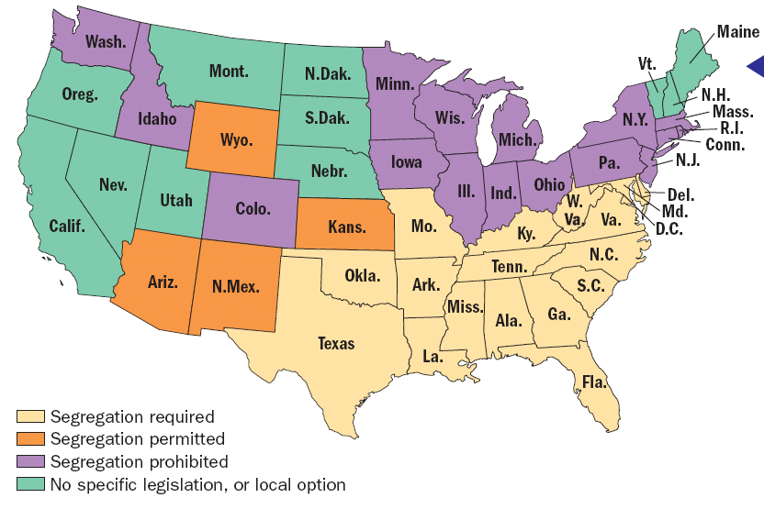
US School Segregation, 1952

Slide 4
Segregated America
The Jim Crow United States was segregated as a society and as a government policy.
De jure segregation: Jim Crow Laws passed to segregate accommodations.
De facto segregation: White flight to suburbs left African Americans in poor inner cities.
Early successes included the integration of the military, and outlawing discrimination in government jobs.
(Jackie Robinson joined the Brooklyn Dodgers in 1947)

Slide 5
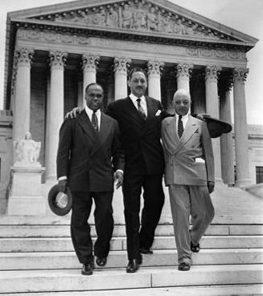
Legal Integration
The NAACP strategized to use lawsuits to challenge segregation on the grounds of violating the 14th amendment.
Thurgood Marshall argued that having separate schools implies that black children are inferior to white children.

Slide 6
Legal Integration
The Board of Education in Topeka, KS refused to allow Linda Brown to attend a white school that was 4 blocks from her house.
Chief Justice Earl Warren ruled in Brown v. Board of Education (1954) that segregation violated the Equal Protection Clause in the 14th amendment, overturning Plessy v. Ferguson (1896).
President Eisenhower left the power to interpret & enforce the Brown decision up to the states.

Slide 7
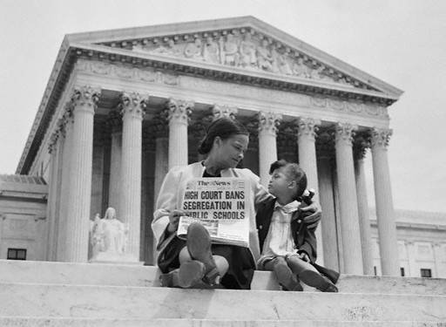

Slide 8
Resistance to the Brown Decision
Southern State leaders vowed to resist integration and the Ku Klux Klan returned to block integration.
North Carolina’s Pearsall Plan created loopholes that allowed families to avoid sending their children to integrated public schools.
“Freedom of Choice” plans allowed parents to choose which public school their children would attend.
Notes:
North Carolina passed the Pearsall Plan, which excused students from attending an integrated school, and recommended that the government pay private school tuition grants to parents whose children were assigned to the integrated public schools.

Slide 9
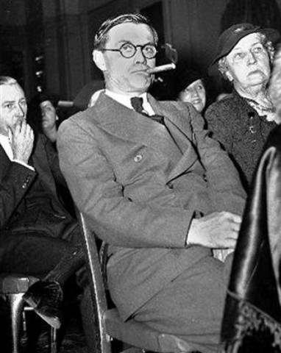
Resistance to the Brown Decision
“The people of Georgia will not comply with the decision of the court… We're going to do whatever is necessary in Georgia to keep white children in white schools and colored children in colored schools."

Slide 10
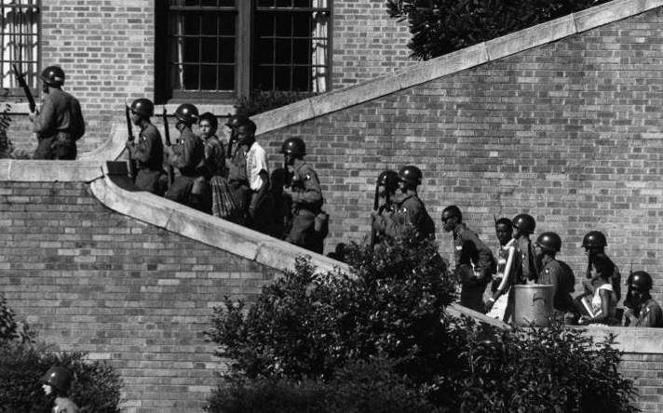
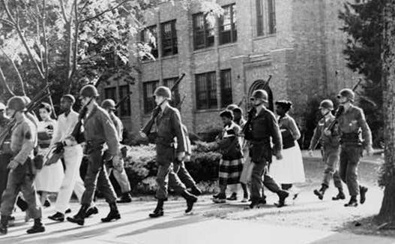
Enforcing the Brown Decision
In 1957, the Governor of Arkansas called in the National Guard to keep black students from entering Central High School in Little Rock.
Eisenhower was forced to act, sending the Army to force integration for the nine black students (“Little Rock 9”).

Slide 11
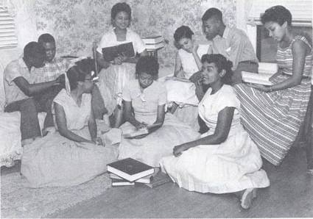
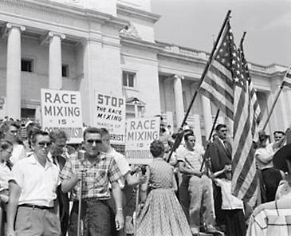
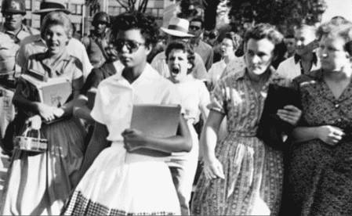
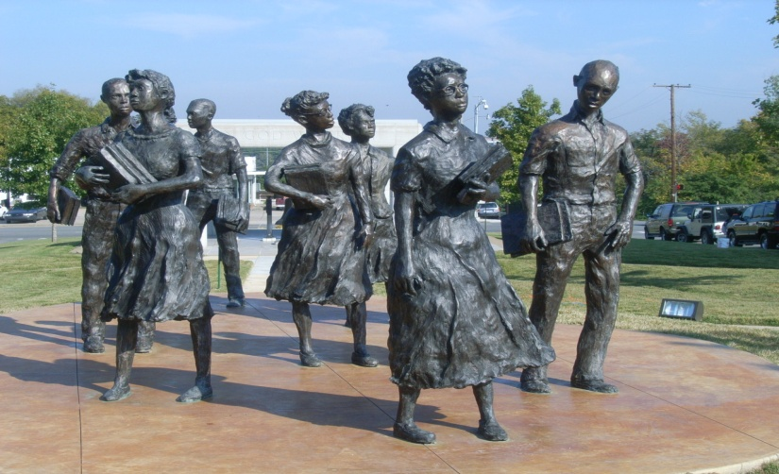
The Little Rock Nine

Slide 12
Enforcing the Brown Decision
In 1962, Air Force veteran James Meredith won a federal court case to enroll at Ole Miss, but Governor Ross Barnett refused to let him register.
“President Kennedy ordered federal marshals to escort Meredith to the registrar’s office. Barnett responded with a heated radio appeal: “I call on every Mississippian to keep his faith and courage. We will never surrender.”
2 people were killed in riots that followed, and federal marshals escorted Meredith to all of his courses.

Slide 13
Impact of the Brown Decision
Brown v. Board of Education was the first major step towards ending Jim Crow segregation in the U.S.
The NAACP provided a model for other Civil Rights leaders to follow by citing the 14th Amendment in their arguments.
Resistance to enforce the decision revealed that Civil Rights leaders could not rely on the government to protect rights guaranteed in the Constitution.
New leaders would emerge to take charge of the movement.

Slide 14
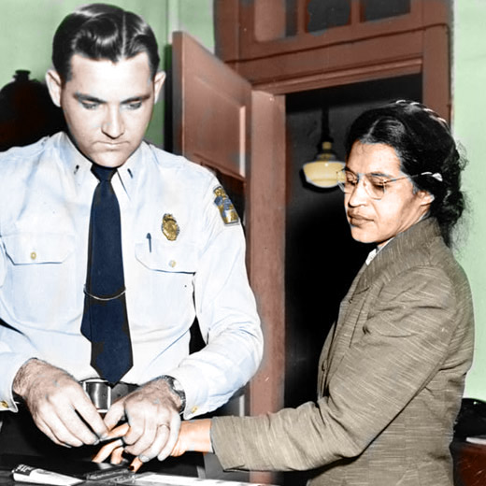
Montgomery Bus Boycott, 1955
Rosa Parks was a prominent woman in her community who is most known for refusing to give up her seat on a city bus for a white man.
Her community rallied behind her to enforce a community-wide boycott of Montgomery buses.

Slide 15
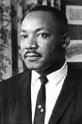
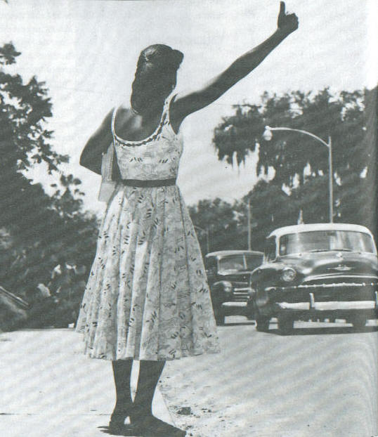
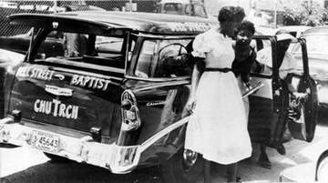
Montgomery Bus Boycott, 1955
Martin Luther King, Jr. became the face of the Montgomery bus boycott. He was new to Montgomery and this was his first role as a leader in the Civil Rights Movement.
The black community boycotted buses in Montgomery for a year until the city agreed to integration.

Slide 16
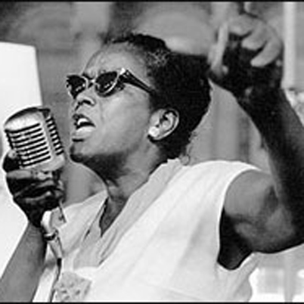
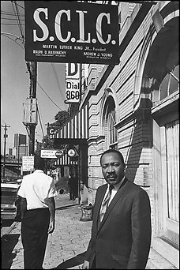
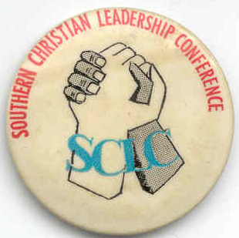
Civil Rights Organizations
The Southern Christian Leadership Conference was organized by Ella Baker; King became the first leader of the SCLC in 1957.
Goals of the SCLC were to practice activism in a non-violent manner to bring an end to segregation.

Slide 17
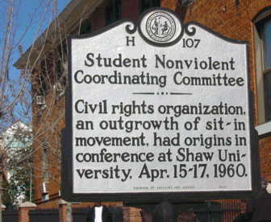
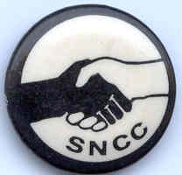
Civil Rights Organizations
The Student Non-Violent Coordinating Committee was also organized by Ella Baker. The first meeting was held at Shaw University in Raleigh, NC.
Baker insisted that students have their own organization independent of the NAACP & SCLC.

Slide 18
Practicing Nonviolence
February 1, 1960: 4 black students from North Carolina A&T sat at the Woolworth’s white-only lunch counter in Greensboro, NC to be served.
Within 3 months, sit-ins had spread to 78 cities.
Freedom Rides: In response to a Supreme Court ruling that interstate buses be desegregated, a group of black and white Americans tested the ruling in 1961 by riding a bus from Washington, D.C. to New Orleans, LA.
The worst violence was met in Anniston, AL, and many riders were hospitalized.

Slide 19
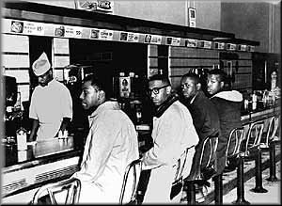
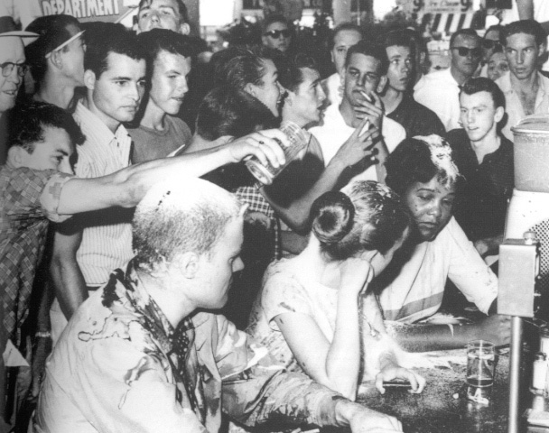
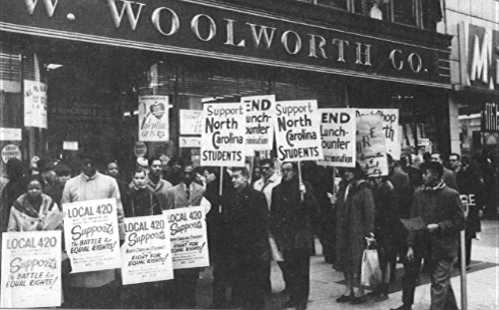
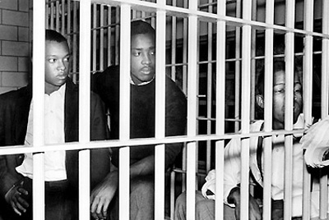
Sit-ins

Slide 20
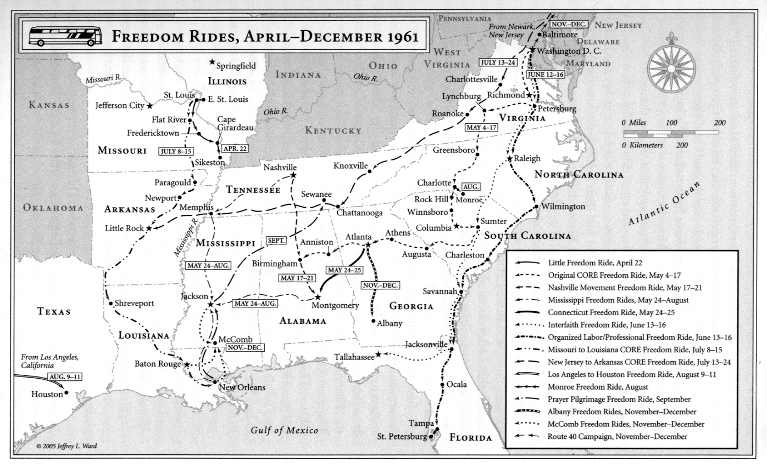
Freedom Ride

Slide 21
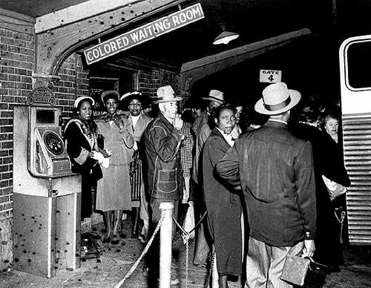
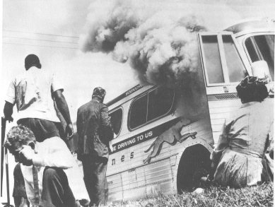
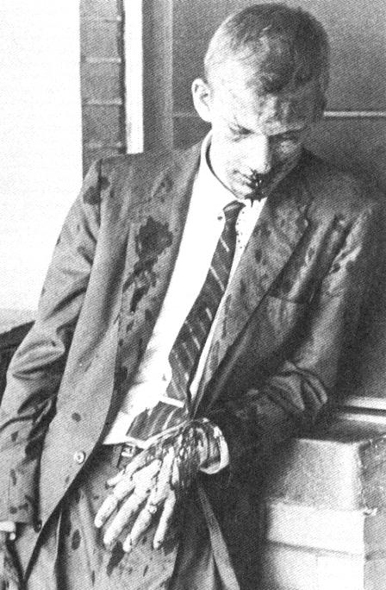
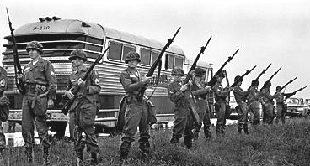
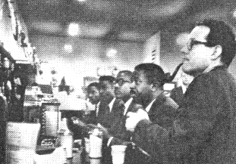
Freedom Ride

Slide 22
Demonstrations in Birmingham
In 1963, SCLC leaders demanded desegregation of Birmingham, but local blacks who participated were risking their job & housing.
Young children volunteered to protest, hundreds were arrested, and upon a children’s march, the Commissioner of Public Safety Bull Connor brought dogs & fire hoses.
King’s hotel room in Birmingham was bombed, as well as the 16th Street Baptist Church, killing 4 little black girls and wounding many more.
During these demonstrations, King was arrested & placed in solitary confinement, where he wrote his Letter from Birmingham City Jail.

Slide 23
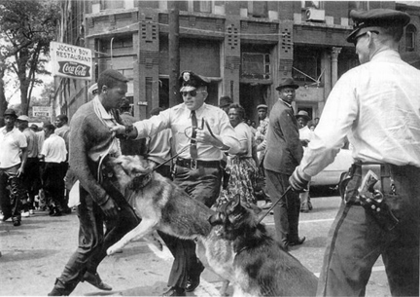
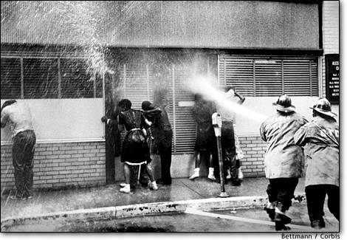
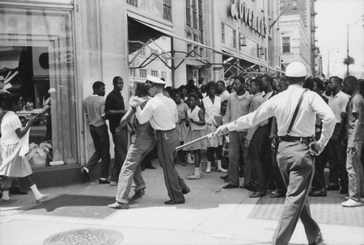
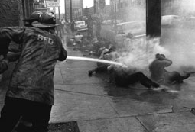
Birmingham, AL

Slide 24
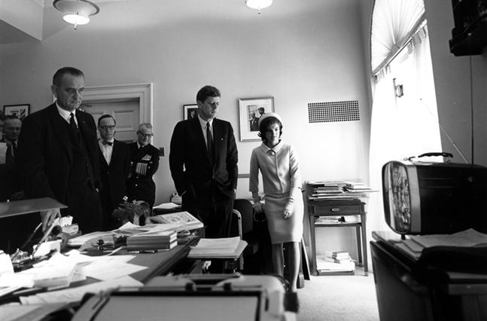
Kennedy & Johnson

Slide 25
March on Washington
Black leaders A. Phillip Randolph & Bayard Rustin planned the “March on Washington for Jobs & Freedom,” which took place Aug. 28, 1963.
One year later the Civil Rights Act of 1964 was passed to abolish legal segregation & guarantee a more favorable climate for civil rights legislation in the future.
Banned discrimination in public places and provided for equal employment opportunities based on race, color, religion, sex, or national origin.
The 24th Amendment was passed in 1964 to eliminate poll taxes as a requirement for voting.

Slide 26
Freedom Summer
The Council of Federated Organizations (COFO) was developed as an umbrella organization to focus on voter registration.
Following the death of NAACP field secretary Medgar Evers, plans were made to bring hundreds of college students to Mississippi to register black voters for the Presidential Election of 1964.
The student project, run by SNCC, was nicknamed, “Freedom Summer”

Slide 27
Freedom Summer
Student volunteers were recruited from black colleges throughout the North.
In the first week, three workers disappeared in Mississippi. The bodies were found buried on a farm, 3 weeks before the Democratic Party National Convention.
COFO set up the Mississippi Freedom Democratic Party to request representation as Mississippi delegates at the Democratic Convention in 1964.
President Johnson denied the request, but allowed them to have two at-large positions, and promised the National Democratic Party would not seat delegates who practiced discrimination.

Slide 28
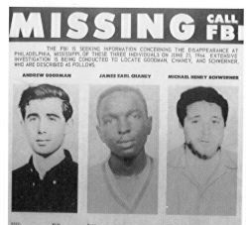
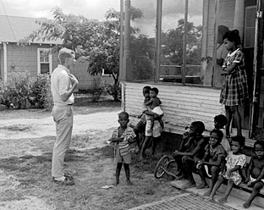
Freedom Summer

Slide 29
Selma to Montgomery
A march to Montgomery was proposed to take place on Sunday, March 7, 1965, and is now known as “Bloody Sunday.”
Live footage of troopers beating civilians was shown to the nation. A week later, King led citizens to march again, but turned them around to avoid further violence.
The night the march ended, a white housewife was shot by the Ku Klux Klan as she was driving black marchers back to Selma.
President Lyndon B Johnson gave a speech, “We Shall Overcome,” and soon afterwards, the Voting Rights Act of 1965 was passed.
The Act abolished all remaining deterrents to exercising the right to vote, and authorized federal supervision of voting where necessary.

