Slide 1
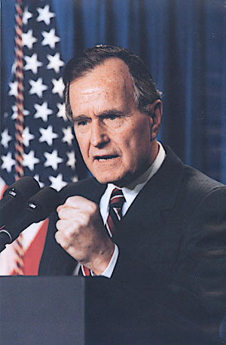
Republican control of the presidency continued after Reagan under George Bush
After defeating Iraq in the Persian Gulf War in 1991, Bush’s popularity was high
After promising “no new taxes” in 1988, Bush raised taxes in order to decrease deficit spending
But, large gov’t deficits due to years of tax cuts & increased military spending led to a recession in 1992

Slide 2
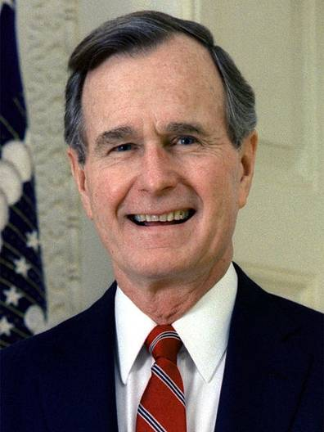
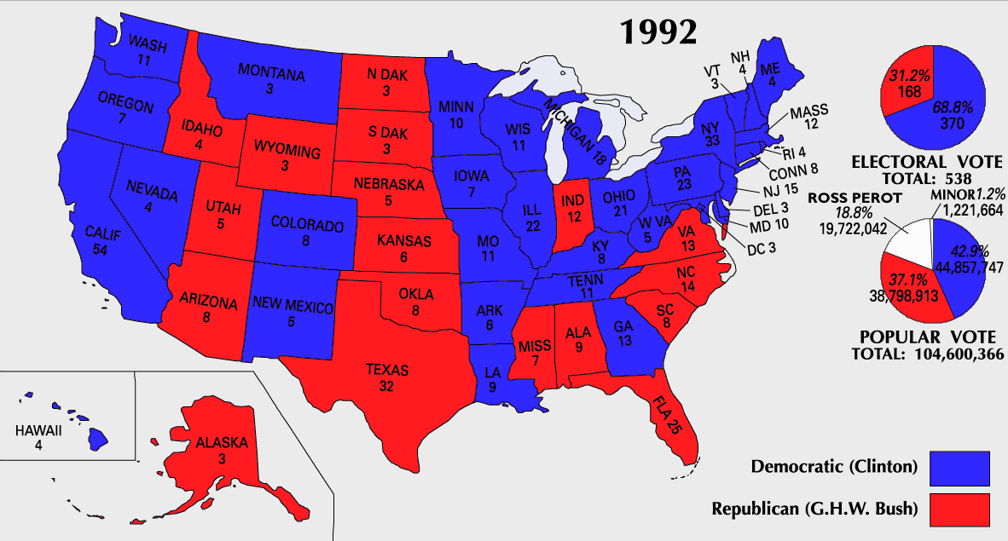
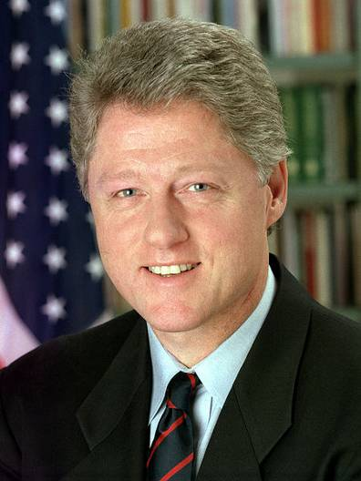
In the 1992 election, George Bush lost to Arkansas governor Bill Clinton

Slide 3
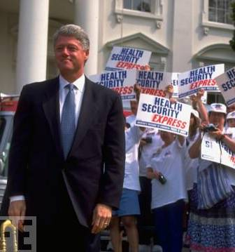
The Presidency of Bill Clinton
Clinton defined himself a “new Democrat” by embracing both liberal & conservative policies
Clinton proposed a plan to guarantee affordable health care for all Americans
Republicans in Congress defeated Clinton’s “big gov’t” health care reform
Notes:
HEALTH CARE REFORM Clinton had pledged to create a plan to guarantee affordable health care for all Americans, especially for the millions of Americans who lacked medical insurance. Once in office, Clinton appointed First Lady Hillary Rodham Clinton, a skilled lawyer and child-welfare advocate, to head the team creating the plan. The president presented the health care reform bill to Congress in September 1993. Congress debated the plan for a year. Intense lobbying and Republican attacks on the plan for promoting “big government” sealed its doom. In the end, Congress never even voted on the bill.

Slide 4
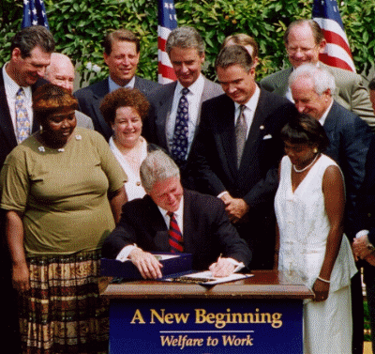
The Presidency of Bill Clinton
Clinton defined himself a “new Democrat” by embracing both liberal & conservative policies
Clinton worked with Republicans to reform the welfare system
The law put limits on how long people could receive benefits & allowed states to decide how welfare money would be spent
Notes:
REFORMING WELFARE Clinton and the congressional Republicans cooperated to reform the welfare system. In 1996, a bill was proposed to place limits on how long people could receive benefits. It also put an end to a 61-year federal guarantee of welfare, and instead gave states “block grants”—set amounts of federal money they could spend on welfare or for other social concerns. Although liberal Democrats feared the effects of eliminating the federal safety net for the poor, the president backed the bill. Over the next few years, states moved millions of people from welfare to jobs. Because of the strong economy, the transition was more successful than some had been predicting.

Slide 5
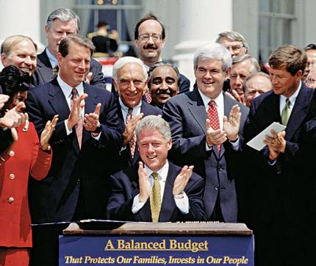
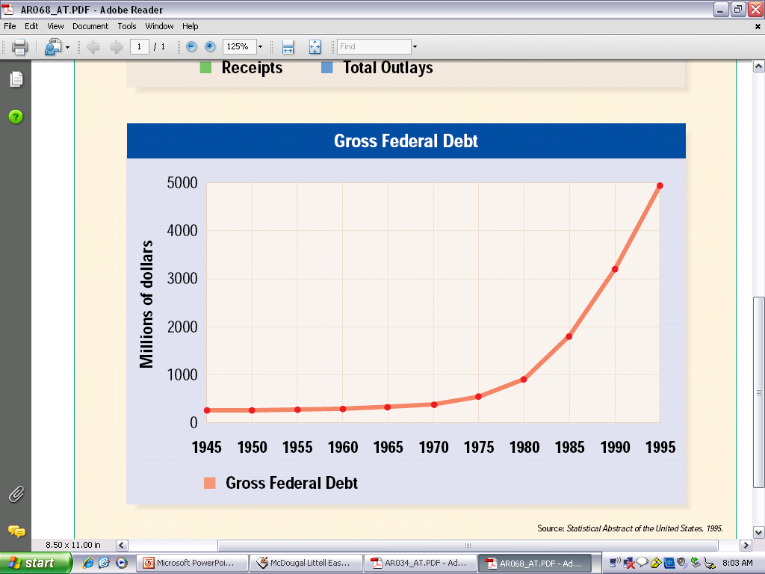
The Presidency of Bill Clinton
Clinton defined himself a “new Democrat” by embracing both liberal & conservative policies
Clinton worked with Congress to reduce the federal deficit & balance the federal budget
In 1997, Clinton cut gov’t spending & lowered taxes
Notes:
BALANCED BUDGET AND AN ECONOMIC BOOM President Clinton was more successful in his efforts to reduce the federal budget deficit. Clinton and the Republican-controlled Congress agreed in 1997 on legislation to balance the federal budget by the year 2002. The bill cut spending by billions of dollars, lowered taxes to win Republican support, and included programs aimed at helping children and improving health care. A year later, Clinton announced that—for the first time in nearly 30 years—the federal budget had a surplus. That is, the government took in more than it spent. Surpluses were used, in part, to pay down the nation’s debt, which had soared to around $5.5 trillion. Perhaps the most effective tool in generating a surplus was the booming economy. About the time Clinton took office, the economy rebounded. Unemployment fell and the stock market soared to new heights. As a result, the government’s tax revenues rose, and fewer people received public aid. These factors helped slash the
federal debt.

Slide 6
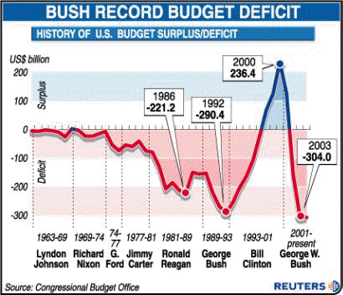
For the 1st time in 30 years, the gov’t had a surplus which Clinton used to pay down the nation’s debt
Notes:
A year later, Clinton announced that—for the first time in nearly 30 years—the federal budget had a surplus. That is, the government took in more than it spent. Surpluses were used, in part, to pay down the nation’s debt, which had soared to around $5.5 trillion. Perhaps the most effective tool in generating a surplus was the booming economy. About the time Clinton took office, the economy rebounded. Unemployment fell and the stock market soared to new heights. As a result, the government’s tax revenues rose, and fewer people received public aid. These factors helped slash the federal debt.

Slide 7
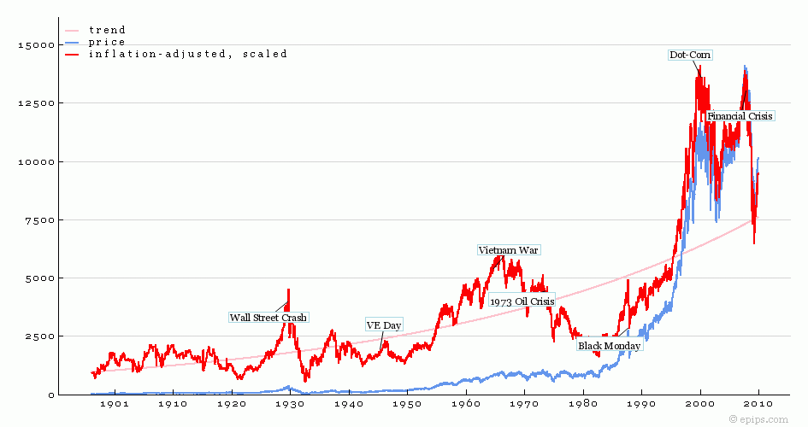
Clinton’s deficit reduction coincided with a boom in the technology industry; This led to the longest sustained era of economic growth in U.S. history
Dow Jones Industrial Average, 1901-2010

Slide 8
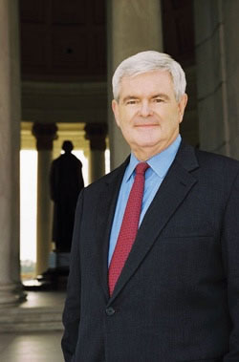
“Contract with America”
Many of Clinton’s conservative policies were in response to Republican control of Congress
In 1994, Republicans took control of the House of Representatives for the 1st time since 1954 & named Georgia Congressman Newt Gingrich as Speaker of the House
Notes:
Partisan Politics and Impeachment
While Clinton and Congress worked together on deficit reduction and NAFTA, relations in Washington became increasingly partisan. In the midst of political wrangling, a scandal rocked the White House, and Bill Clinton became the second president in U.S. history to be impeached.
REPUBLICANS TAKE CONTROL OF CONGRESS In mid-1994, after the failure of President Clinton’s health care plan and recurring questions regarding his leadership, Republican congressman Newt Gingrich began to turn voters’ dissatisfaction with Clinton into support for Republicans. He drafted a document called the Contract with America—ten items Republicans promised to enact if they won control of Congress. They included congressional term limits, a balanced budget amendment, tax cuts, tougher crime laws, and welfare reform. In the November 1994 election, the Republicans handed the Democrats a humiliating defeat. Voters gave Republicans control of both houses of Congress for the first time since 1954. Chosen as the new Speaker of the House, Newt Gingrich was jubilant. President Clinton and the Republican-controlled Congress clashed. Clinton opposed Republican budgets that slowed entitlements—federal programs which provide for basic human needs—such as Social Security and Medicaid. Clinton and Congress refused to compromise, and the Republicans refused to pass the larger budgets he wanted. As a result, the federal government shut down for almost a week in November 1995, and again for several weeks in the next two months.
THE 1996 REELECTION The budget standoff helped Clinton, as did the strong economy and passage of the welfare reform law of 1996, which suggested an improved working relationship with Congress. As a result, voters reelected Clinton in November 1996. With 49 percent of the popular vote, he outpolled the Republican nominee, U.S. Senator Bob Dole, and the Reform Party candidate, H. Ross Perot. Still, the Republicans maintained control of the House and Senate. Both President Clinton and Republican leaders pledged to work more cooperatively. Soon however, the president faced his most severe problems yet.

Slide 9
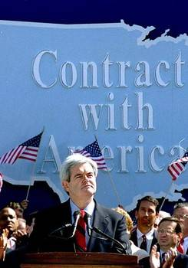
“Contract with America”
Gingrich pushed for a “Contract with America” that would have created a balanced budget amendment, tax cuts, welfare reform, & tougher crime laws
The clash between Clinton & Gingrich led to a gov’t shut down in 1995
Clinton used the rivalry with Republicans to win re-election in 1996
Notes:
Partisan Politics and Impeachment
REPUBLICANS TAKE CONTROL OF CONGRESS In mid-1994, after the failure of President Clinton’s health care plan and recurring questions regarding his leadership, Republican congressman Newt Gingrich began to turn voters’ dissatisfaction with Clinton into support for Republicans. He drafted a document called the Contract with America—ten items Republicans promised to enact if they won control of Congress. They included congressional term limits, a balanced budget amendment, tax cuts, tougher crime laws, and welfare reform. In the November 1994 election, the Republicans handed the Democrats a humiliating defeat. Voters gave Republicans control of both houses of Congress for the first time since 1954. Chosen as the new Speaker of the House, Newt Gingrich was jubilant. President Clinton and the Republican-controlled Congress clashed. Clinton opposed Republican budgets that slowed entitlements—federal programs which provide for basic human needs—such as Social Security and Medicaid. Clinton and Congress refused to compromise, and the Republicans refused to pass the larger budgets he wanted. As a result, the federal government shut down for almost a week in November 1995, and again for several weeks in the next two months.
THE 1996 REELECTION The budget standoff helped Clinton, as did the strong economy and passage of the welfare reform law of 1996, which suggested an improved working relationship with Congress. As a result, voters reelected Clinton in November 1996. With 49 percent of the popular vote, he outpolled the Republican nominee, U.S. Senator Bob Dole, and the Reform Party candidate, H. Ross Perot. Still, the Republicans maintained control of the House and Senate. Both President Clinton and Republican leaders pledged to work more cooperatively. Soon however, the president faced his most severe problems yet.

Slide 10
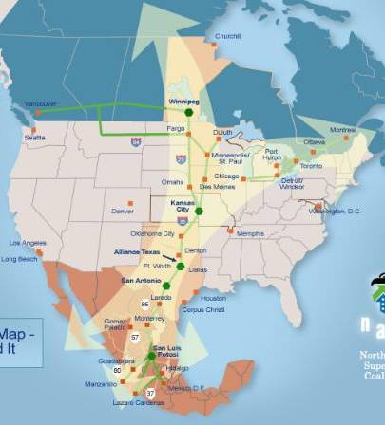
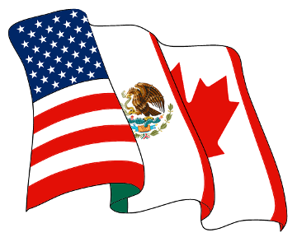
Foreign Policy
Clinton signed the North American Free Trade Agreement (NAFTA) which reduced trade barriers among USA, Mexico, & Canada

Slide 11
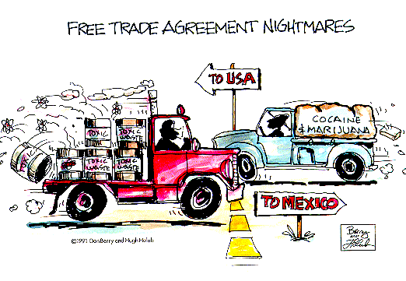
Criticisms of NAFTA?

Slide 12
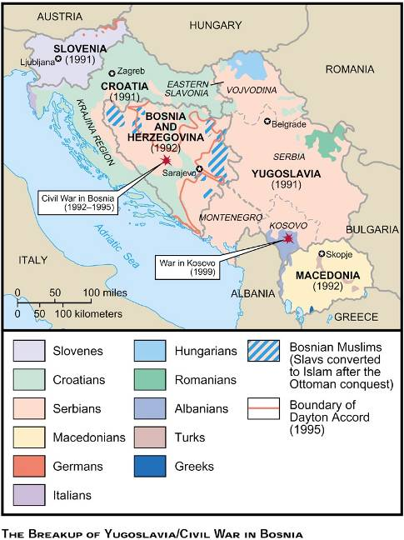
Foreign Policy
During his presidency, Clinton committed U.S. troops to peacekeeping efforts
From 1995 to 1999, U.S. troops were sent to Bosnia to stop ethnic cleansing by Serbs & to Kosovo to stop a civil war
Notes:
New Foreign Policy Challenges
Conflicts and confused alliances grew in the wake of the Cold War. The question of U.S. intervention overseas, and the globalization of the economy presented the United States with a host of new challenges.
RELATIONS WITH FORMER COLD WAR FOES Maintaining strong relations with Russia and China became major goals for the Clinton administration. Throughout the 1990s, the U.S. and Russia cooperated on economic and arms control issues. Still, Russia criticized U.S. intervention in Yugoslavia, where a bloody civil war raged. Meanwhile, U.S. officials protested against Russian attacks on rebels in the Russian region of Chechnya. U.S. relations with China were strained as well. Clinton had stressed that he would lean on China to grant its citizens more democratic rights. As president, however, he put greater emphasis on increasing trade with China. Despite concerns that Chinese spies had stolen U.S. defense secrets, Clinton supported a bill—passed in 2000—granting China permanent trade rights.
TROOPS ABROAD With the Cold War over, the United States turned more of its attention to regional conflicts. President Clinton proved willing to use troops to end conflicts overseas. In 1991, military leaders in Haiti forced the elected president from office. Thousands of refugees fled the military leaders’ harsh rule. In 1994, President Clinton dispatched American troops to Haiti, and the military rulers were forced to step down. Other interventions occurred in the former Communist country of Yugoslavia. In 1991, Yugoslavia broke apart into five nations. In Bosnia, one of
the newly independent states, Serbs began “ethnic cleansing,” killing or expelling from their homes people of certain ethnic groups. In 1995, the United States helped negotiate a peace agreement in Bosnia. Clinton sent U.S. troops to join NATO troops to help ensure the deal. About three years later, Serb forces attacked ethnic Albanians in the Serb province of Kosovo. The U.S. and its NATO allies launched air strikes against Serbian targets in 1999, forcing the Serbs to back down. Again, American troops followed up by participating in an international peace-keeping force. In both Bosnia and Kosovo, the administration promised early withdrawal. However, the U.S. troops stayed longer than had been intended, drawing criticism of Clinton’s policies.
TRADE AND THE GLOBAL ECONOMY Seeing flourishing trade as essential to U.S. prosperity and to world economic
and political stability, President Clinton championed the North American Free Trade Agreement (NAFTA). This legislation would bring Mexico into the free-trade zone that the United States and Canada already had formed. Supporters said NAFTA would strengthen all three economies and create more American jobs. Opponents insisted that NAFTA would transfer American jobs to Mexico, where wages were lower, and harm the environment because of Mexico’s weaker antipollution laws. Congress rejected these arguments, and the treaty was ratified by all three countries’ legislatures in 1993. Once the treaty took effect, on January 1, 1994, trade with Mexico increased. Critics of free trade and the global economy remained vocal, however. In late 1999, the World Trade Organization (WTO), an organization that promotes trade and economic development, met in Seattle. Demonstrators protested that the
WTO made decisions with little public input and that these decisions harmed poorer countries, the environment, and American manufacturing workers. Subsequent anti-globalization protests have been held worldwide. Violent clashes
erupted between police and demonstrators at the April 2001 third Summit of the Americas, held in Quebec City, Canada. Nevertheless, the activists failed to halt plans to launch, by 2006, the Free Trade Area of the Americas (FTAA)—an enlarged version of NAFTA covering the 34 countries in the Western Hemisphere, except Cuba.

Slide 13
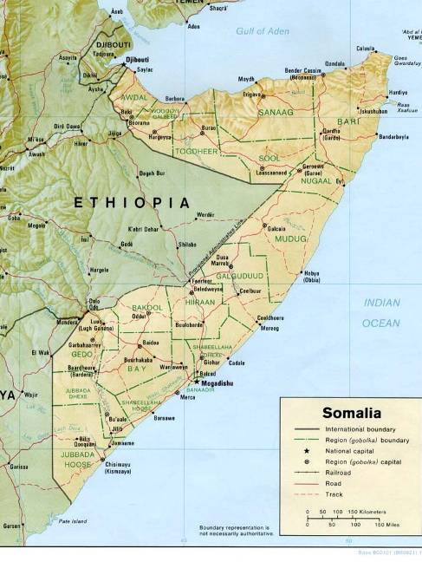
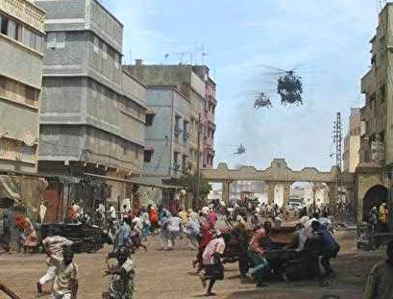
Foreign Policy
During his presidency, Clinton committed U.S. troops to peacekeeping efforts
From 1993-1995, U.S. troops were sent to Somalia to offer food & restore order to civil war
Notes:
New Foreign Policy Challenges
Conflicts and confused alliances grew in the wake of the Cold War. The question of U.S. intervention overseas, and the globalization of the economy presented the United States with a host of new challenges.
RELATIONS WITH FORMER COLD WAR FOES Maintaining strong relations with Russia and China became major goals for the Clinton administration. Throughout the 1990s, the U.S. and Russia cooperated on economic and arms control issues. Still, Russia criticized U.S. intervention in Yugoslavia, where a bloody civil war raged. Meanwhile, U.S. officials protested against Russian attacks on rebels in the Russian region of Chechnya. U.S. relations with China were strained as well. Clinton had stressed that he would lean on China to grant its citizens more democratic rights. As president, however, he put greater emphasis on increasing trade with China. Despite concerns that Chinese spies had stolen U.S. defense secrets, Clinton supported a bill—passed in 2000—granting China permanent trade rights.
TROOPS ABROAD With the Cold War over, the United States turned more of its attention to regional conflicts. President Clinton proved willing to use troops to end conflicts overseas. In 1991, military leaders in Haiti forced the elected president from office. Thousands of refugees fled the military leaders’ harsh rule. In 1994, President Clinton dispatched American troops to Haiti, and the military rulers were forced to step down. Other interventions occurred in the former Communist country of Yugoslavia. In 1991, Yugoslavia broke apart into five nations. In Bosnia, one of
the newly independent states, Serbs began “ethnic cleansing,” killing or expelling from their homes people of certain ethnic groups. In 1995, the United States helped negotiate a peace agreement in Bosnia. Clinton sent U.S. troops to join NATO troops to help ensure the deal. About three years later, Serb forces attacked ethnic Albanians in the Serb province of Kosovo. The U.S. and its NATO allies launched air strikes against Serbian targets in 1999, forcing the Serbs to back down. Again, American troops followed up by participating in an international peace-keeping force. In both Bosnia and Kosovo, the administration promised early withdrawal. However, the U.S. troops stayed longer than had been intended, drawing criticism of Clinton’s policies.
TRADE AND THE GLOBAL ECONOMY Seeing flourishing trade as essential to U.S. prosperity and to world economic
and political stability, President Clinton championed the North American Free Trade Agreement (NAFTA). This legislation would bring Mexico into the free-trade zone that the United States and Canada already had formed. Supporters said NAFTA would strengthen all three economies and create more American jobs. Opponents insisted that NAFTA would transfer American jobs to Mexico, where wages were lower, and harm the environment because of Mexico’s weaker antipollution laws. Congress rejected these arguments, and the treaty was ratified by all three countries’ legislatures in 1993. Once the treaty took effect, on January 1, 1994, trade with Mexico increased. Critics of free trade and the global economy remained vocal, however. In late 1999, the World Trade Organization (WTO), an organization that promotes trade and economic development, met in Seattle. Demonstrators protested that the
WTO made decisions with little public input and that these decisions harmed poorer countries, the environment, and American manufacturing workers. Subsequent anti-globalization protests have been held worldwide. Violent clashes
erupted between police and demonstrators at the April 2001 third Summit of the Americas, held in Quebec City, Canada. Nevertheless, the activists failed to halt plans to launch, by 2006, the Free Trade Area of the Americas (FTAA)—an enlarged version of NAFTA covering the 34 countries in the Western Hemisphere, except Cuba.

Slide 14
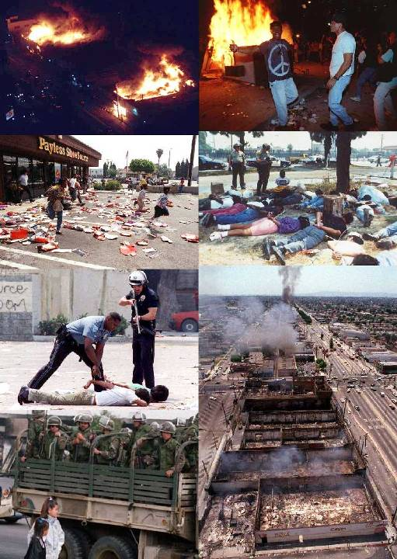
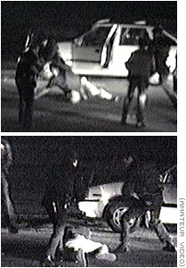
Crime & Terrorism
During the Clinton years, America experienced new waves of violence
Race riots hit Los Angeles in 1992 when 4 white police officers were acquitted of police brutality charges in the Rodney King case
Notes:
The improved economy—along with enlargement of police forces—combined to lower crime rates in the 1990s. However, fears were raised among Americans by acts of violence and terrorism around the country. A shocking crime occurred April 1999 when two students at Columbine High School, in Colorado, killed 12 students and a teacher and wounded 23 others, and then shot themselves. Americans were appalled at copycat crimes that began to occur. Some called for tougher gun control, while others argued that exposure to violent imagery should be curtailed. Violence had pervaded television news throughout the decade. In 1993, terrorists had exploded bombs in
the World Trade Center in New York City. This was closely followed by a 1995 blast that destroyed a nine-story federal office building in Oklahoma City, killing 168 children, women, and men. Timothy McVeigh, an American veteran of the Gulf War, was found guilty in the Oklahoma bombing. He was executed in 2001, the first use of the federal death penalty in 38 years. Although American embassies and military targets abroad were subject to sporadic and deadly terrorist attacks during the decade, the U.S. was in no way prepared for a devastating attack that took place on its own soil on the morning of September 11, 2001. In a coordinated effort, two hijacked commercial jets struck the twin towers of the World Trade Center in New York City, one crashing just minutes after the other. The jets exploded on impact and subsequently leveled the tallest buildings of New York’s skyline, the symbolic center of American finance. About an hour later, a third plane tore into the Pentagon building, the U.S. military headquarters outside Washington, D.C. Air travel ceased almost immediately; across the nation planes in the air were ordered to land. During the evacuation of the White House and the New York financial district, a fourth hijacked plane crashed near Pittsburgh, Pennsylvania. About 3,000 people were killed in the attacks. These included all the passengers on all four planes, workers and visitors in the World Trade Center and the Pentagon, and hundreds of rescue workers. (See the first issue in “Issues for the 21st Century,” on page 1100.)

Slide 15
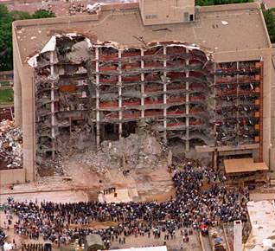
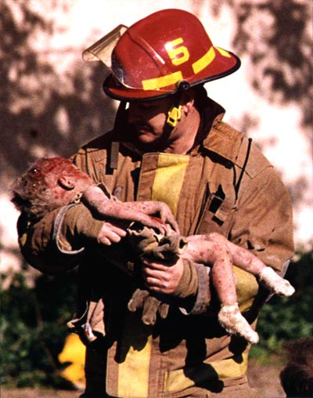
Crime & Terrorism
During the Clinton years, America experienced new waves of violence
In 1995, Gulf War veteran Timothy McVeigh detonated a bomb that destroyed a federal building in Oklahoma City, killing 168 people
Notes:
The improved economy—along with enlargement of police forces—combined to lower crime rates in the 1990s. However, fears were raised among Americans by acts of violence and terrorism around the country. A shocking crime occurred April 1999 when two students at Columbine High School, in Colorado, killed 12 students and a teacher and wounded 23 others, and then shot themselves. Americans were appalled at copycat crimes that began to occur. Some called for tougher gun control, while others argued that exposure to violent imagery should be curtailed. Violence had pervaded television news throughout the decade. In 1993, terrorists had exploded bombs in
the World Trade Center in New York City. This was closely followed by a 1995 blast that destroyed a nine-story federal office building in Oklahoma City, killing 168 children, women, and men. Timothy McVeigh, an American veteran of the Gulf War, was found guilty in the Oklahoma bombing. He was executed in 2001, the first use of the federal death penalty in 38 years. Although American embassies and military targets abroad were subject to sporadic and deadly terrorist attacks during the decade, the U.S. was in no way prepared for a devastating attack that took place on its own soil on the morning of September 11, 2001. In a coordinated effort, two hijacked commercial jets struck the twin towers of the World Trade Center in New York City, one crashing just minutes after the other. The jets exploded on impact and subsequently leveled the tallest buildings of New York’s skyline, the symbolic center of American finance. About an hour later, a third plane tore into the Pentagon building, the U.S. military headquarters outside Washington, D.C. Air travel ceased almost immediately; across the nation planes in the air were ordered to land. During the evacuation of the White House and the New York financial district, a fourth hijacked plane crashed near Pittsburgh, Pennsylvania. About 3,000 people were killed in the attacks. These included all the passengers on all four planes, workers and visitors in the World Trade Center and the Pentagon, and hundreds of rescue workers. (See the first issue in “Issues for the 21st Century,” on page 1100.)

Slide 16
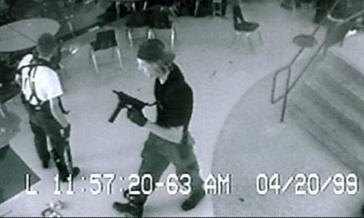
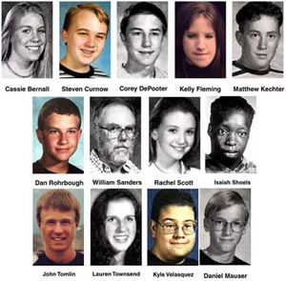
Crime & Terrorism
During the Clinton years, America experienced new waves of violence
In 1999, 2 students opened fire at Columbine High School in Colorado, killing 13 people & wounding 23 others
Notes:
The improved economy—along with enlargement of police forces—combined to lower crime rates in the 1990s. However, fears were raised among Americans by acts of violence and terrorism around the country. A shocking crime occurred April 1999 when two students at Columbine High School, in Colorado, killed 12 students and a teacher and wounded 23 others, and then shot themselves. Americans were appalled at copycat crimes that began to occur. Some called for tougher gun control, while others argued that exposure to violent imagery should be curtailed. Violence had pervaded television news throughout the decade. In 1993, terrorists had exploded bombs in
the World Trade Center in New York City. This was closely followed by a 1995 blast that destroyed a nine-story federal office building in Oklahoma City, killing 168 children, women, and men. Timothy McVeigh, an American veteran of the Gulf War, was found guilty in the Oklahoma bombing. He was executed in 2001, the first use of the federal death penalty in 38 years. Although American embassies and military targets abroad were subject to sporadic and deadly terrorist attacks during the decade, the U.S. was in no way prepared for a devastating attack that took place on its own soil on the morning of September 11, 2001. In a coordinated effort, two hijacked commercial jets struck the twin towers of the World Trade Center in New York City, one crashing just minutes after the other. The jets exploded on impact and subsequently leveled the tallest buildings of New York’s skyline, the symbolic center of American finance. About an hour later, a third plane tore into the Pentagon building, the U.S. military headquarters outside Washington, D.C. Air travel ceased almost immediately; across the nation planes in the air were ordered to land. During the evacuation of the White House and the New York financial district, a fourth hijacked plane crashed near Pittsburgh, Pennsylvania. About 3,000 people were killed in the attacks. These included all the passengers on all four planes, workers and visitors in the World Trade Center and the Pentagon, and hundreds of rescue workers. (See the first issue in “Issues for the 21st Century,” on page 1100.)

Slide 17
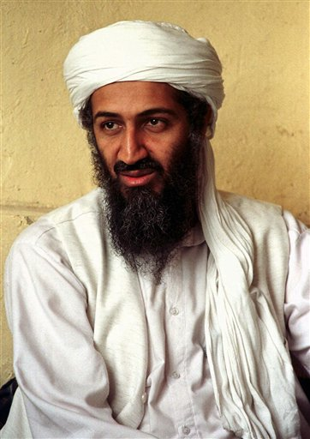
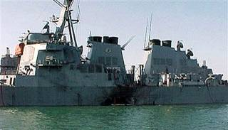
During the Clinton years, America experienced new waves of violence
After the Persian Gulf War, Osama bin Laden formed al-Qaeda & began terrorist attacks on the USA
Embassy bombings in Tanzania & Kenya and attack on USS Cole
Bombing of the World Trade Center in 1993
Notes:
In 1993, terrorists had exploded bombs in the World Trade Center in New York City. This was closely followed by a 1995 blast that destroyed a nine-story federal office building in Oklahoma City, killing 168 children, women, and men. Timothy McVeigh, an American veteran of the Gulf War, was found guilty in the Oklahoma bombing. He was executed in 2001, the first use of the federal death penalty in 38 years. Although American embassies and military targets abroad were subject to sporadic and deadly terrorist attacks during the decade, the U.S. was in no way prepared for a devastating attack that took place on its own soil on the morning of September 11, 2001. In a coordinated effort, two hijacked commercial jets struck the twin towers of the World Trade Center in New York City, one crashing just minutes after the other. The jets exploded on impact and subsequently leveled the tallest buildings of New York’s skyline, the symbolic center of American finance. About an hour later, a third plane tore into the Pentagon building, the U.S. military headquarters outside Washington, D.C. Air travel ceased almost immediately; across the nation planes in the air were ordered to land. During the evacuation of the White House and the New York financial district, a fourth hijacked plane crashed near Pittsburgh, Pennsylvania. About 3,000 people were killed in the attacks. These included all the passengers on all four planes, workers and visitors in the World Trade Center and the Pentagon, and hundreds of rescue workers. (See the first issue in “Issues for the 21st Century,” on page 1100.)

Slide 18
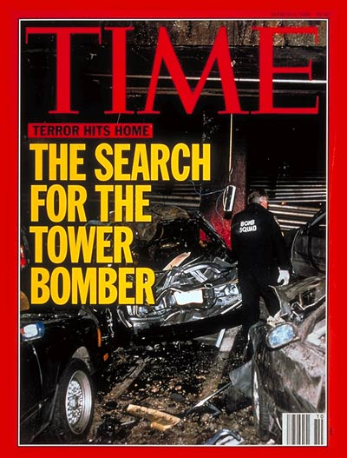
Bombing of the World Trade Center in 1993
Notes:
In 1993, terrorists had exploded bombs in the World Trade Center in New York City. This was closely followed by a 1995 blast that destroyed a nine-story federal office building in Oklahoma City, killing 168 children, women, and men. Timothy McVeigh, an American veteran of the Gulf War, was found guilty in the Oklahoma bombing. He was executed in 2001, the first use of the federal death penalty in 38 years. Although American embassies and military targets abroad were subject to sporadic and deadly terrorist attacks during the decade, the U.S. was in no way prepared for a devastating attack that took place on its own soil on the morning of September 11, 2001. In a coordinated effort, two hijacked commercial jets struck the twin towers of the World Trade Center in New York City, one crashing just minutes after the other. The jets exploded on impact and subsequently leveled the tallest buildings of New York’s skyline, the symbolic center of American finance. About an hour later, a third plane tore into the Pentagon building, the U.S. military headquarters outside Washington, D.C. Air travel ceased almost immediately; across the nation planes in the air were ordered to land. During the evacuation of the White House and the New York financial district, a fourth hijacked plane crashed near Pittsburgh, Pennsylvania. About 3,000 people were killed in the attacks. These included all the passengers on all four planes, workers and visitors in the World Trade Center and the Pentagon, and hundreds of rescue workers. (See the first issue in “Issues for the 21st Century,” on page 1100.)

Slide 19
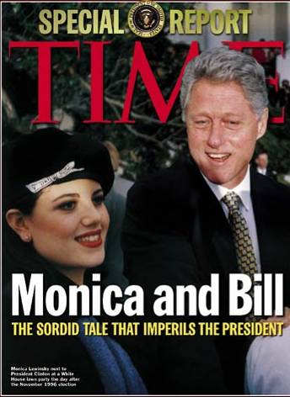
Scandals & Impeachment
While president, Clinton faced numerous scandals
While still governor of Arkansas, Clinton was connected to an improper land deal (Whitewater scandal)
Clinton was accused of numerous sexual affairs, including White House intern Monica Lewinsky
Notes:
CLINTON IMPEACHED President Clinton was accused of improperly using money from a land deal with the Whitewater Development Company to fund his 1984 gubernatorial reelection campaign. In addition, Clinton allegedly had lied under oath about having an improper relationship with a young White House intern. In 1998, Clinton admitted that he had had an improper relationship with the young woman, but he denied lying about the incident under oath or attempting to obstruct the investigation. In December 1998, the House of Representatives approved two articles of impeachment, charging the president with perjury and obstruction of justice. Clinton became only the second president—and the first in 130 years—to face a trial in the Senate. At the trial a month later, the Senate fell short of the 67 votes—a two-thirds majority—required to convict him. Clinton remained in office and apologized
for his actions.

Slide 20
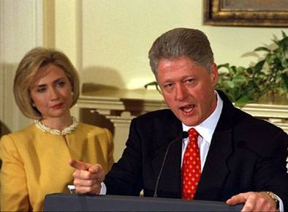
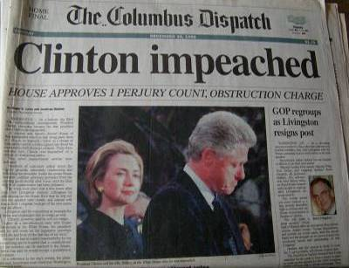
Scandals & Impeachment
While president, Clinton faced numerous scandals
When Clinton lied under oath about his relationship with Monica Lewinsky, Republicans in Congress voted to impeach him
Clinton became only the 2nd president to be impeached, but he was not removed from office
Notes:
CLINTON IMPEACHED President Clinton was accused of improperly using money from a land deal with the Whitewater Development Company to fund his 1984 gubernatorial reelection campaign. In addition, Clinton allegedly had lied under oath about having an improper relationship with a young White House intern. In 1998, Clinton admitted that he had had an improper relationship with the young woman, but he denied lying about the incident under oath or attempting to obstruct the investigation. In December 1998, the House of Representatives approved two articles of impeachment, charging the president with perjury and obstruction of justice. Clinton became only the second president—and the first in 130 years—to face a trial in the Senate. At the trial a month later, the Senate fell short of the 67 votes—a two-thirds majority—required to convict him. Clinton remained in office and apologized for his actions.

Slide 21
Conclusions
The Clinton years during the 1990s represented new changes for the U.S.
The Democratic Party took back the presidency by becoming more moderate
The economic boom of the 1990s was based largely on technology innovation that would crash in early 2000
The emergence of terrorism, at home & abroad, presented new threats to American security

