Slide 1
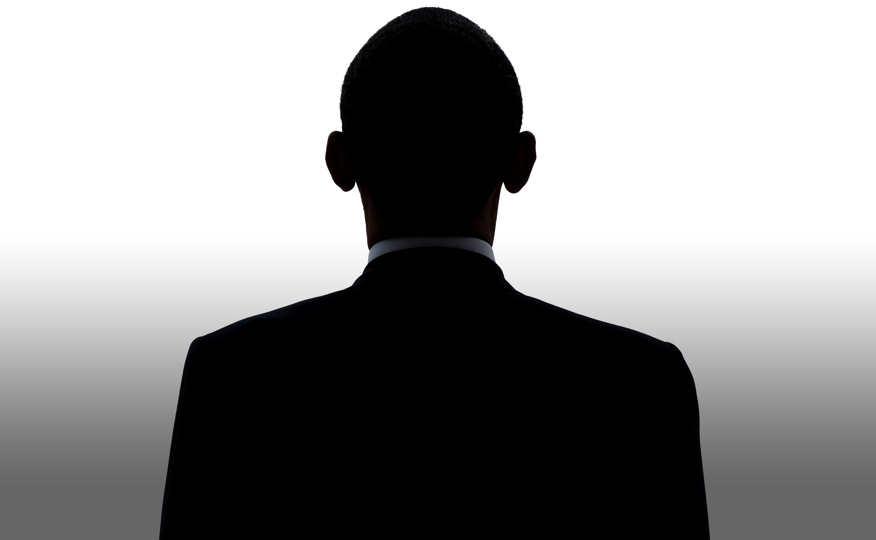
Bell Ringer
What have you heard about his presidency so far?
Barack bama

Slide 3
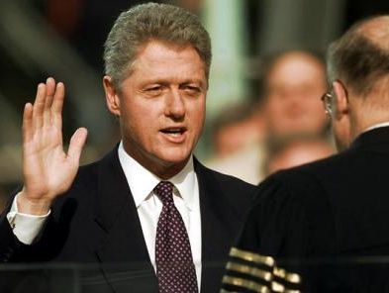
William Clinton

Slide 4
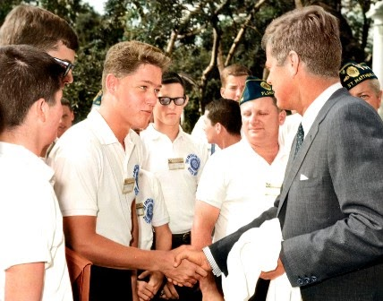
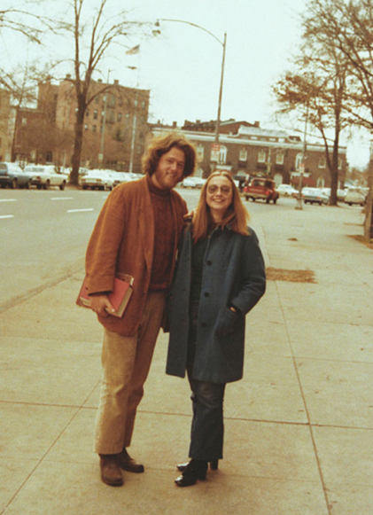
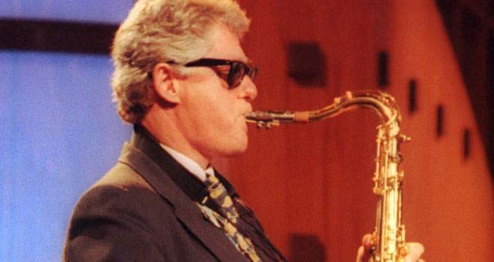

Slide 5
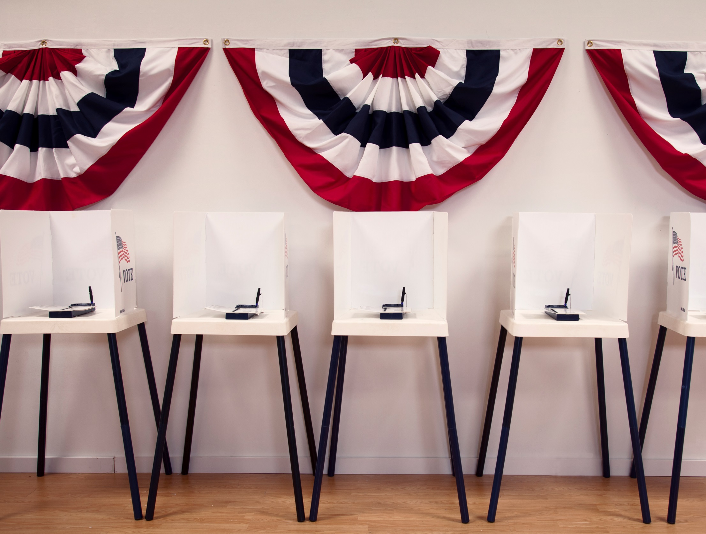
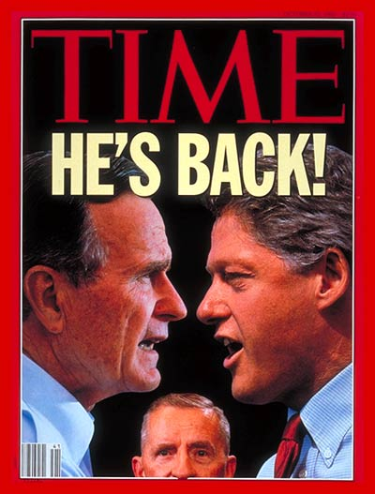
Clinton Elected
1992 election Bill Clinton won the election with only 43 percent of the popular vote
focused on the economy, the family, education, crime, and health care.
VERY charming
Will win re-election in 1996
ROSS PEROT- Biggest showing by a third party candidate in American history
Notes:
Clinton knew everyone’s name
Was a surprise winner in the election of 1992
He could empathize with people
He was a philanderer

Slide 6
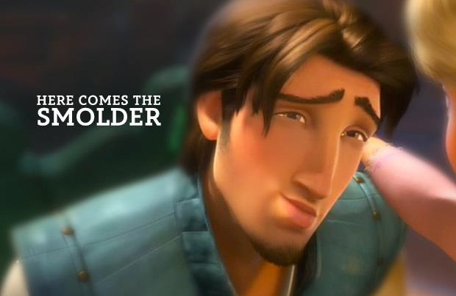
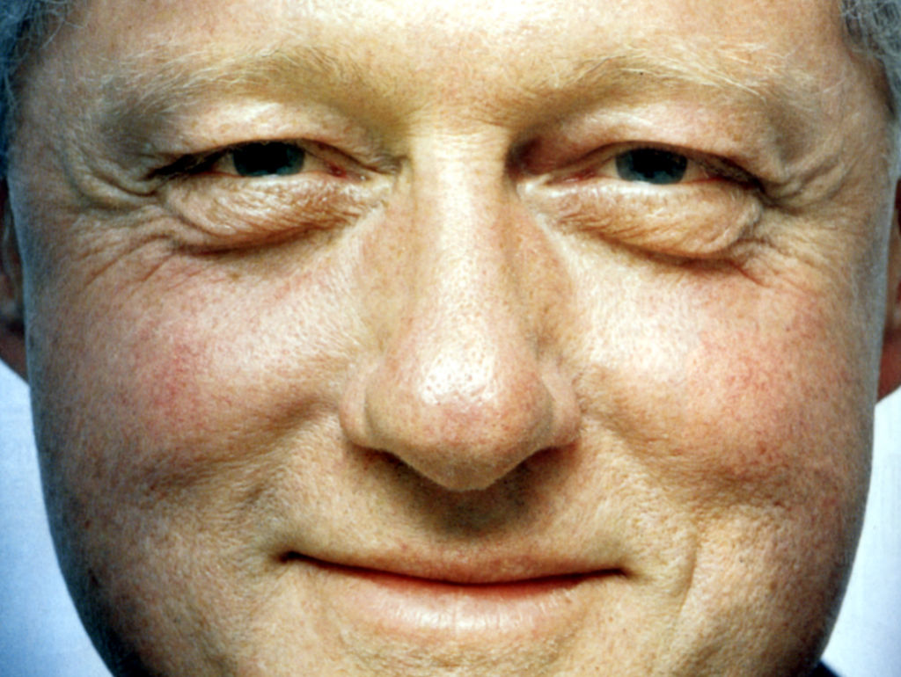
“I feel your pain, I do.”

Slide 7
Domestic Policy
NAFTA
In 1994 the North American Free Trade Agreement (NAFTA) was created to increase international trade. American manufacturers increased trade with Canada and Mexico.
Surplus
Cut spending → first government surplus in over 30 years ($236 billion by 2000)
Health Care
Wanted nationalized public health care → but was defeated. But did signed the Family & Medicare Leave Act
Notes:
international trade. Canada, the United States, and Mexico joined in a free-trade zone.

Slide 8
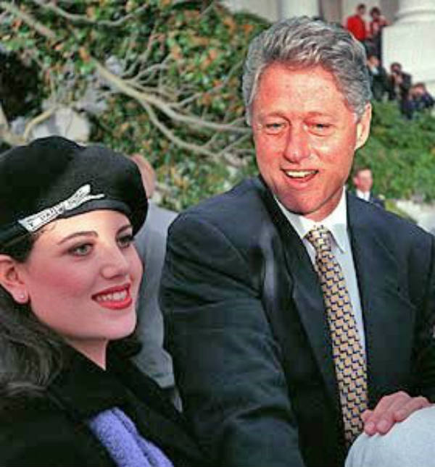
Bill Clinton’s approval ratings actually went up during the Monica Lewinsky scandal.
Scandal
Clinton was accused of lying under oath about relations with White House intern, Monica Lewinsky
In 1998, Congress approved 2 articles of impeachment-perjury and obstruction of justice
2nd president and 1st in 130 years to face a trial in the Senate
The Senate fell short of the 2/3rds majority required for conviction.
Clinton remained in office and apologized for his actions

Slide 9
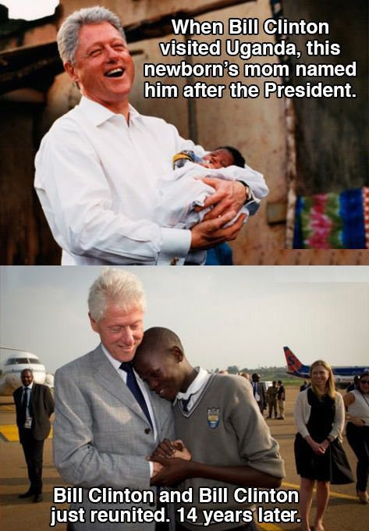
Foreign Policy
Somalia
98’ Clinton warned Congress of Iraqi dictator Saddam Huss
Iraq
98’-99’ at least 5,000 Kosovars had been executed during civil war and ethnic cleansing of Albanians. Clinton authorized the use of US forces along with NATO in a bombing campaign against Yugoslavia in 99’
Kosovo
2 US helicopters were shot down by rocket-propelled grenades→ resulted in a battle that killed 18 US soldiers. American bodies were dragged through the streets

Slide 10
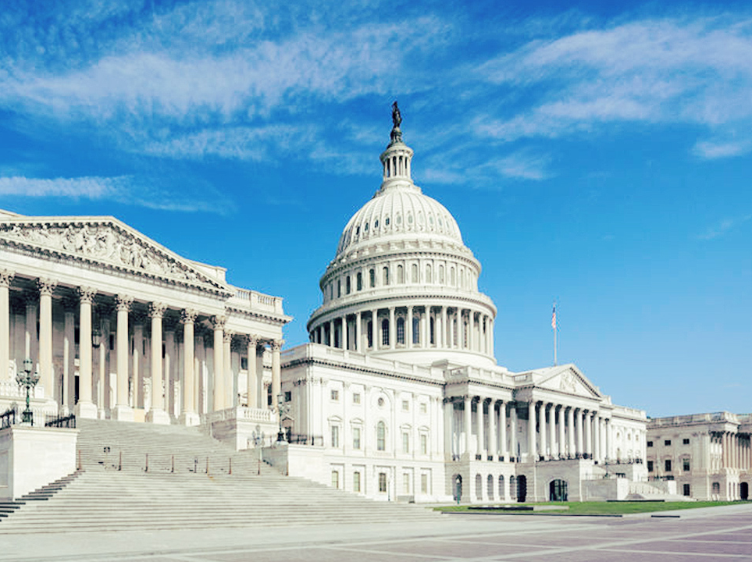
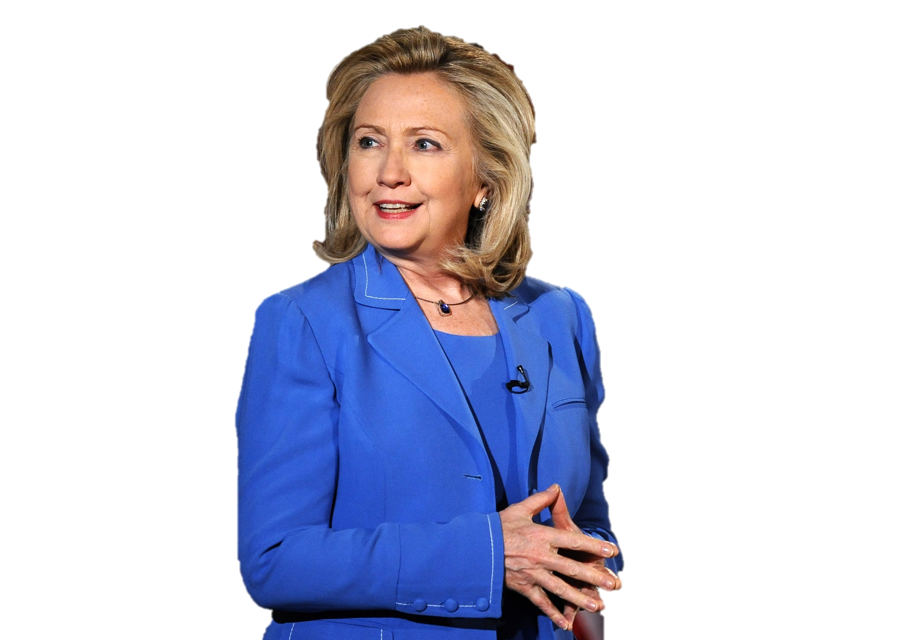
Hillary Rodham Clinton
Former US Secretary of State, US Senator, 1st Lady of the USA
Clinton visited more countries than any other Secretary of State
Encourages empowerment of women everywhere
Likely front runner for the Democratic Nominee for the next presidential election

Slide 11
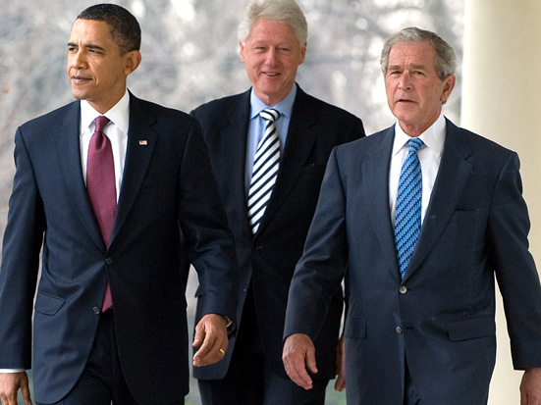
In 1992 who had the largest 3rd party votes in a presidential election?
Ross Perot
Checking for Understanding

Slide 12
How was the national debt under Clinton?
Surplus- $236 billion
Checking for Understanding

Slide 13
What was the result of NAFTA on American Trade?
Increased trade between N. American countries
Checking for Understanding

Slide 14
What did Clinton do that was illegal that led to his impeachment?
Perjury- lied under oath
Checking for Understanding

Slide 15
What did Clinton do that was illegal that led to his impeachment?
Perjury- lied under oath
Checking for Understanding

Slide 16
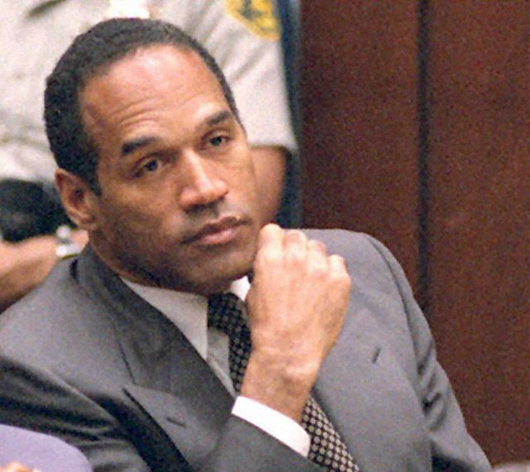
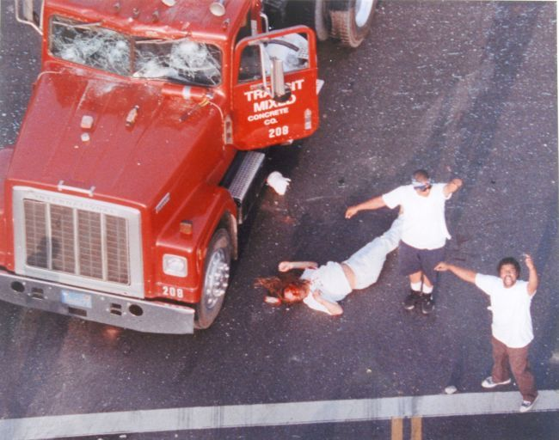
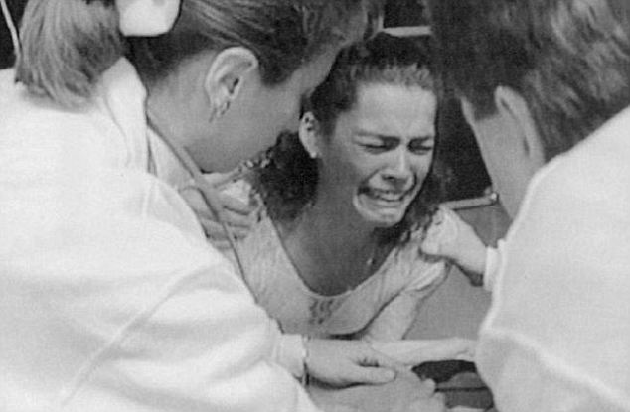
AJ-Spoof
When Apple was within days of bankruptcy, Bill Gates announced that Microsoft would throw Steve Jobs’ company a financial lifeline to the tune of a $150 million investment.
The Rodney King verdict and L.A. Riots- The three days of disorder killed 55 people, injured almost 2,000, led to 7,000 arrests, and caused nearly $1 billion in property damage, including the burnings of nearly 4,000 buildings.
90 million watched the verdict for the OJ Simpson Trial
Ice Skater Tanya Harding ordered hit men to break rival Nancy Kerrigan's leg
The U.S. spent around $100 billion to prepare for Y2K.
Biggie Smalls & TuPac are murdered. Both men challenged social norms and brought attention to racial & class issues.
Memorable
Events from the 90s

Slide 17
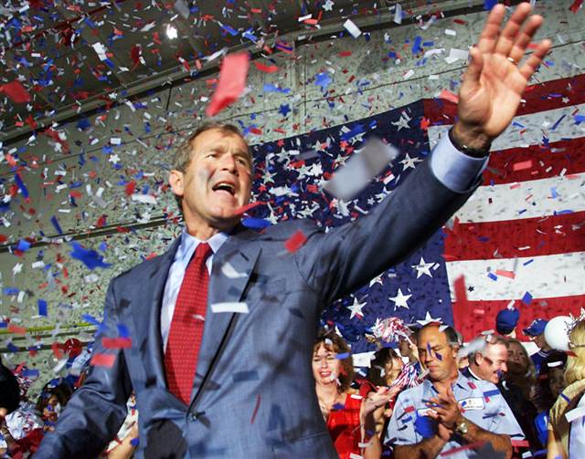
George W Bush

Slide 18
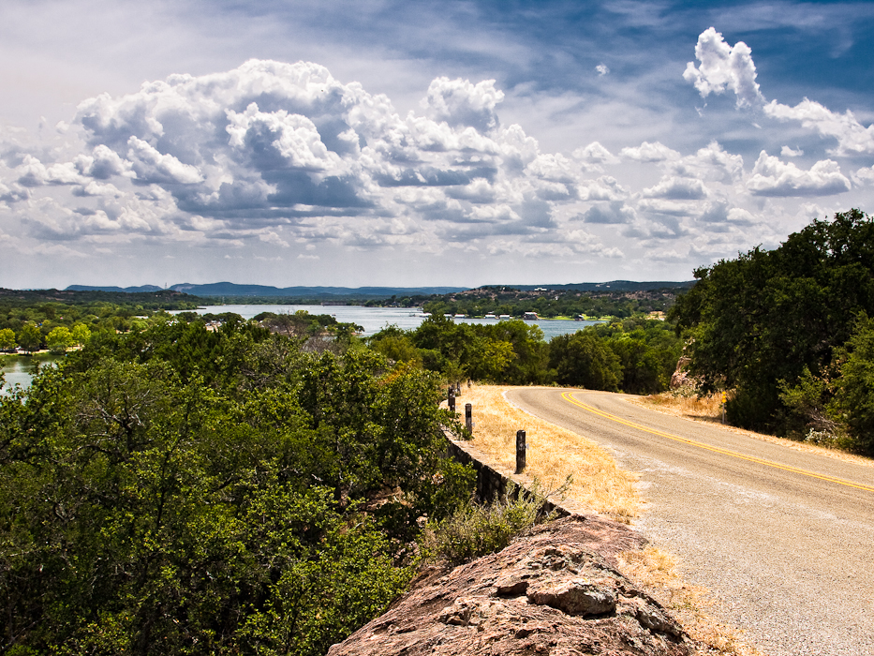
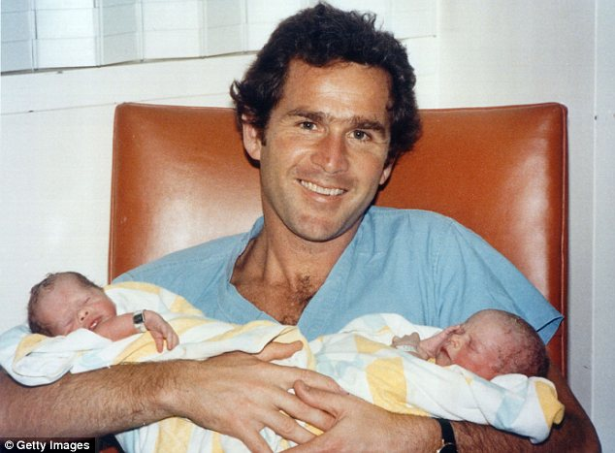
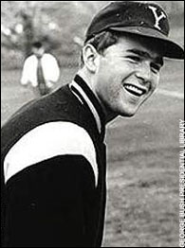
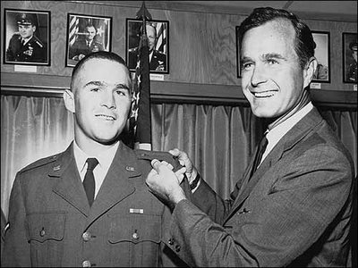
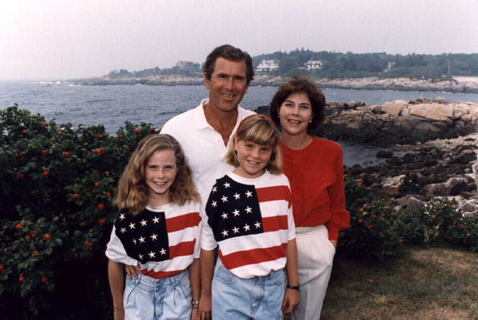
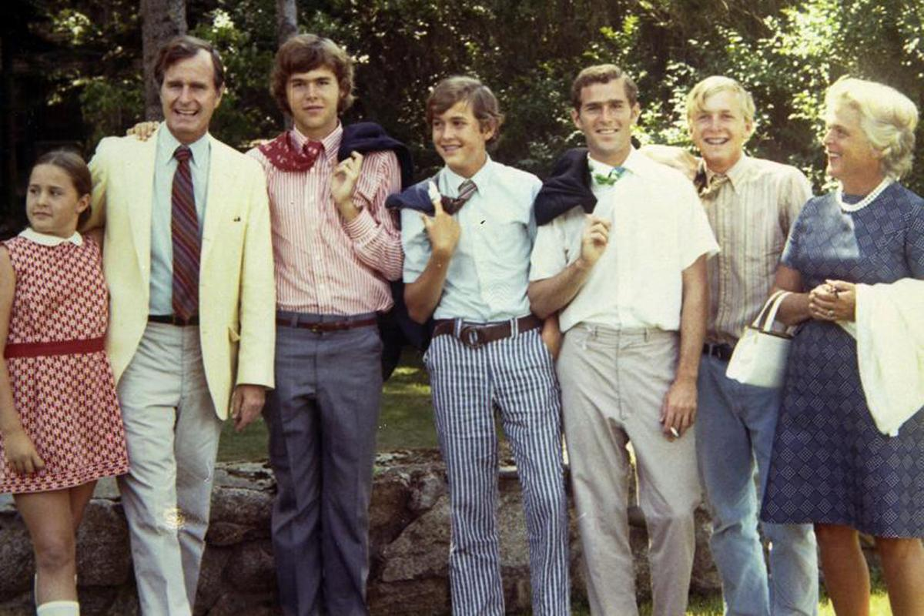
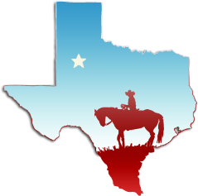

Slide 19
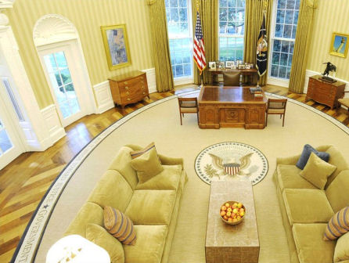
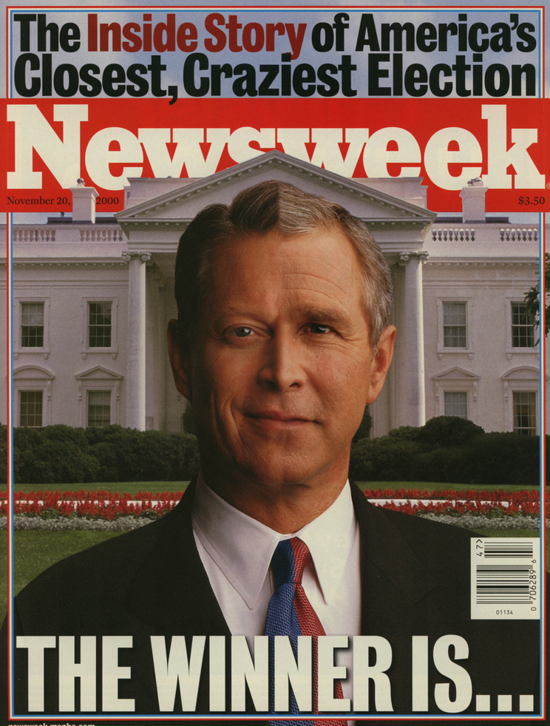
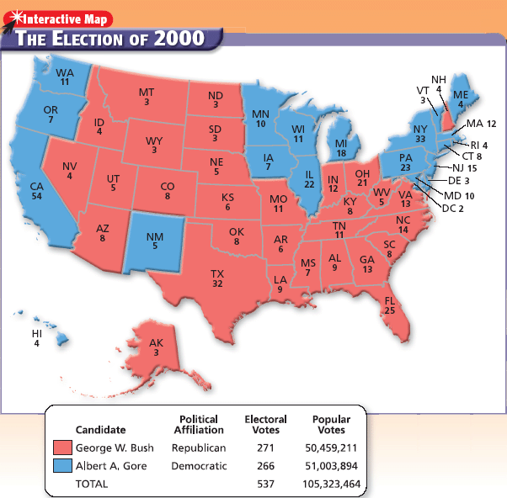
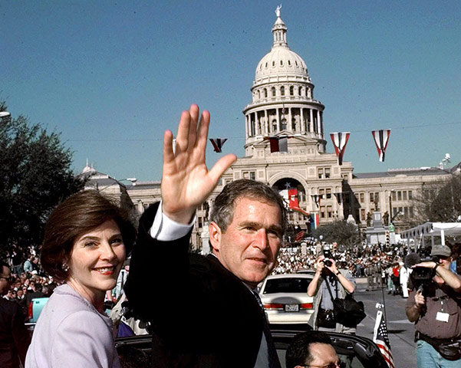
Bush Elected
2000 election was the closest in history
Baby Bush wins
Will win re-election in 2004

Slide 20
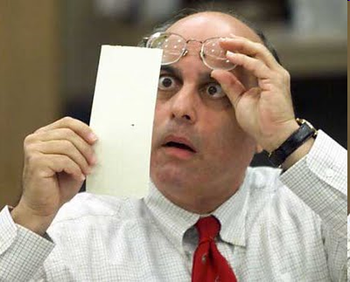
Total Votes in 2000 Election:
Bush 50,461,092 total votes
(47.9%)
271 Electoral Votes
Gore 50,994,086 total votes
(48.4%)
266 Electoral Votes
Nader 2,882,728 total votes
(2.7%)
0 Electoral College Votes
Both needed Florida’s 25 electoral votes to win
Close results in Florida
State law required a recount
Bush won by 537 votes
Gore took the case to the Supreme Court

Slide 21
Domestic Policy
Education
Increased funds for National Science Foundation & National Institutes of health. Supportive of the NCLB initiative aimed at closing the achievement gap in schools
Health Care
Signed into law Medicare drug benefit program ($7 Trillion).
Vetoed State Children’s Health Care Insurance Program aimed to assist low income kids
Environment
Proposed Clear Skies Act but was not approved as it would have allowed higher emission rates of pollutants than were previously legal.
Believes global warming is real but will not confirm that it is man made
Notes:
international trade. Canada, the United States, and Mexico joined in a free-trade zone.

Slide 22
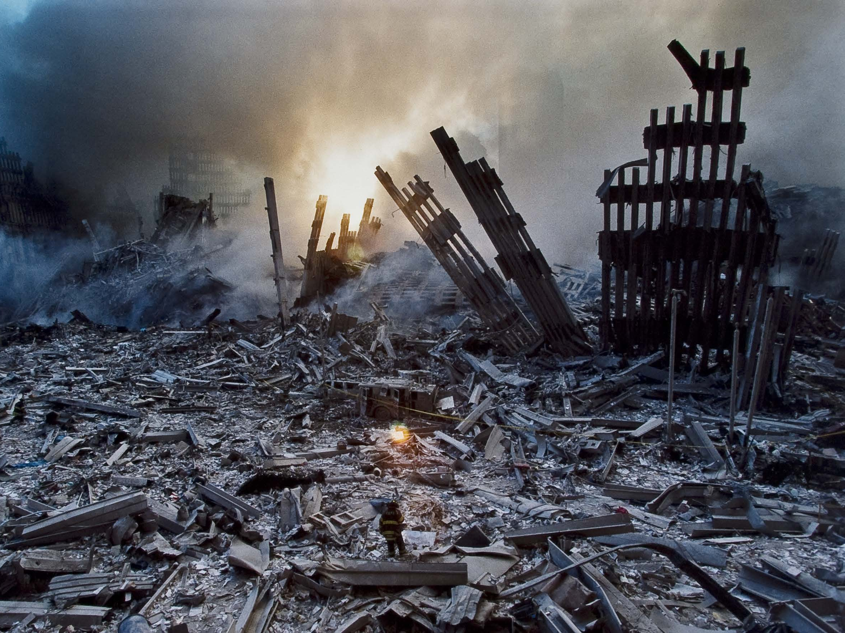
9/11/2001
The 9/11 attacks were a series of 4 coordinated terrorist attacks launched by the Islamic terrorist group al-Qaeda upon the US

Slide 23
9/11/2001
NY
DC
Penn.
2 planes crashed into the World Trade Center’s Twin Towers
Within hours both towers collapsed
1 Plane crashed into the Pentagon leading to a partial collapse of the West Side
1 Plane headed for Washington DC crash in a Penn. Field as result of those on board taking down the hijackers

Slide 24
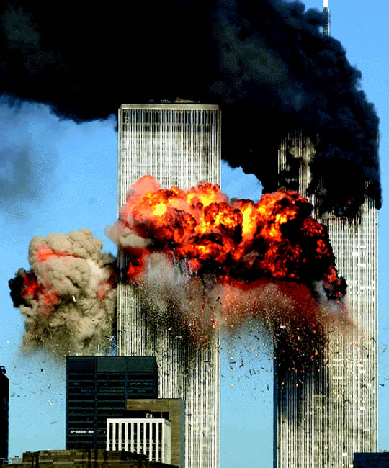
Death Toll
All passengers on the 4 planes were killed
About 3,000 people died in the attacks
340 firefighters and 60 police officers died

Slide 25
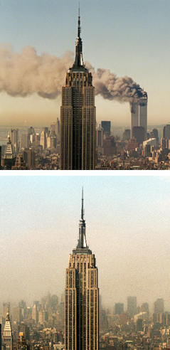
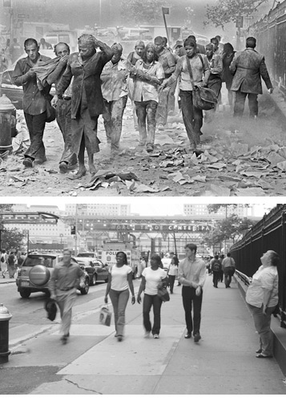

Slide 26
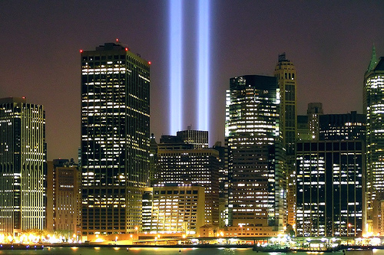

Slide 27
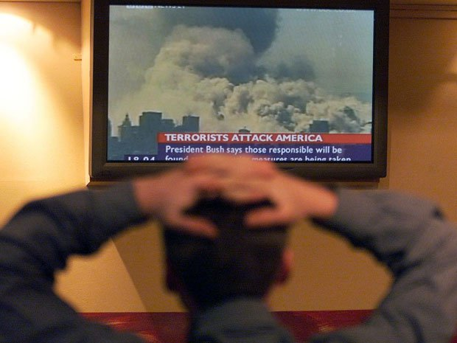
Impact
9/11 had a devastating impact on the way Americans looked at life
Many felt everything had changed
Before Americans felt terrorism was something that happened in other countries→ WAKE UP CALL!

Slide 28
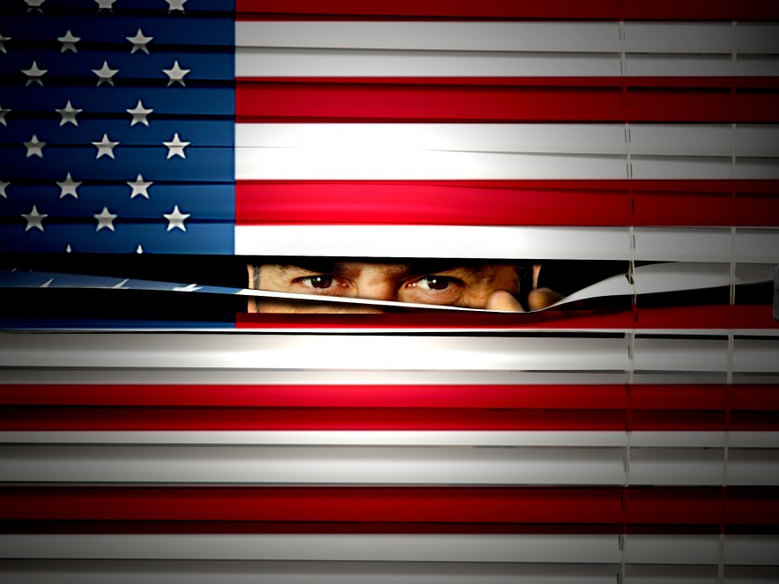
Anti-Terrorism
Department of Homeland Security was created in 2002
Coordinates national efforts against terrorism
Patriot Act

Slide 29
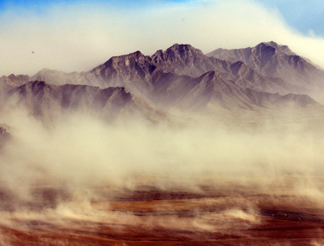
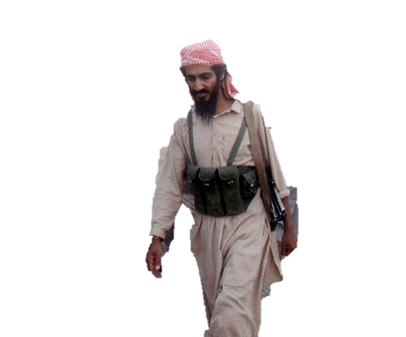
Osama Bin Laden
President Bush announced that the war on terrorism would start against al-Qaeda
But would also be waged against every terrorist group around the globe
including states that aided or harbored terrorists.
Bin Laden killed by US forces in 2011 (Obama)

Slide 30
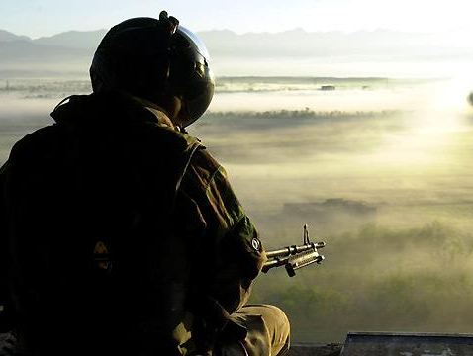
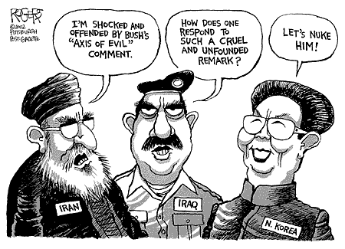
Iraq War
“AXIS of EVIL” : N. Korea, Iran, & Iraq
Went to war with Iraq on the basis that they had WMD
Which we now know they never had
Captured Saddam Hussein
Dissent & criticism of Bush’s leadership increased as the War in Iraq continued

Slide 31
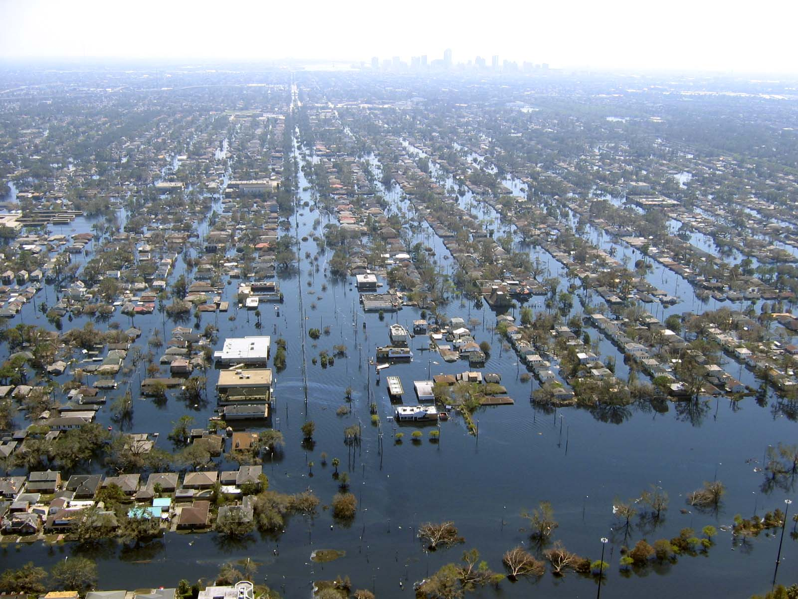
Hurricane Katrina
Katrina wrecked the Louisiana coast with 125 mph sustained winds, causing a storm surge that broke levees that shielded New Orleans from surrounding, higher coastal waters
Left 80 percent of the city under water.
Katrina killed at least 1,836 people and inflicted damages estimated at around $125 billion.
It took the National Guard troops TWO WEEKS to arrive in New Orleans after Hurricane Katrina struck
Notes:
Knowing the problem existed.
U.S. GAO, 1976, 1982.
New Orleans Times Picayune June 23-27,2002.
Civil Engineering Magazine, 2003.
National Geographic October 2004.
FEMA, Allbaugh, three most likely disasters (New Orleans, California, New York), 2001.
FEMA, Hurricane Pam simulation, 2004.

Slide 32
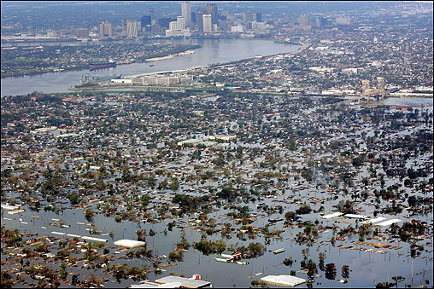
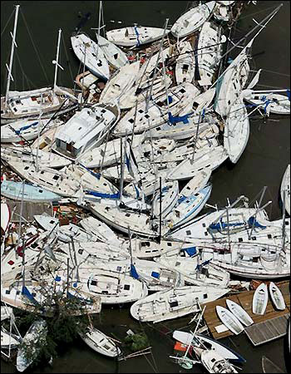
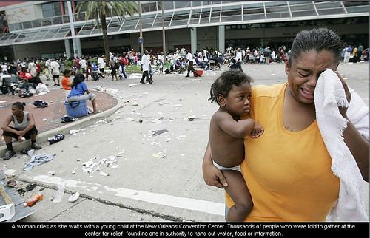
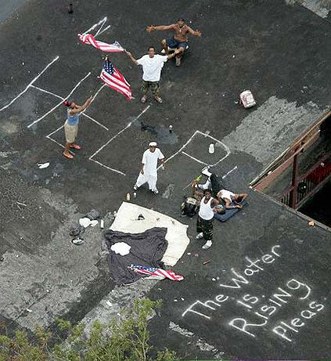
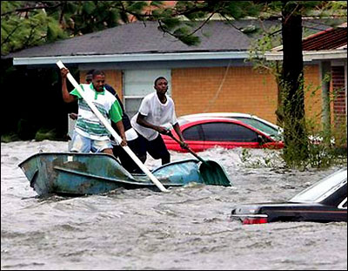
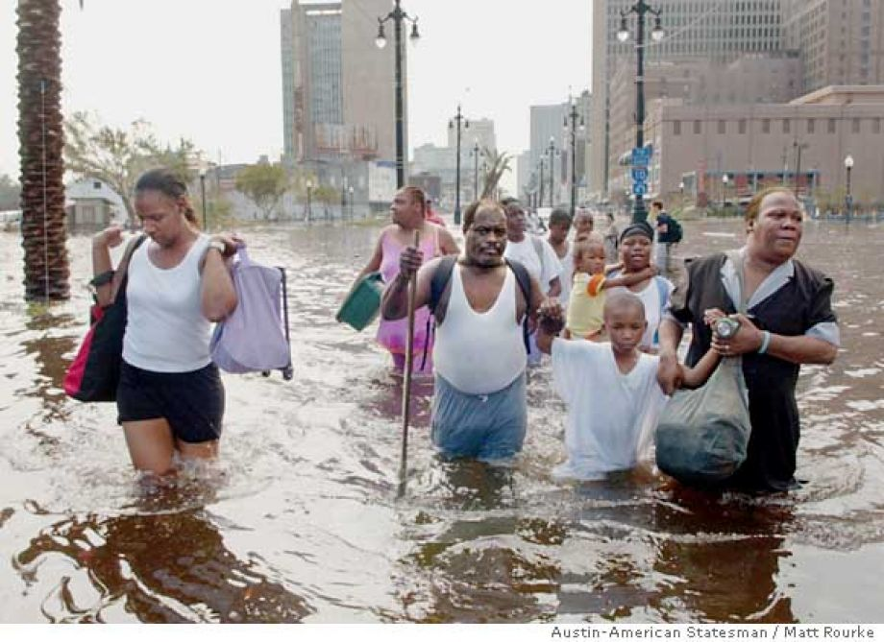
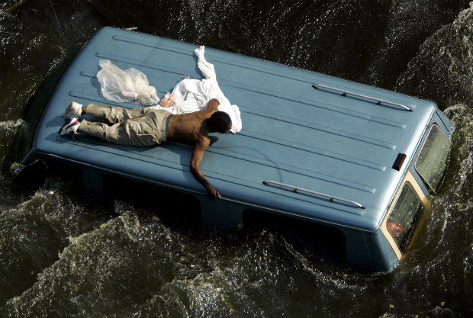
Hip Hop artist Kanye West publically criticized Bush’s handling of the Hurricane Katrina crisis

Slide 33
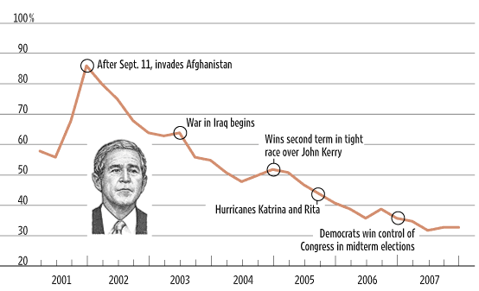
Approval Ratings

Slide 34
Who did Bush run against in 2000 that resulted in one of the closest elections in history?
Al Gore
Checking for Understanding

Slide 35
What 3 countries is Bush referring to when he notes “Axis of Evil”?
Iran, Iraq, N. Korea
Checking for Understanding

Slide 36
What was Bush’s response to 9/11?
“War on Terror”
Dept of Homeland Security
Patriot Act
Checking for Understanding

Slide 37
What are 2 big criticisms of Bush’s presidency?
Hurricane Katrina
Iraq War
Checking for Understanding

Slide 40
Obama Elected
2008 Obama won the presidency against John McCain with 52.9% of the popular vote.
He became the first African American to be elected president.
He was be re-elected in 2012.

Slide 42
Broken Campaign Promises
Guantanamo Bay
Promised to close Guantanamo Bay in Cuba but hasn’t been able to make it happen yet. As of January 2015, 122 prisoners were still there -- down from a total of 779.

Slide 43
Broken Campaign Promises
Immigration Reform
Promised comprehensive immigration reform but hasn’t been able to get it passed through Congress. The Senate approved a sweeping bill in 2013 that would have offered a path to citizenship for millions of illegal immigrants while boosting border security. HR never passed it.

Slide 44
Dream Act
Development, Relief, and Education for Alien Minors
Addresses young immigrants who grew up in the United States and have graduated from our high schools
The DREAM Act would permit certain immigrant students who have grown up in the U.S. to apply for temporary legal status and to eventually obtain permanent legal status and become eligible for U.S. citizenship if they go to college or serve in the U.S. military; and
The DREAM Act would eliminate a federal provision that penalizes states that provide in-state tuition without regard to immigration status.

Slide 45
Domestic Policy
Women
First bill he signed into law was regarding relaxing the statue of limitations for equal pay lawsuits.
Appointed 2 women to serve in the Sup Court
LGBT
Overturned don’t ask, Don’t Tell
Overturned DOMA (Defense of Marriage Act)
Signed off on Hate Crimes Prevention Acts
First president to openly support Gay rights
Health Care
Reauthorized the State Children’s Health Insurance Program to cover millions of poor uninsured children
“Obama Care”-Affordable Health Care Act
Notes:
international trade. Canada, the United States, and Mexico joined in a free-trade zone.

Slide 46
Affordable Care Act
Every tax paying resident in America must have health insurance
Options:
Keep current plan (as long as it meets the minimum requirements) or obtain health insurance
Tax Penalties if you don’t have healthcare
Can stay on your parents insurance until age 26
Employer mandate health care if 25 employees or more

Slide 47
Obama Elected Again

Slide 48
Election of 2012
YUP! I won again!

Slide 49
Foreign Policy
Iraqi Withdrawal
War in Afghanistan
Osama Bin Laden
2009- Announced combat operations in Iraq would end in 18 months.
Trained, equipped, & advised Iraqi security council
8/2010 Iraq War over
ISIS now in Iraq
Early in presidency upped troop #’s to “stabilize” the situation in Afghanistan.
Troop #s have been declining since 2011
Projected war’s end is 2016
2011 Navy Seals in connection with the CIA located Osama Bin Laden which resulted in his death

Slide 50
Isis
“Islamic State in Iraq and Syria”
They are a jihadist militant group who want to have their own country
They proclaim strict sharia law
Most successful jihadist group ever in the world
Executed 1600 Iraqi soldiers

Slide 52
Isis scare Tactics
They force people to dig their own graves and then mass execute them.
During the world cup they posted a picture of ISIS playing soccer with a human head #worldcup
They have beheaded hundreds of people including Americans – including Christians
Often stack their bodies and heads in a row

Slide 53
Leader Abu Bakr Al-Baghdadi seriously wounded by American airstikes on March 18, 2015

Slide 54
This symbol is the Arabic letter “nun” – the first letter in the word “Nazarene.” It is being painted on property owned by Christians in Mosul so that Islamic terrorists can identify them.

Slide 55
debt

Slide 57
We gotta blame
someone

Slide 58
How has Obama been supportive of Gay rights?
Overturned DADT & DOMA
Checking for Understanding

Slide 59
What record does Obama have with the National Debt?
More national debt then all the other presidents combined
Checking for Understanding

Slide 60
Explain was the Affordable Health Care Act is?
Everyone must have insurance & gov’t will help off set cost based off your income. Can stay on parents insurance until 26. Companies of 26+ must have health care for employees.
Checking for Understanding

Slide 61
Who are ISIS?
They are a jihadist militant terrorist group who want to have their own country
Checking for Understanding

