Slide 1
U.S. Perspective
Source A: Sinews of Peace “Iron Curtain Speech” given by Winston Churchill March , 1946
A shadow has fallen upon the scenes so lately lighted by the Allied victory. Nobody knows what Soviet Russia and its Communist international organization intends to do in the immediate future, or what are the limits, if any, to their expansive and proselytizing tendencies. I have a strong admiration and regard for the valiant Russian people and for my wartime comrade, Marshal Stalin. There is deep sympathy and goodwill in Britain - and I doubt not here also - towards the peoples of all the Russia's and a resolve to persevere through many differences and rebuffs in establishing lasting friendships. We understand the Russian need to be secure on her western frontiers by the removal of all possibility of German aggression. We welcome Russia to her rightful place among the leading nations of the world. We welcome her flag upon the seas. Above all, we welcome constant, frequent and growing contacts between the Russian people and our own people on both sides of the Atlantic. It is my duty however, for I am sure you would wish me to state the facts as I see them to you, to place before you certain facts about the present position in Europe.
From Stettin in the Baltic to Trieste in the Adriatic, an iron curtain has descended across the Continent. Behind that line lie all the capitals of the ancient states of Central and Eastern Europe. Warsaw, Berlin, Prague, Vienna, Budapest, Belgrade, Bucharest and Sofia, all these famous cities and the populations around them lie in what I must call the Soviet sphere, and all are subject in one form or another, not only to Soviet influence but to a very high and, in many cases, increasing measure of control from Moscow. Athens alone - Greece with its immortal glories - is free to decide its future at an election under British, American and French observation. The Russian-dominated Polish Government has been encouraged to make enormous and wrongful inroads upon Germany, and mass expulsions of millions of Germans on a scale grievous and undreamed-of are now taking place. The Communist parties, which were very small in all these Eastern States of Europe, have been raised to pre-eminence and power far beyond their numbers and are seeking everywhere to obtain totalitarian control. Police governments are prevailing in nearly every case, and so far, except in Czechoslovakia, there is no true democracy.
Source:https://www.nationalchurchillmuseum.org/sinews-of-peace-history.html
Soviet Union’s Perspective
Source B: Stalin’s response to the Iron Curtain Speech 1946
In substance, Mr. Churchill now stands in the position of a firebrand of war. And Mr. Churchill is not alone here. He has friends not only in England but also in the United States of America. In this respect, one is reminded remarkably of Hitler and his friends. Hitler began to set war loose by announcing his racial theory, declaring that only people speaking the German language represent a fully valuable nation. Mr. Churchill begins to set war loose, also by a racial theory, maintaining that only nations speaking the English language are fully valuable nations, called upon to decide the destinies of the entire world. The German racial theory brought Hitler and his friends to the conclusion that the Germans, as the only fully valuable nation, must rule over other nations. The English racial theory brings Mr. Churchill and his friends to the conclusion that nations speaking the English language, being the only fully valuable nations, should rule over the remaining nations of the world.... As a result of the German invasion, the Soviet Union has irrevocably lost in battles with the Germans, and also during the German occupation and through the expulsion of Soviet citizens to German slave labor camps, about 7,000,000 people. In other words, the Soviet Union has lost in men several times more than Britain and the United States together.
It may be that some quarters are trying to push into oblivion these sacrifices of the Soviet people which insured the liberation of Europe from the Hitlerite yoke. But the Soviet Union cannot forget them. One can ask therefore, what can be surprising in the fact that the Soviet Union, in a desire to ensure its security for the future, tries to achieve that these countries should have governments whose relations to the Soviet Union are loyal? How can one, without having lost one's reason, qualify these peaceful aspirations of the Soviet Union as "expansionist tendencies" of our Government?. . . Mr. Churchill wanders around the truth when he speaks of the growth of the influence of the Communist parties in Eastern Europe.... The growth of the influence of communism cannot be considered accidental. It is a normal function. The influence of the Communists grew because during the hard years of the mastery of fascism in Europe, Communists slowed themselves to be reliable, daring and self-sacrificing fighters against fascist regimes for the liberty of peoples.
Mr. Churchill sometimes recalls in his speeches the common people from small houses, patting them on the shoulder in a lordly manner and pretending to be their friend. But these people are not so simpleminded as it might appear at first sight. Common people, too, have their opinions and their own politics. And they know how to stand up for themselves.
It is they, millions of these common people, who voted Mr. Churchill and his party out in England, giving their votes to the Labor party. It is they, millions of these common people, who isolated reactionaries in Europe, collaborators with fascism, and gave preference to Left democratic parties
Source: "Stalin's Reply to Churchill," March 14, 1946 (interview with Pravda), The New York Times, p. 4.
Was Europe Divided by an Iron Curtain?

Slide 2
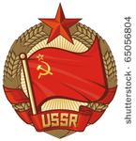
How did the United States and Soviet Union view the post-war world?
Source C: George Kennan “The Long Telegram” (an account of Soviet Policy by an American Embassy Official) EXCERPTS
Soviet Perspective: How the USSR views the Postwar world
(a) USSR still lives in antagonistic "capitalist encirclement" with which in the long run there can be no permanent peaceful coexistence. As stated by Stalin in 1927 to a delegation of American workers:
"In course of further development of international revolution there will emerge two centers of world significance: a socialist center, drawing to itself the countries which tend toward socialism, and a capitalist center, drawing to itself the countries that incline toward capitalism. Battle between these two centers for command of world economy will decide fate of capitalism and of communism in entire world."
(b) Capitalist world is beset with internal conflicts, inherent in nature of capitalist society. These conflicts are insoluble by means of peaceful compromise. Greatest of them is that between England and US.
(d) Intervention against USSR, while it would be disastrous to those who undertook it, would cause renewed delay in progress of Soviet socialism and must therefore be forestalled at all costs.
(e) Conflicts between capitalist states, though likewise fraught with danger for USSR, nevertheless hold out great possibilities for advancement of socialist cause, particularly if USSR remains militarily powerful, ideologically monolithic and faithful to its present brilliant leadership.
Everything must be done to advance relative strength of USSR as factor in international society. Conversely, no opportunity most be missed to reduce strength and influence, collectively as well as individually, of capitalist powers. Soviet efforts, and those of Russia's friends abroad, must be directed toward deepening and exploiting of differences and conflicts between capitalist powers. If these eventually deepen into an "imperialist" war, this war must be turned into revolutionary upheavals within the various capitalist countries.
U.S. Perspective: Realities of Communism & Capitalism
First, [the current Soviet Union’s ideology] does not represent the natural outlook of Russian people. Latter are, by and large, friendly to outside world, eager for experience of it, eager to measure against it talents they are conscious of possessing, eager above all to live in peace and enjoy fruits of their own labor…. Experience has shown that peaceful and mutually profitable coexistence of capitalist and socialist states is entirely possible... To speak of possibility of intervention against USSR today, after elimination of Germany and Japan and after example of recent war, is sheerest nonsense. If not provoked by forces of intolerance and subversion "capitalist“ world of today is quite capable of living at peace with itself and with Russia…At bottom of Kremlin's neurotic view of world affairs is traditional and instinctive Russian sense of insecurity…For this reason they have always feared foreign penetration, feared direct contact between Western world and their own, feared what would happen if Russians learned truth about world without or if foreigners learned truth about world within.

Slide 3
U.S. Perspective: How to handle the Soviet Union
I think we may approach calmly and with good heart the problem of how to deal with Russia. As to how this approach should be made, I only wish to advance, by way of conclusion, following comments:
(1) Our first step must be to apprehend, and recognize for what it is, the nature of the movement with which we are dealing. We must study it with same courage, detachment, objectivity, and same determination not to be emotionally provoked or unseated by it,
with which doctor studies unruly and unreasonable individual.
(2) We must see that our public is educated to realities of Russian situation. I cannot over-emphasize importance of this. Press cannot do this alone. It must be done mainly by Government, which is necessarily more experienced and better informed on practical problems involved. In this we need not be deterred by [ugliness?] of picture. I am convinced that there would be far less hysterical anti-Sovietism in our country today if realities of this situation were better understood by our people. There is nothing as dangerous or as terrifying as the unknown. It may also be argued that to reveal more information on our difficulties with Russia would reflect unfavorably on Russian- American relations. I feel that if there is any real risk here involved, it is one which we should have courage to face, and sooner the better. But I cannot see what we would be risking. Our stake in this country, even coming on heels of tremendous demonstrations of our friendship for Russian people, is remarkably small. We have here no investments to guard, no actual trade to lose, virtually no citizens to protect, few cultural contacts to
preserve. Our only stake lies in what we hope rather than what we have; and I am convinced we have better chance of realizing those hopes if our public is enlightened and if our dealings with Russians are placed entirely on realistic and matter-of-fact basis.
(3) Much depends on health and vigor of our own society. World communism is like malignant parasite which feeds only on diseased tissue. This is point at which domestic and foreign policies meets Every courageous and incisive measure to solve internal problems of our own society, to improve self-confidence, discipline, morale and community spirit of our own people, is a diplomatic victory over Moscow worth a
thousand diplomatic notes and joint communiqués. If we cannot abandon fatalism and indifference in face of deficiencies of our own society, Moscow will profit—Moscow cannot help profiting by them in its foreign policies.
(4) We must formulate and put forward for other nations a much more positive and constructive picture of sort of world we would like to see than we have put forward in past. It is not enough to urge people to develop political processes similar to our own. Many foreign peoples, in Europe at least, are tired and frightened by experiences of past, and are less interested in abstract freedom than in security. They are seeking guidance rather than responsibilities. We should be better able than Russians to give them this. And unless we do, Russians certainly will.
Source: https://www.trumanlibrary.org/whistlestop/study_collections/coldwar/documents/pdf/6-6.pdf

Slide 4
U.S. Perspective
Source D: Excerpt from President Truman’s speech to Congress,
March 12, 1947.
I believe it must be the policy of the United States to support free peoples who are resisting attempted subjugation [domination] by armed minorities or by outside pressure. Should we fail to aid Greece and Turkey in this fateful hour [against the Soviet threat], the effect will be far-reaching to the West. The seeds of totalitarian regimes are nurtured by misery and want. They spread and grow in the evil soil of poverty and strife. The reach their full growth when the hope of a people for a better life has died. Therefore, I propose giving Greece and Turkey $400 million in aid.
U.S. Perspective
Source E: Excerpt from Secretary of State Marshall’s speech explaining his plan for European recovery
June 5, 1947
I need to say that the world situation is very serious. . . . Europe must have a great deal of additional help, or face heavy economic, social, and political damage. This would have a harmful effect on the world at large. There are also possibilities of disturbances because of the desperation of the people concerned.
The effect on the economy of the United States should be clear to all. So the United States should do whatever it can to help restore normal economic health to the world. Without this there can be no
political stability or peace. Our policy is directed . . . against hunger, poverty, desperation and chaos
[disorder]. Its purpose is to revive a working economy in the world.
Should Economic aid be sent to Europe?
Soviet Perspective: Source F: Andrei Vyshinsky, Soviet spokesman, at the United Nations September 18, 1947 in response to the Truman Doctrine and Marshall Plan
The so-called Truman Doctrine and the Marshall Plan are particularly glaring examples of the way in which the principles of the United Nations are violated, of the way in which the Organization is ignored. As is now clear, the Marshall Plan constitutes in essence merely a variant of the Truman Doctrine adapted to the conditions of postwar Europe. In bringing forward this plan, the United States Government apparently counted on the cooperation of the Governments of the United Kingdom and France to confront the European countries in need of relief with the necessity of renouncing their inalienable right to dispose of their economic resources and to plan their national economy in their own way. The United States also counted on making all these countries directly dependent on the interests of American monopolies, which are striving to avert the approaching depression by an accelerated export of commodities and capital to Europe. It is becoming more and more evident to everyone that the implementation of the Marshall Plan will mean placing European countries under the economic and political control of the United States and direct interference by the latter in the internal affairs of those countries. Moreover, this plan is an attempt to split Europe into two camps and, with the help of the United Kingdom and France, to complete the formation of a bloc of several European countries hostile to the interests of the democratic countries of Eastern Europe and most particularly to the interests of the Soviet Union. An important feature of this Plan is the attempt to confront the - countries of Eastern Europe with a bloc of Western European States including Western Germany. The intention is to make use of Western Germany and German heavy industry (the Ruhr) as one of the most important economic bases for American expansion in Europe, in disregard of the national interests of the countries which suffered from German aggression.

Slide 5
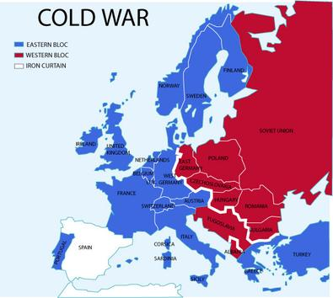
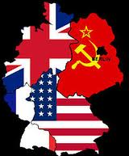
Warsaw Pact
Soviet Union’s Perspective
Source H: Speech by Soviet Premier Nikita Khrushchev in 1956 in which he explains his point of view on U.S. actions. (Excerpt)
The inspirers of the “cold war” began to establish military blocs—the North Atlantic bloc, SEATO, and the Baghdad pact. [They claim] they have united for defense against the “communist threat.” But this is sheer hypocrisy! We know from history that when planning a re-division of the world, the imperialist powers have always lined up military blocs. Today the “anti-communism” slogan is being used as a smoke screen to cover up the claims of one power for world domination. The United States wants, by means of blocs and pacts, to secure a dominant position in the capitalist world. The inspirers of the “position of strength” policy assert that it makes another way impossible because it ensures a “balance of power” in the world. [They] offer the arms race as their main recipe for the preservation of peace! It is perfectly obvious that when nations compete to increase their military might, the danger of war becomes greater, not lesser. Capitalism will find its grave in another world war, should it unleash it.
U.S. Perspective
Source G: NATO- North Atlantic Treaty (Excerpt), signed by the United States, Canada, and ten nations of Western Europe in 1948.
The parties agree that an armed attack against one or more of them in Europe or in North America shall be considered as an attack against them all. They agree that if such an armed attack occurs, each of them
will assist the party or parties so attacked. Each will immediately take whatever action it considers necessary to restore and maintain the security of the North Atlantic area. It will, if necessary, use armed force.
NATO
Soviet Union’s Perspective
Source I: Warsaw Pact May 1955
Background Info: The “treaty of mutual friendship, co-operation and mutual assistance” was signed between the People’s Republic of Albania, the People’s Republic of Bulgaria, the Hungarian People’s Republic, the German Democratic Republic, the Polish People’s Republic, the Rumanian People’s Republic, the Union of Soviet Socialist Republics, and the Czechoslovak Republic in May 1955. It was the Communist counteraction to NATO (North Atlantic Treaty Organization)
Excerpt from Treaty: The contracting parties shall take council among themselves on all important international questions relating to their common interests, guided by the interests of strengthening international peace and security.
They shall take council among themselves immediately, whenever, in the opinion of any of them, there has arisen the threat of an armed attack on one or several states that are signatories of the treaty, in the interests of organizing their joint defense and of upholding peace and security…
Were the U.S. & S.U. taking sides against one another?

Slide 6
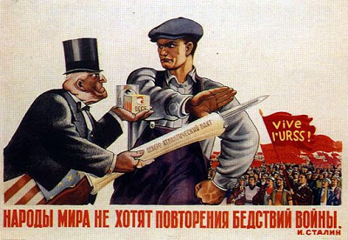
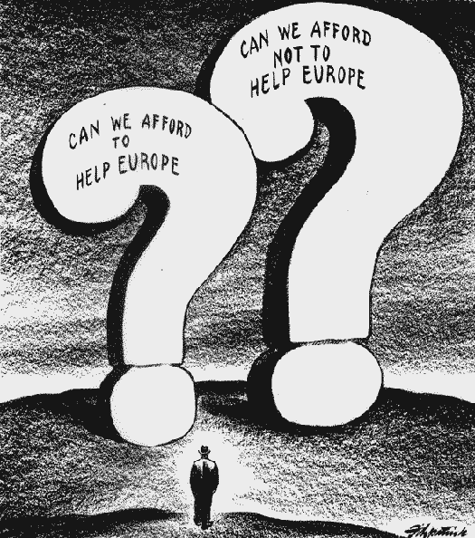
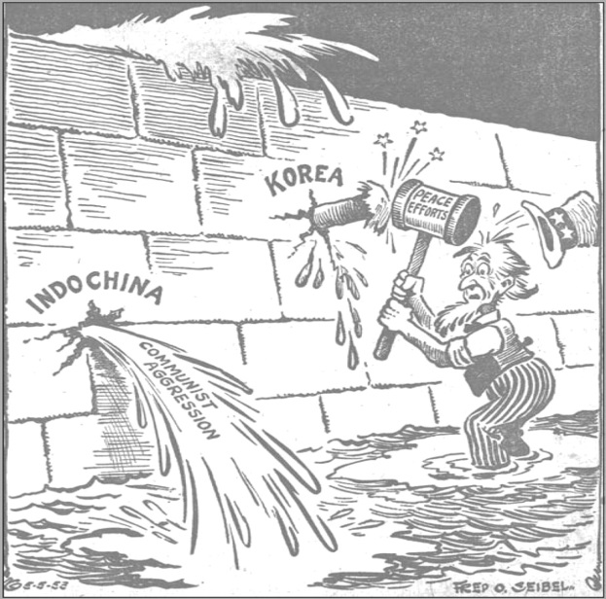
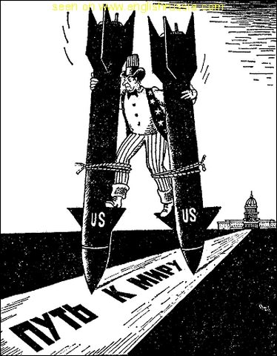
Soviet Union’s Perspective
United States Perspective
Source J
Source L
The Cartoon caption above reads: “People of the world don’t want a repeat of the horrors of war” -Stalin
Source M
Source K
This Cartoon reads “Path to Peace”
Sources: http://voiceseducation.org/sites/default/files/images/Mashall_Plan.jpghttp://www.bing.com/images/search?q=1950s+Cold+War+Political+Cartoons&view=detailv2&&&id=CC60B29F6673D56DA35E4B019E3939A2FBFAD321&selectedIndex=75&ccid=leYL0gCx&simid=607999208799928419&thid=JN.9sCsxdebFXoUMzyYro4TKA&ajaxhist=0http://3.bp.blogspot.com/_ouxxa0eFam8/SpGFVFAjJKI/AAAAAAAAEco/ltTbv6oSPdM/s400/poster-18.jpghttp://www.octavarius.com/blog/soviet-propaganda-from-the-cold-war/

