Slide 1
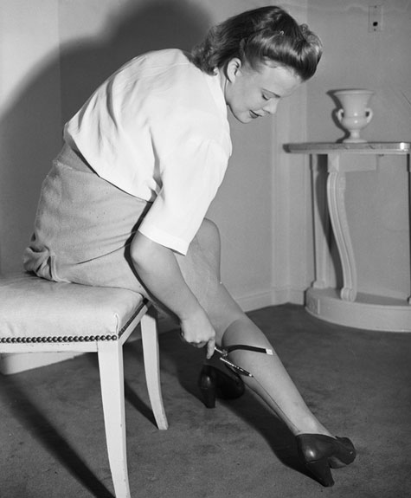
Minorities ~Women~
Why were women drawing lines on their legs during WWII?
To find out, scan the QR Code provided or visit:
http://www.smithsonianmag.com/arts-culture/stocking-series-part-1-wartime-rationing-and-nylon-riots-25391066/?no-ist
Scan the QR code provided or visit: http://www.mcneilmusic.com/music/RosieThe.mp3
to hear the contributions of women during WWII and to listen to the song “Rosie the Riveter”.

Slide 2
Women Exhibit: Why were women drawing lines on their legs? (Transcript)
Nylon stockings made their debut in my hometown, Wilmington, Delaware, on October 24, 1939. That’s because Wallace Hume Carothers, the chemist who invented the synthetic material in 1935, worked for the DuPont company, which is headquartered there. In fact, the first test sale to DuPont employees’ wives took place at the company’s experimental station, just up the street from my childhood home. Not long before the 4,000 pairs of stockings sold out—in only three hours!—DuPont had had women modeling nylon hosiery at the 1939 New York World’s Fair, touting nylon as a synthetic fabric made of “carbon, water and air.” A prototype of that initial run (get it?) can be found in the Smithsonian’s collection.
From the moment DuPont realized what kind of stretchy, durable, washable, dryable revolution it had synthesized, the company channeled its invention to women’s hosiery, a huge potential market. Hemlines were rising throughout the 1930s, and stockings, made at that time from silk or rayon, had become an essential component to a woman’s wardrobe, even though they were delicate and prone to runs. (The delicacy didn’t hurt the bottom line; women purchased an average of eight pairs of stockings per year during that decade.) Then came DuPont’s wonder fabric; the word “nylon,” as the lore goes, originated from the attempted coinage “nuron,”—”no run” spelled backward. Trademark issues caused DuPont to adapt the word to “nilon,” and then finally to “nylon” to remove any pronunciation ambiguity.
DuPont’s initial sales success in Wilmington was just the beginning of the nylon stocking craze. On May 16, 1940, officially known as “Nylon Day,” four million pairs of brown nylons landed on department store shelves throughout the United States at about $1.15 per pair. They sold out within two days. Silk stockings—which didn’t stretch, were challenging to clean, and ripped easily, but had been standard—were quickly supplanted.
That is, until the war came around. As quickly as nylon stockings found their way into department stores and boutiques, providing women with inexpensive, longer-lasting hosiery options, they disappeared. After Pearl Harbor was bombed on December 7, 1941, and the United States entered World War II, the material that had its beginnings briefly as toothbrush bristles (prior to entering the women’s hosiery market) was severely rationed and channeled into war efforts. Nylon was permitted only in the manufacturing of parachutes, tire cords, ropes, aircraft fuel tanks, shoe laces, mosquito netting and hammocks, aiding in the U.S.’s national defense. Because American women had seen the future and it had them wearing nylons, they had to be inventive to meet their leg-beautifying needs (Paint-on stockings, anyone? More on that soon.) or turn to the black market (a “diverted” nylon shipment earned one sly entrepreneur $100,000).
Read more: http://www.smithsonianmag.com/arts-culture/stocking-series-part-1-wartime-rationing-and-nylon-riots-25391066/#W8PpzEzET3rp2jPE.99

Slide 3
Women
Why were women drawing lines on their legs during WWII?
What war materials were made with Nylon during WWII?
Name 3 ways women were involved in the war effort?
Listen to the song, “Rosie the Riveter”. Describe the tone and subject of this song?
Who was “Rosie the Riveter”- what did she represent?

Slide 4
Minorities ~African Americans~
Background: During World War II, many African Americans served in the armed forces, but some questioned the rationale for supporting the war effort. James Thompson wrote a letter to the Pittsburgh Courier expressing his belief that he should not fight for a nation that discriminated against him and African Americans in general. He suggested the idea that African Americans wage a "double V" campaign….what was that?
DEAR EDITOR: Like all true Americans, my greatest desire at this time, this crucial point of our history; is a desire for a complete victory over the forces of evil, which threaten our existence today. Behind that desire is also a desire to serve, this, my country, in the most advantageous way. Most of our leaders are suggesting that we sacrifice every other ambition to the paramount one, victory. With this I agree; but I also wonder if another victory could not be achieved at the same time. Being an American of dark complexion and some 26 years, these questions flash through my mind: "Should I sacrifice my life to live half American?" "Will things be better for the next generation in the peace to follow?" "Would it be demanding too much to demand full citizenship rights in exchange for the sacrificing of my life." "Is the kind of America I know worth defending?" "Will America be a true and pure democracy after this war?" "Will colored Americans suffer still the indignities that have been heaped upon them in the past?" I suggest that while we keep defense and victory in the forefront that we don't loose sight of our fight for true democracy at home. The "V for Victory" sign is being displayed prominently in all so-called democratic countries which are fighting for victory over aggression, slavery and tyranny. If this V sign means that to those now engaged in this great conflict then let colored Americans adopt the double VV for a double victory; The first V for victory over our enemies from without, the second V for victory over our enemies within. For surely those who perpetrate these ugly prejudices here are seeing to destroy our democratic form of government just as surely as the Axis forces. In way of an answer to the foregoing questions in a preceding paragraph, I might say that there is no doubt that this country is worth defending; things will be different for the next generation; colored Americans will come into their own, and America will eventually become the true democracy it was designed to be. These things will become a reality in time; but not through any relaxation of the efforts to secure them. JAMES G. THOMPSON.
Exhibit A: Excerpt of Double V Letter

Slide 5
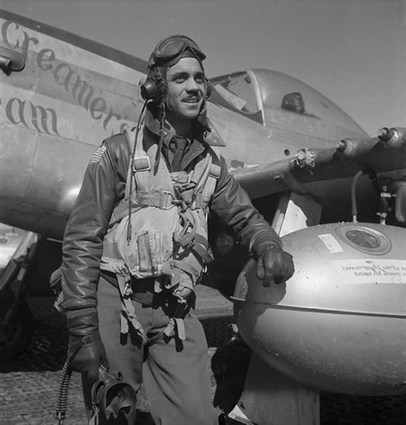
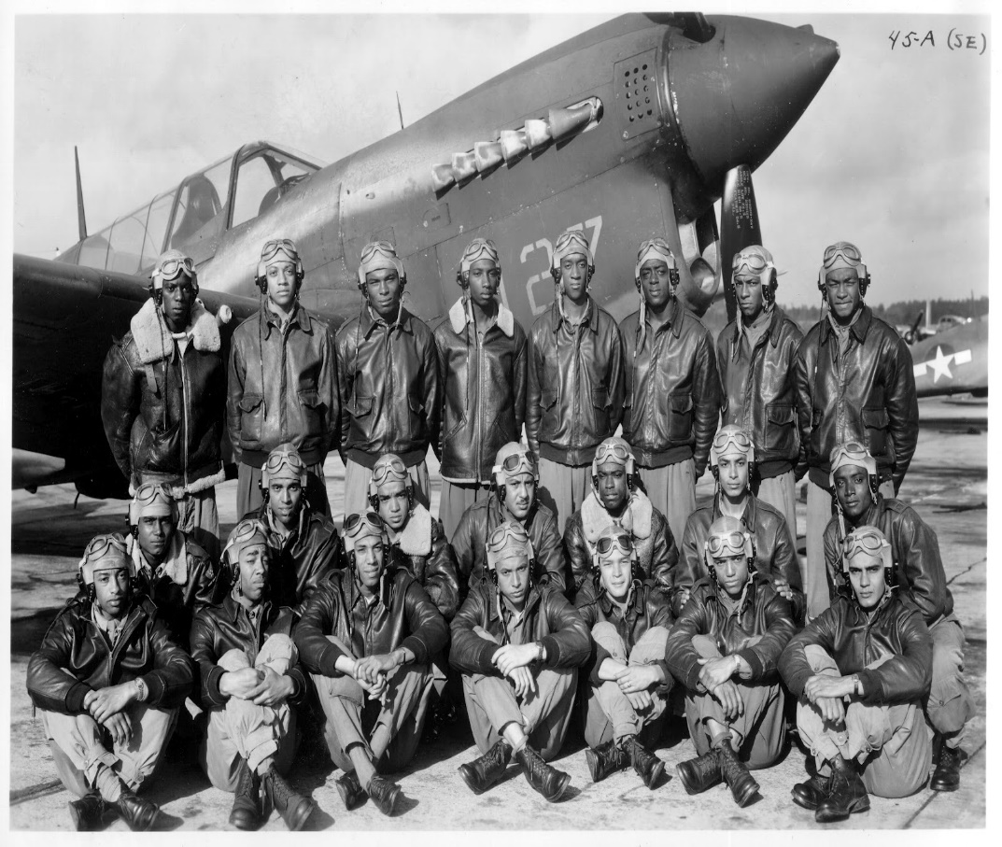
Minorities ~African Americans~
Scan the QR Code or visit YOUTUBE: Tuskegee Airmen - Red Tails

Slide 6
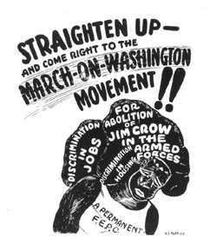
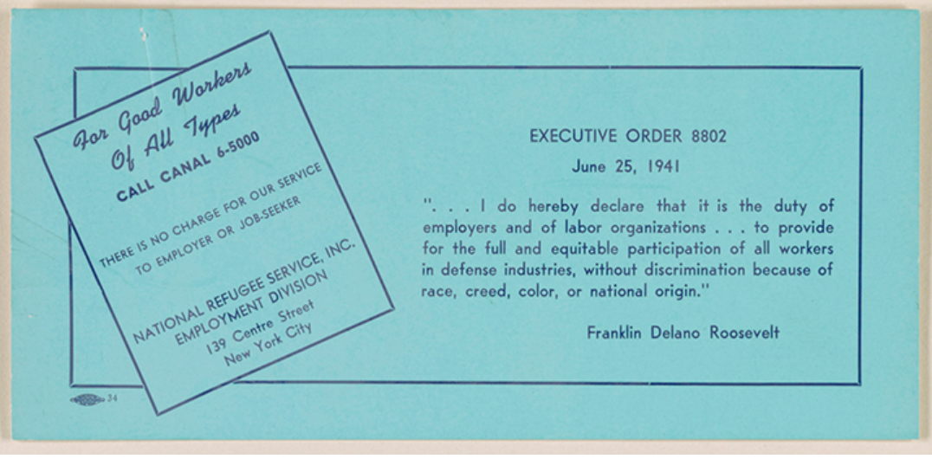
Minorities ~African Americans~
Exhibit B

Slide 7
African Americans
What was the significance of the letter written by James G. Thompson? What was its impact? (Exhibit A)
How did Thompson justify his proposal for a Double V Campaign? (Exhibit A)
Who were the Tuskegee Airmen and how did they contribute to the war effort?
Were the airmen successful? What evidence from the video supports your answer?
What did the Tuskegee Airmen and other black units influence President Truman to do?
Based upon the information in Exhibit B, what was probably occurring in the 1940’s that caused President Roosevelt to take action? What action did he take? (Exhibit B)

Slide 8
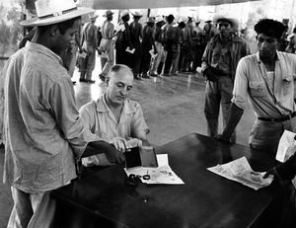
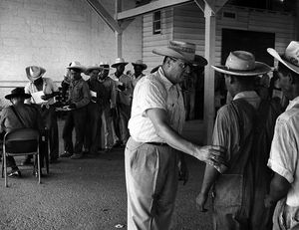
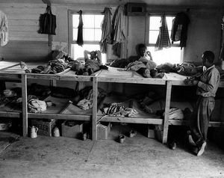
Minorities ~Mexican Americans~
Scan the QR Code or visit: http://amhistory.si.edu/onthemove/
and search “Bracero Program”.
Exhibit A

Slide 9
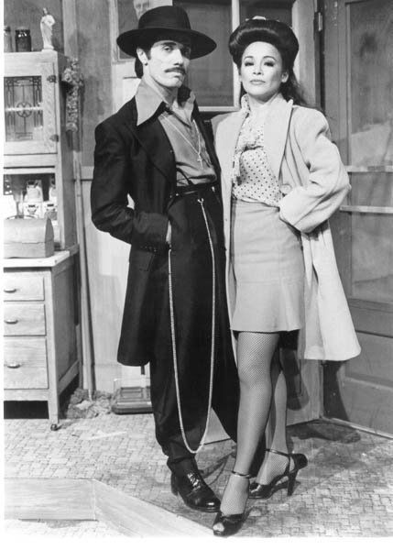
Minorities ~Mexican Americans~
Newsweek June 21, 1943
“The Suit”
The zoot suit is distinctly something from the bottom drawer. Its origin is obscure although when its main features -- the pegged trousers and the long coat -- resemble those of suits of the early 1900's. Its creation has been attributed variously to a Negro busboy in Georgia, and to costumes Clark Gable wore in "Gone With the Wind." But no one actually knows -- or can prove -- where the zoot suit started. Harlem is its acknowledged gate to popularity, however, and there has flourished in all its glory the pleat, drape shape and stuff cuff. The War Production Board virtually banned it in March 1942, when it restricted the amount of material to be used in men's clothes, but the zoot suit has continued to thrive- mainly through the diligence of bootleg tailors.
As one result of the Los Angeles outbreak, the Federal government cracked down on this illicit trading in zoot suits. The War Frauds Division got an injunction forbidding one shop to sell any of the 800 zoot suits in stock. Claiming that the shopkeeper had contributed to "hoodlumism," agents said they had found that great numbers of zoot coats and pants were being made in New York and Chicago.
The question thus was whether the zoot suit could survive assaults by both the government and its men in uniform.
Scan the QR Code to hear the song “Zoot Suit” sung by the Andrew Sisters (YOTUBE)
Exhibit B

Slide 10
Minorities ~Mexican Americans~
In its most common form, the Zoot Suit included a long, baggy coat with large shoulder pads and wide lapels. Its narrow, reet-pleated peg pants buttoned high--and were sometimes accompanied by a fancy vest. A long chain loop dangled from the belt. Often, a pancake hat with ostrich feather topped off the outfit. A typical Zoot Suit cost its wearer $45 to $75, which was no small sum in the lean war years of the early '40s
Exhibit C
Breaking News
On the night of June 3rd, 1943, as American men of all ethnicities shipped off to service in World War II, the city of Los Angeles witnessed a violent racist outbreak when a group of fifty sailors ran through the streets viciously targeting and attacking Mexican-American youths wearing zoot suits. Deemed to be provocatively flaunting their lack of patriotism by wearing such flamboyant garb during wartime, the victims were stripped, beaten and urinated upon. Their clothing was ritualistically burned. For nearly two weeks, thousands of servicemen joined in the hunt for young zooters, fueled by a racist local press that lauded the “cleansing” of “miscreants” and “hoodlums”. A few days into the riots, the city council banned the wearing of zoot suits – not to protect the victims, but because they were a “badge of hoodlumism.” Soon civilians were joining in on the attacks. The Los Angeles Police Department, meanwhile, turned a blind eye to the attacks and instead indiscriminately arrested hundreds of Mexican-American youths. The rampage stopped only when the army and navy commanders in Southern California took seriously what had become a national crisis and confined military men to their bases. The so-called Zoot Suit Riots would expose the polarization between White America and the growing Mexican-American community, and intensify national wartime anxieties which perceived all non-whites as a threat to homeland security.
Source: Onthisdeity.com

Slide 11
Mexican Americans
Why were Mexican American men coming into the United States in large numbers during WWII? (Exhibit A)
Describe the Bracero Program. (Exhibit A)
Based on the pictures in Exhibit A, what conditions did Mexican Americans experience during the Bracero Program?
Describe a Zoot Suit. (Exhibit Suit B and C)
What was the tone and message of the song in Exhibit B.
Why did the War Productions Board ban the Zoot Suit I 1942? (Exhibit B)
What was the motivation and effect of the Zoot Suit Riots on the United States? (Exhibit C)

Slide 12
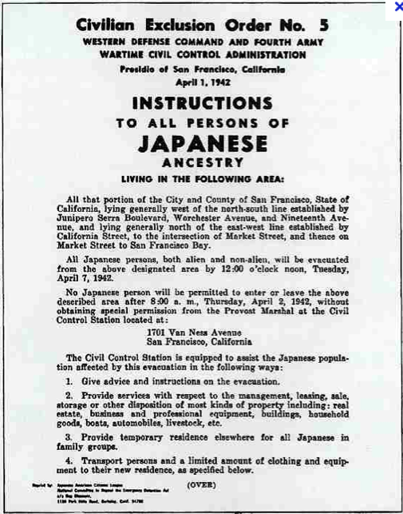
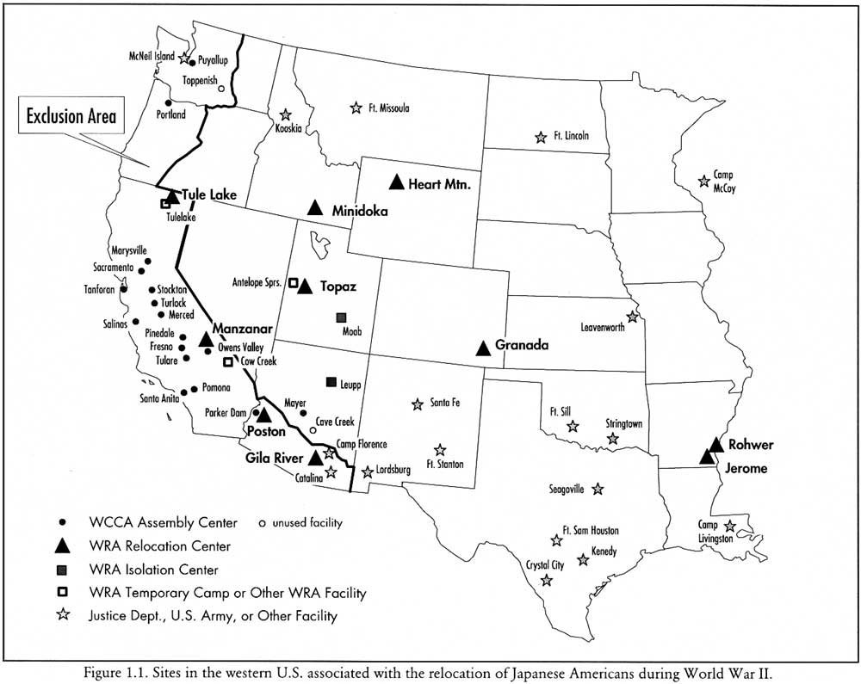
Minorities ~Japanese Americans~
Exhibit A

Slide 13
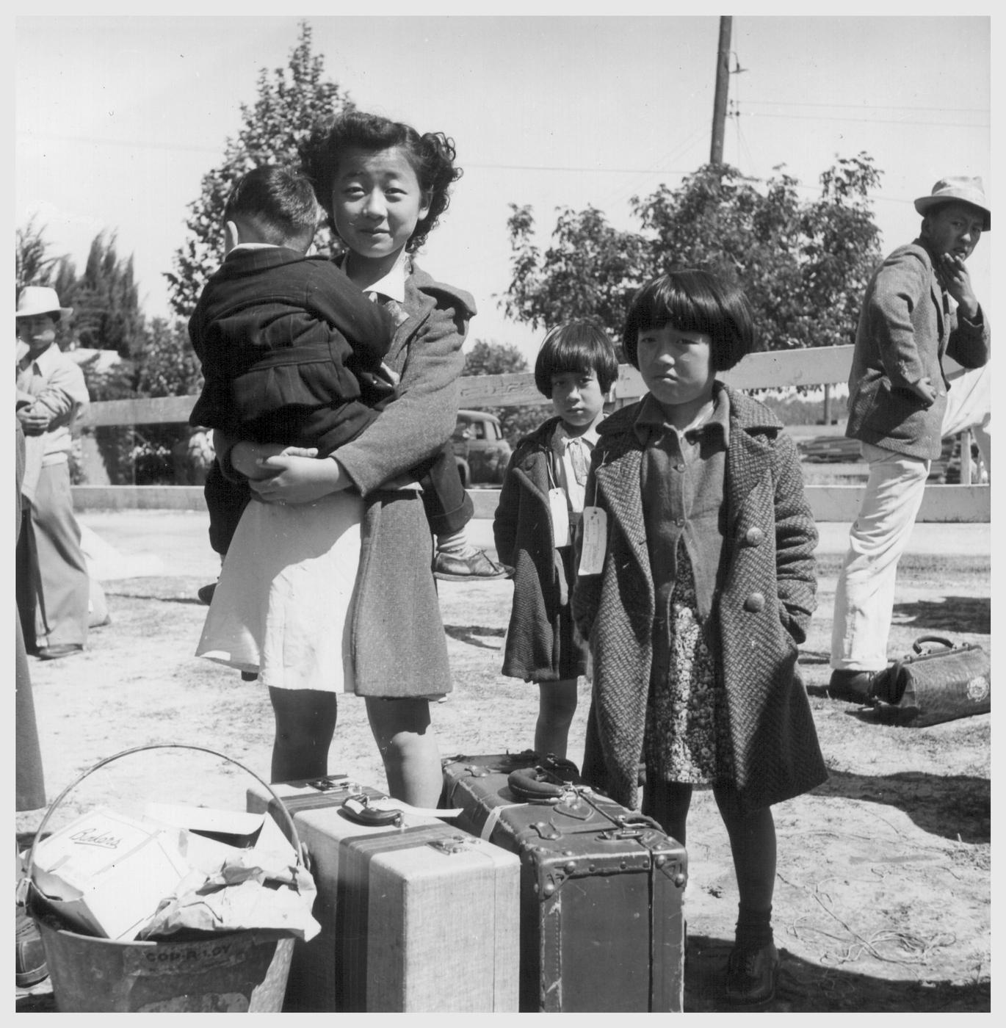
Minorities ~Japanese Americans~
Exhibit B
Background: On December 7, 1941 the United States was attacked by the Japanese at Pearl Harbor, Hawaii. As a result, Japanese Americans were placed into internment camps. Listen to our story….
Scan the QR code or go to tellingstories.org/internment to listen and watch Japanese Americans tell about their internment experiences.

Slide 14
Japanese Americans
Describe the Exclusion Order in Exhibit A. What type of document was it, who wrote it, who was the audience, purpose etc.)
What was the purpose of the map in Exhibit A?
Listen/read the stories from 2 different Japanese Americans in Exhibit B. What were their internment experiences? How were they the same? How did they differ?

Slide 15
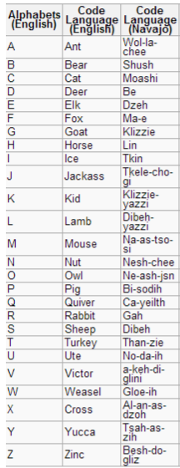
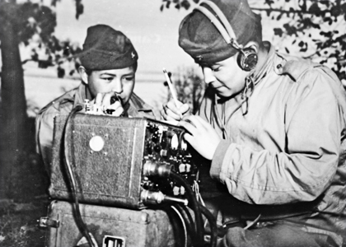
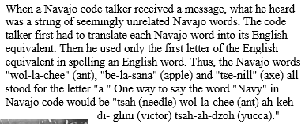
Minorities ~Native Americans~
Decipher this code:
Nes-chee/ Wol-la-chee/ a-keh-di-glini/ Wol-la-chee/ Tkele-cho-gi/ Ne-ash-jsn/ Moashi/ Ne-ash-jsn/ Be/Dzeh/ Gloe-ih/Wol-la-chee/Dibeh/ No-da-ih/Nesh-chee/Shush/Gah/ Dzeh/Wol-la-chee/ Klizzie-yazzi/Wol-la-chee/Shush/Dibeh-yazzi/Dzeh
Scan the QR code or go to YOUTUBE: The last original code talker
How did the Code work?

Slide 16
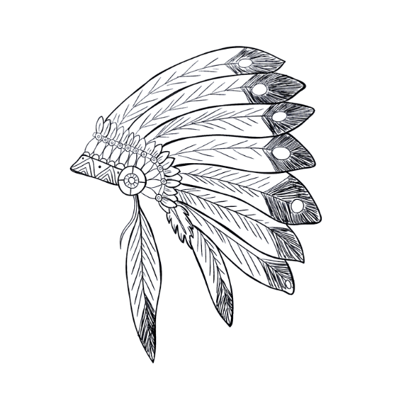
Native Americans
1) What unique contribution to the war effort did the Navajo Code Talkers make during WWII?
2) Did the Navajo Code consist of only the Navajo language?
3) How were Native Americans, like the Navajo, treated before and after the war?
4) Why were the Navajo willing to fight for the United States during WWII?
5) Crack the Code! Use the Code Breaker in the exhibit to decipher the secret message in this exhibit.

Slide 17
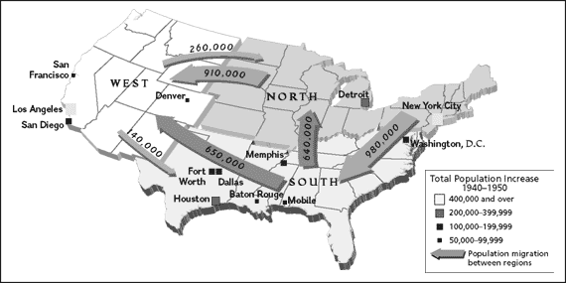
~Movement of Americans~
Scan the QR Code or go to: http://geography.about.com/od/specificplacesofinterest/a/sunbelt.htm

Slide 18
Movement of Americans
Draw a quick sketch of the United States Map and label the Sunbelt Region and Rustbelt Region.
Why were military manufacturing jobs moving from the Rust Belt to Sun Belt during WWII?
Using the map in the exhibit, explain which region experienced the most growth during the 1940’s. Which region experienced the least growth?

Slide 19
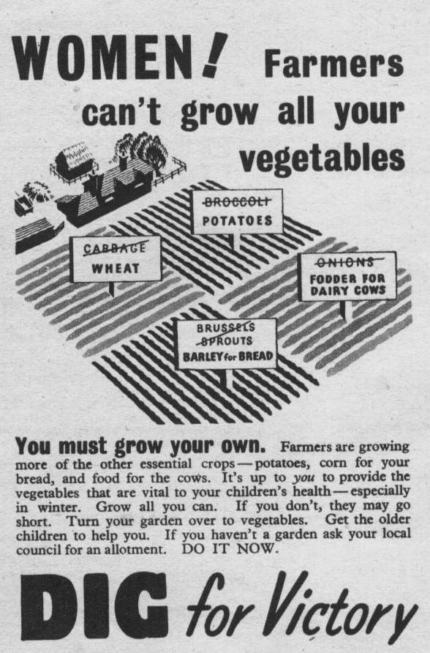
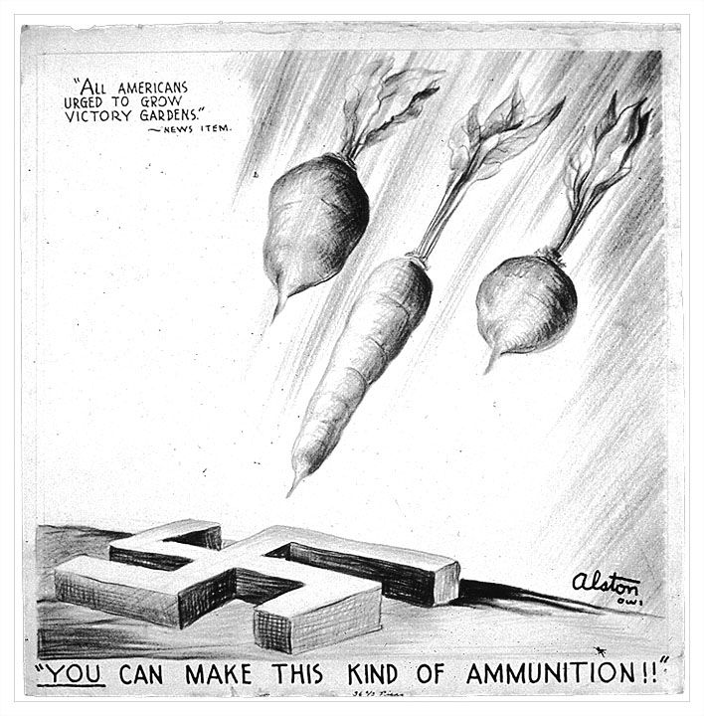
~ American Families Pitch In~

Slide 20
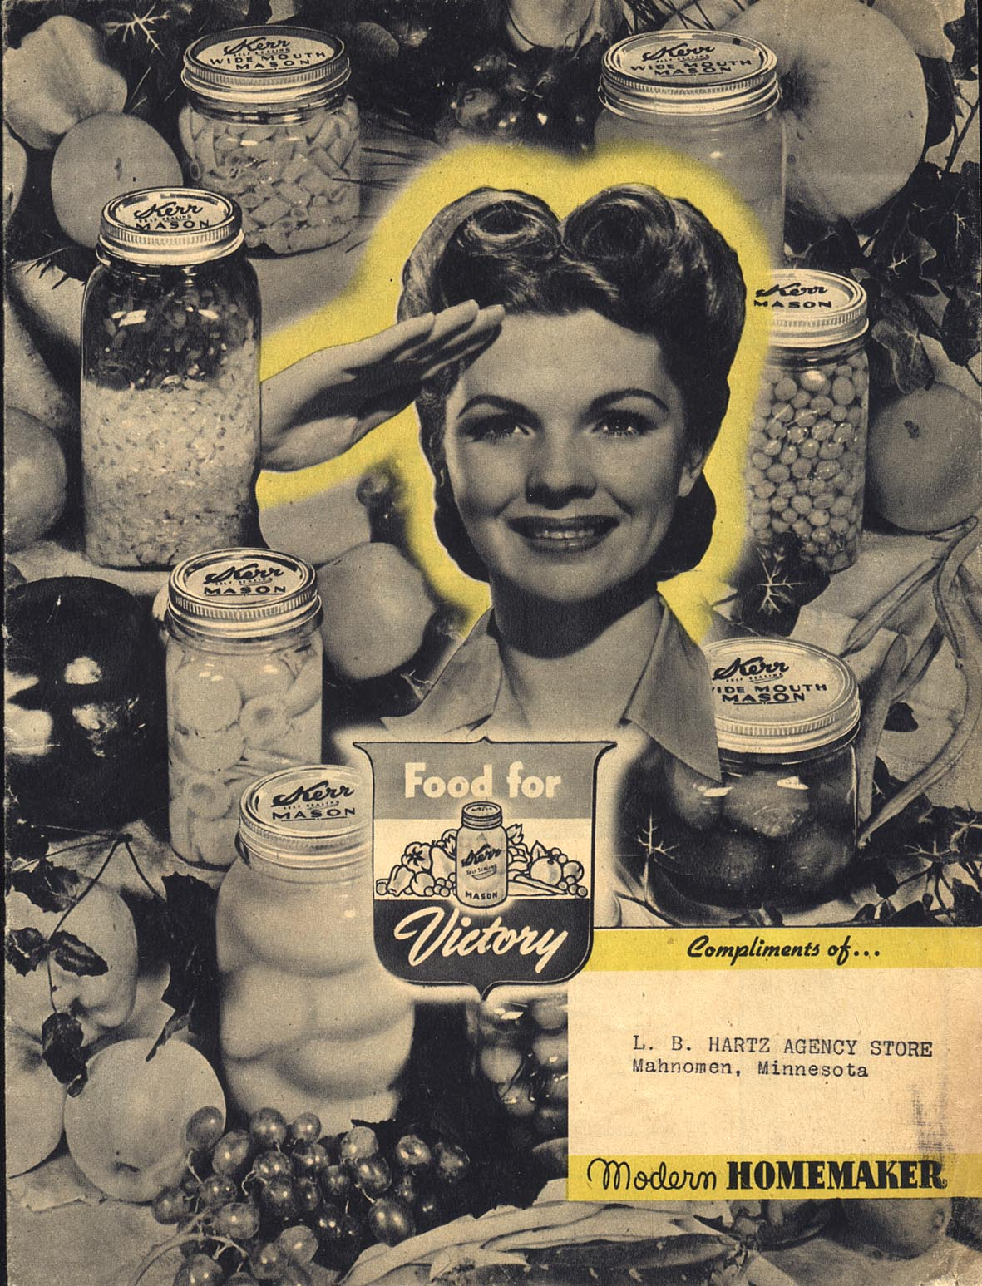
~ American Families Pitch In~
During World War II, Victory Gardens were planted by families in the United States to help prevent a food shortage.
Planting Victory Gardens helped make sure that there was enough food for our soldiers fighting around the world. Because canned vegetables were rationed, Victory Gardens also helped people stretch their ration coupons (the amount of certain foods they were allowed to buy at the store).
Many different types of vegetables were grown-such as tomatoes, carrots, lettuce, beets, and peas.
At their peak there were more than 20,000,000 Victory Gardens planted across the United States.
By 1944 Victory Gardens were responsible for producing 40% of all vegetables grown in the United States. More than one million tons of vegetables were grown in Victory Gardens during the war.
People with no yards planted small Victory Gardens in window boxes and watered them through their windows. Some city dwellers who lived in tall apartment buildings planted rooftop gardens and the whole building pitched in and helped.
Many schools across the country planted Victory Gardens on their school grounds and used their produce in their school lunches.
Source: National WWII Museum

Slide 21
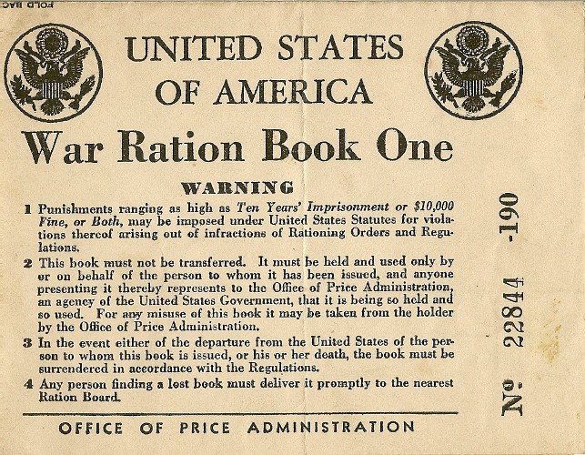
~ American Families Pitch In ~
Rationing for the War Effort
Ask anyone who remembers life on the Home Front during WWII about their strongest memories and chances are they will tell you about rationing. You see, the war caused shortages of all sorts of things: rubber, metal, clothing, etc. But it was the shortages of various types of food that effected just about everyone on a daily basis.
Food was in short supply for a variety of reasons: much of the processed and canned foods was reserved for shipping overseas to our military and our Allies; transportation of fresh foods was limited due to gasoline and tire rationing and the priority of transporting soldiers and war supplies instead of food; imported foods, like coffee and sugar, was limited due to restrictions on importing.
Because of these shortages, the U.S. government’s Office of Price Administration established a system of rationing that would more fairly distribute foods that were in short supply. Every American was issued a series of ration books during the war. The ration books contained removable stamps good for certain rationed items, like sugar, meat, cooking oil, and canned goods. A person could not buy a rationed item without also giving the grocer the right ration stamp. Once a person’s ration stamps were used up for a month, she couldn’t buy any more of that type of food. This meant planning meals carefully, being creative with menus, and not wasting food. More than 8,000 ration boards across the country administered the program.
Source: National WWII Museum

Slide 22
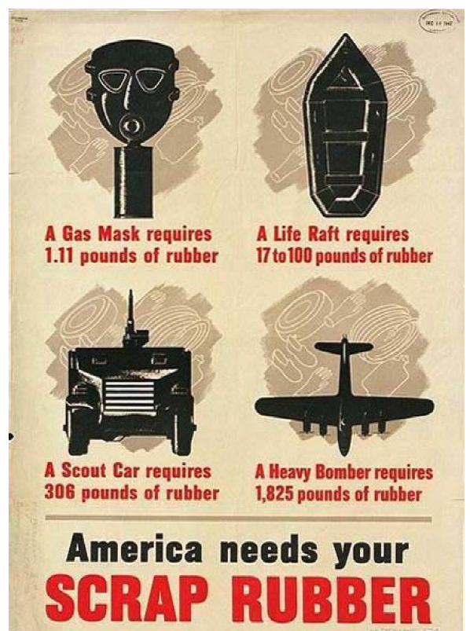
~ American Families Pitch In~
In 1940, Franklin Roosevelt, calling rubber a “strategic and critical material,” creates the Rubber Reserve Company (RRC), to stockpile natural rubber and regulate synthetic rubber production. Firestone, B.P. Goodrich, Goodyear, and U.S. Rubber agree to work together to solve the nation’s wartime rubber needs.
During the war, Americans are encouraged by the government to conserve rubber, contribute to scrap rubber drives, and abide by rationing regulations for tires, shoes, and other rubber products.
Source: National WWII Museum

Slide 23
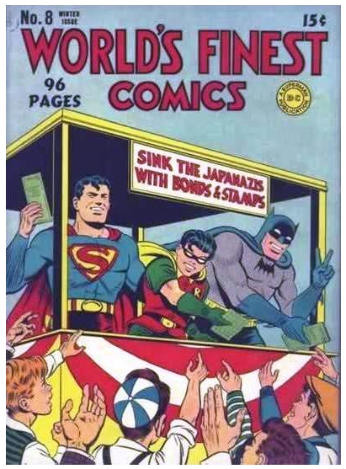
~ American Families Pitch In~
War Bonds for the War Effort
War is expensive. World War II was very expensive. The United States spent more than $300 billion fighting the Axis Powers and supplying our Allies—that equals more than $4 trillion today! To help fund this effort, the government turned to ordinary Americans. The United States Treasury offered Americans a series of War Bonds they could purchase during the war. A War Bond was both an investment in one’s country and an investment in one’s own financial future. Here’s how it worked:
You could purchase a $25 War Bond for $18.75. The government would take that money to help pay for tanks, planes, ships, uniforms, weapons, medicine, food, and everything else the military needed to fight and win. That’s the investment in your country. Ten years from the time you purchased your War Bond you could redeem it and get $25. That’s the investment you made in your own financial future. Now, $6.25 may not sound like a lot, but most Americans bought more than just $18.75 worth of War Bonds.
Everywhere they went Americans were encouraged to help support the war effort by purchasing War Bonds. Posters picturing Uncle Sam or a soldier on the battlefield implored people to do they part. Celebrities like Bob Hope, Frank Sinatra, Bette Davis, and Marlene Dietrich, traveled the country putting on live shows or radio programs promoting War Bond sales. Children did their part, too, purchasing .25¢ War Stamps to paste into War Bond booklets. Schools held their own War Bond drives and students would bring in nickels, dimes, and quarters to see if their school could out-raise other schools. Even Superman, Batman, Bugs Bunny, and other cartoon characters got into the spirit, reminding young people that “we’re all in this together.”
Source: National WWII Museum

Slide 24
American Families Pitch In
In what 4 specific ways were Americans encouraged to help the United States in the war effort according to the exhibit?
What was the purpose of planting a Victory Garden- how did a garden “beat” the Nazis?
If you did not have space to plant a Victory Garden, what could you do?
What items were rationed during WWII?
After a person used up their ration stamps for the month how did they get food or other rationed items?
Why was Rubber a precious material during WWII?
Explain the process of purchasing a war bond. How did you purchase one? How did you redeem it later?
How did the government “advertise” the sale of war bonds?

Slide 25
Building up the Army
The Draft and WWII
On September 16, 1940, the United States instituted the Selective Training and Service Act of 1940, which required all men between the ages of 21 and 45 to register for the draft. This was the first peacetime draft in United States' history. Those who were selected from the draft lottery were required to serve at least one year in the armed forces. Once the U.S. entered WWII, draft terms extended through the duration of the fighting. By the end of the war in 1945, 50 million men between eighteen and forty-five had registered for the draft and 10 million had been inducted in the military.
Source: National WWII Museum
Scan the QR code or go to YOUTUBE:FDR at the Selective Service Draft Lottery, October 1940 to watch the video.

Slide 26
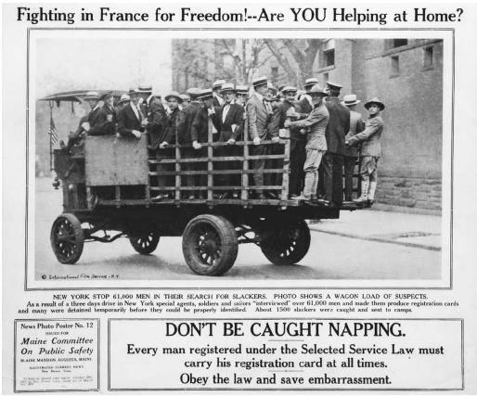
Building up the Army

Slide 27
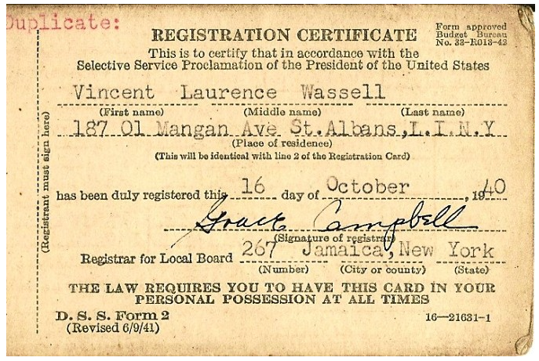
Building up the Army
What did the Selective Service and training Act do?
2) What was unique about the draft in 1940?
3) What was the overall message of President Roosevelts speech that you heard in this exhibit?
4) Who was the first soldier drafted in WWII according to the video clip?

Slide 28
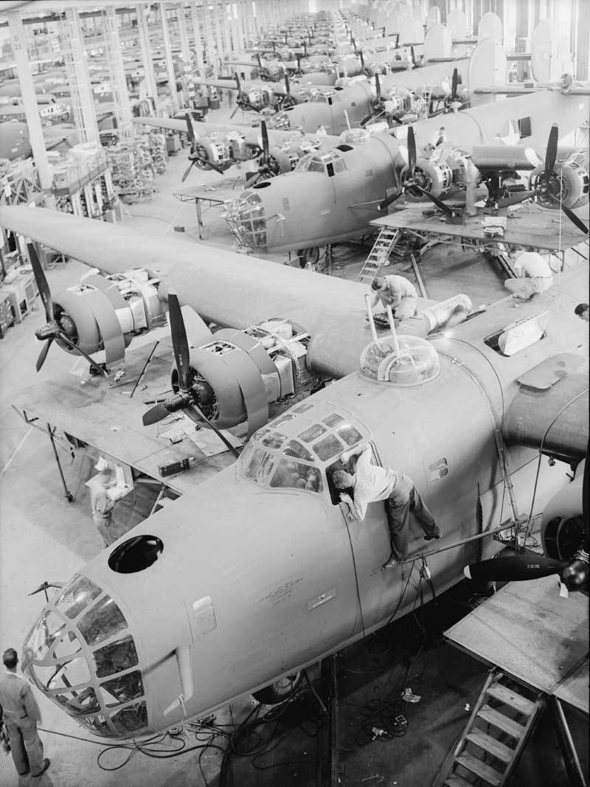
“The most important single task before the nation is the rapid conversion of the automobile industry to war production.”
American Factories
Scan the QR code
or go to YOUTUBE:
Frigidaire Military Production during WW2
*Only watch the first 6 minutes*

Slide 29
What were the 2 “battlefronts” of WWII according to the video?
What was unique about the Frigidaire Factory making 50 caliber machine guns?
What did the Axis not expect from American Factories?
Describe the process of factory conversion during the 1940’s. List at least 4 steps involved.
American Factories

Slide 30
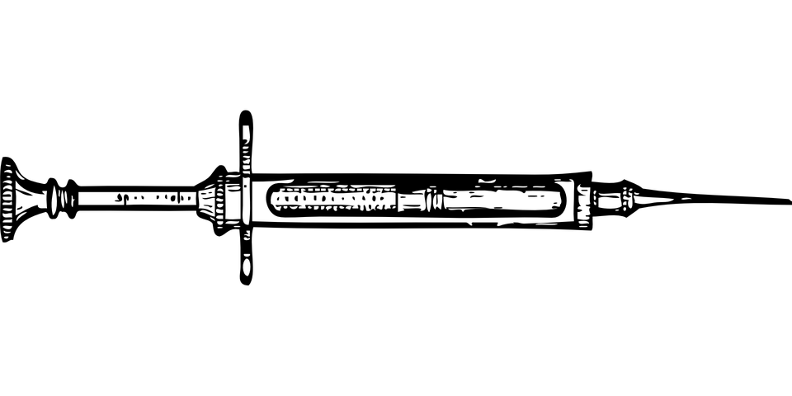
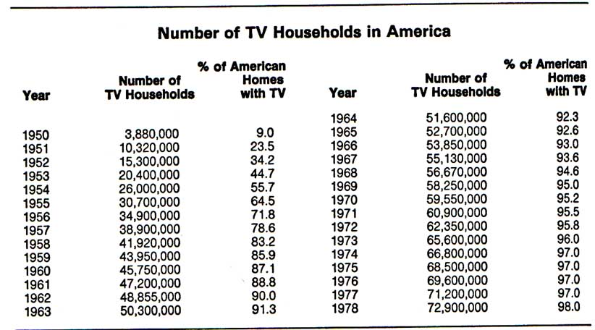
Scan the QR code to go to the following website:
http://nnwwiim.org/images/sci-tech-wwii-poster.pdf
Advances in Technology
The number of homes with TVs increased from 0.4 percent in 1948 to 55.7 percent in 1954 and to 83.2 percent four years later. No other household technology, not the telephone or indoor plumbing, had ever spread so rapidly into so many homes. And TV had absorbed evenings that had once been spent reading, listening to the radio, or going to the movies. By the mid-1950s, wrote Leo Bogart, TV's first historian, "Television had established its place as the most important single form of entertainment and of passing the time.“
Source: James L. Baughman University of Wisconsin, Madison

Slide 31
According to the infographic, what life-saving medical advance was used during WWII and is still used today?
Today’s white boards and video games are the descendants of what WWII technological advance?
What WWII advance continues to threaten world security today? Why?
Why were electronic digital computers first developed?
What effect has DDT had on the environment?
What WWII era technology has spread the most rapidly through American homes?
According to the chart in the exhibit, how much has the percentage of households with TV’s increase from 1950?
Advances in Technology

