Slide 1
The Gilded Age:
Captain of Industry or Robber Baron
Background: During the late 1800’s, men like Andrew Carnegie, John D. Rockefeller, and J.P. Morgan were accused of using unfair business tactics to reap large profits and put their competitors out of business. However these men were also known for giving away fortunes most men could only dream about. These Captains of Industry, defended their vast wealth by pointing to the philanthropy in which they were engaged.
What is a Robber Baron?
During the American Industrial Revolution, the term Robber Baron, was used to describe a person who made, what some considered, excessive amounts of money in business. It was an insulting term used for a person who was thought to have used unfair business practices and showed little empathy for the common factory worker. If this industrialist used his political and corporate influence for his own selfish ends, he could be described as a robber baron.
What is a Captain of Industry (Philanthropist)?
The men that used ingenious business methods to create monopolies and vast wealth were also known as Captains of Industry because they exhibited leadership in their field and commanded the respect of the business world. Often times these Captains of Industry gave back their communities by participating in philanthropy. Men like Carnegie, were often known for their large contributions for projects of public benefit like libraries.
Assignment Directions:
Read the “Who were Carnegie, Rockefeller and Morgan?” summary enclosed.
Read each Primary Source document, A- H. Ask yourself: Does this document portray Carnegie, Rockefeller and Morgan as Captains of Industry or Robber Barons?
Complete the portion of the DBQ Document Analysis Chart allocated to each Primary Source document.
Assessment: Answer the following question, using information from the primary source documents to support your response,
“Were Andrew Carnegie, John D. Rockefeller, and J.P. Morgan- Captains of Industry or Robber Barons?”

Slide 2
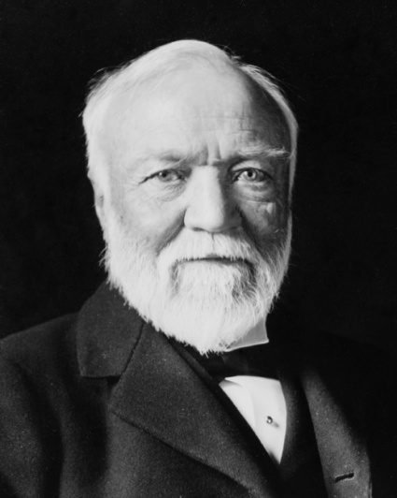
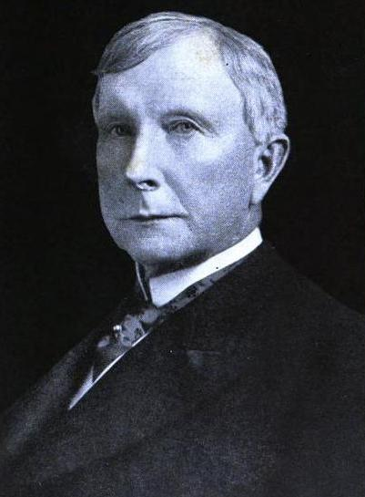
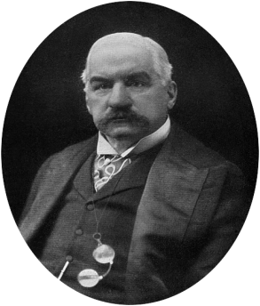
Who were Carnegie, Rockefeller and Morgan?
At the end of the 19th century, America was experiencing rapid industrialization and
tremendous change. Many entrepreneurs were able to go from rags to riches using what
many considered to be unfair business tactics. Who were some of these men?
Andrew Carnegie was actually a Scottish immigrant who moved to America when
he was 12. Initially Carnegie worked in a cotton mill and because of his strong work
ethic he eventually became the assistant of a railroad superintendent. Eventually
Carnegie became known for the production of steel and slowly began to beat his
competition by making a cheaper and better product. Carnegie was able to
monopolize (take total control of a certain industry or business) the steel industry from
1889 to around 1901 when he sold his business to J.P. Morgan, the U.S.’s most
prominent banker.
John D. Rockefeller was also born to a poor family and was a native of New York.
Rockefeller built his first oil refinery in 1863 and over time was able to beat out his
competitors and form a monopoly. His oil refining business was named Standard Oil
and by 1880 the trust (a legal body created to hold stock in many businesses)
controlled 95 % of all oil refining in the U.S.
J.P. Morgan became an accountant at the age of 20, and worked for several banking institutions
until he controlled his own company at the age of 35. His success was in reorganizing railroads,
consolidating electric, steel and agricultural manufacturing facilities. One of his reorganizations led
to the creation of U.S. Steel which became a billion dollar company.
Carnegie, Rockefeller and Morgan all became extremely wealthy and successful
businessmen but they were also known for their philanthropy. All three generously gave
millions of dollars to various charities, universities and public libraries over their lifetime.

Slide 3


Robber Baron or Captain of Industry: Document Set
Document A: Do not make riches, but usefulness,
your first aim; and let your chief pride
be that your daily occupation is in the line of
progress and development; that your work, in
whatever capacity it may be, is useful work,
honestly conducted, and as such ennobling to
your life.
To sum up, do not drink, do not smoke, do not
indorse, do not speculate. Concentrate, perform
more than your prescribed duties; be strictly
honest in word and deed. And may all who read
these words be just as happy and prosperous and
long lived as I wish them all to be. And let this
great fact always cheer them: It is impossible for
any one to be cheated out of an honorable career
unless he cheats himself.
Source: How to succeed in Life by Andrew
Carnegie

Slide 4
Document B:
There remains, then, only one mode of using great fortunes; but in this we have the true antidote for the temporary unequal distribution of wealth, the reconciliation of the rich and the poor-a reign of harmony-another ideal, differing, indeed, from that of the Communist in requiring only the further evolution of existing conditions, not the total overthrow of our civilization. It is founded upon the present most intense individualism, and the race is prepared to put it in practice by degrees whenever it pleases. Under its sway we shall have an ideal state, in which the surplus wealth of the few will become, in the best sense, the property of the many, because administered for the common good; and this wealth, passing through the hands of the few, can be made a much more potent force for the elevation of our race than if it had been distributed in small sums to the people themselves. Even the poorest can be made to see this, and to agree that great sums gathered by some of their fellow-citizens and spent for public purposes, from which the masses reap the principal benefit, are more valuable to them than if scattered among them through the course of many years in trifling amounts.
This, then, is held to be the duty of the man of wealth: First, to set an example of modest, unostentatious living, shunning display or extravagance; … and, after doing so, to consider all surplus revenues which come to him simply as trust funds, which he is called upon to administer… to produce the most beneficial results for the community—the man of wealth thus becoming the mere trustee and agent for his poorer brethren, bringing to their service his superior wisdom, experience and ability to administer, doing for them better than they would or could do for themselves."
Source: "Wealth," by Andrew Carnegie,(1889) EXCERPTS

Slide 5
Document C: I myself was rich and also educated, and possessed, therefore, all the elements of happiness enjoyed by the most fortunate in that age. Living in luxury, and occupied only with the pursuit of the pleasures and refinements of life, I derived the means of my support from the labor of others, rendering no sort of service in return. My parents and grand-parents lived in the same way, and I expected that my descendants, if I had any, would enjoy a like easy existence.
. . . This mystery of use without consumption, of warmth without combustion, seems like magic, but was merely an ingenious application of the art now happily lost but carried to a great perfection by your ancestors, of shifting the burden of one's support on the shoulders of others. The man who had accomplished this, and it was the end all sought, was said to live on the income of his investments. . . . I shall only stop now to say that interest on investments was a species of tax in perpetuity upon the product of those engaged in industry which a person possessing or inheriting money was able to levy.
Document : D "Meanwhile, without being in the smallest degree checked by the clamor against it, the absorption of business by ever larger monopolies continued. In the United States there was not, after the beginning of the last quarter of the century, any opportunity whatever for individual enterprise in any important field of industry, unless backed by great capital. During the last decade of the century, such small businesses as still remained were fast-failing survivals of a past epoch. . . . The railroads had gone on combining till a few great syndicates controlled every rail in the land. In manufactories, every important staple was controlled by a syndicate. These syndicates, pools, trusts, or whatever their name, fixed prices and crushed all competition except when combinations as vast as themselves arose. Then a struggle, resulting in still greater consolidation, ensued.
The movement toward the conduct of business by larger and larger aggregations of capital, the tendency toward monopolies, which had been so desperately and vainly resisted, was recognized at last, in its true significance, as a process which only needed to complete its logical evolution to open a golden future to humanity.
"Early in the last century the evolution was completed by the final consolidation of the entire capital of the nation. The industry and commerce of the country, ceasing to be conducted by a set of irresponsible corporations and syndicates of private persons at their caprice and for their profit, were intrusted to a single syndicate representing the people, to be conducted in the common interest for the common profit. The nation, that is to say, organized as the one great business corporation in which all other corporations were absorbed. . "
Source: Edward Bellamy, from Looking Backward (1888) EXCERPTS

Slide 6

Document E:
This truth involves both a menace and a promise. It shows that the evils arising from the unjust and unequal distribution of wealth, which are becoming more and more apparent as modern civilization goes on, are not incidents of progress, but tendencies which must bring progress to a halt; that they will not cure themselves, but, on the contrary, must, unless their cause is removed, grow greater and greater, until they sweep us back into barbarism by the road every previous civilization has trod. But it also shows that these evils are not imposed by natural laws; that they spring solely from social maladjustments which ignore natural laws, and that in removing their cause we shall be giving an enormous impetus to progress.
The reform I have proposed accords with all that is politically, socially, or morally desirable. It has the qualities of a true reform, for it will make all other reforms easier. What is it but the carrying out in letter and spirit of the truth enunciated in the Declaration of Independence—the "self-evident" truth that is the heart and soul of the Declaration—"That all men are created equal; that they are endowed by their Creator with certain unalienable rights; that among these are life, liberty, and the pursuit of happiness!"
These rights are denied when the equal right to land—on which and by which men alone can live—is denied. Equality of political rights will not compensate for the denial of the equal right to the bounty of nature. Political liberty, when the equal right to land is denied, becomes, as population increases and invention goes on, merely the liberty to compete for employment at starvation wages. This is the truth that we have ignored. And so there come beggars in our streets and tramps on our roads; and poverty enslaves men who we boast are political sovereigns; and want breeds ignorance that our schools cannot enlighten…
Source: Henry George from Progress and Poverty (1879) EXCERPT

Slide 7

Document F:
Our primary social adjustment is a denial of justice. In allowing one man to own the land on which and from which other men must live, we have made them his bondsmen in a degree which increases as material progress goes on. This is the subtile alchemy that in ways they do not realize is extracting from the masses in every civilized country the fruits of their weary toil; that is instituting a harder and more hopeless slavery in place of that which has been destroyed; that is bringing political despotism out of political freedom, and must soon transmute democratic institutions into anarchy.
It is this that turns the blessings of material progress into a curse. It is this that crowds human beings into noisome cellars and squalid tenement houses; that fills prisons and brothels; that goads men with want and consumes them with greed; that robs women of the grace and beauty of perfect womanhood; that takes from little children the joy and innocence of life's morning.
Source: Henry George, Progress and Poverty (1879) EXCERPT

Slide 8
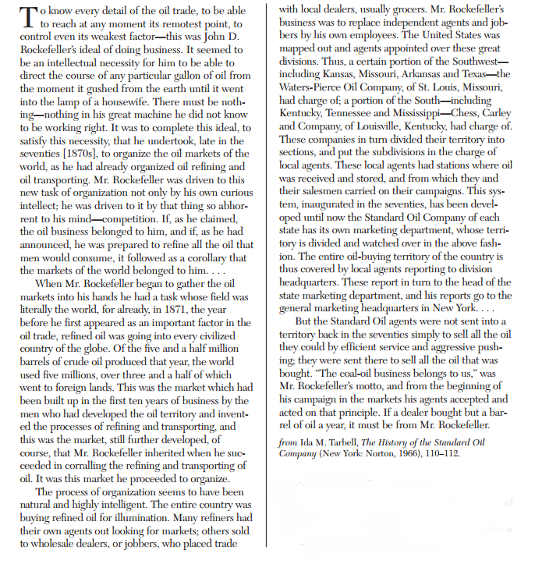
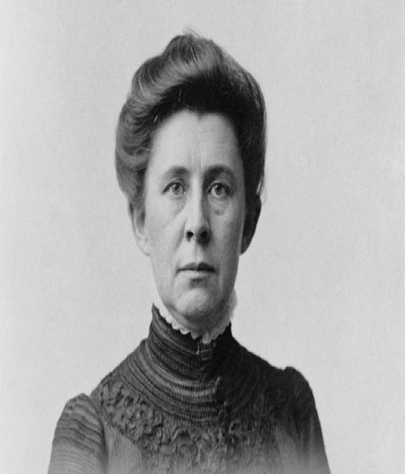

Document G:

Slide 9
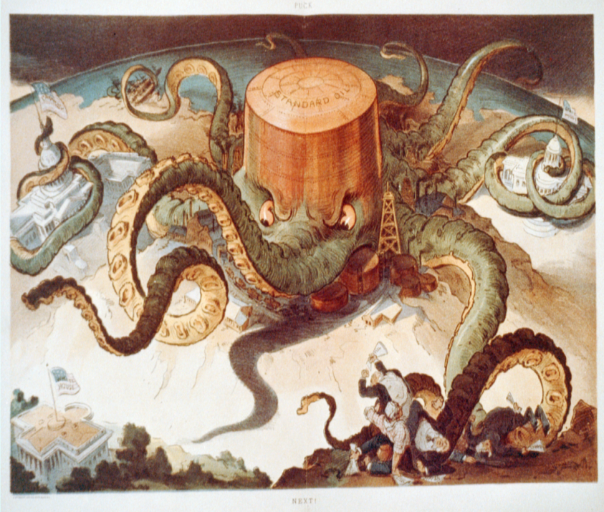
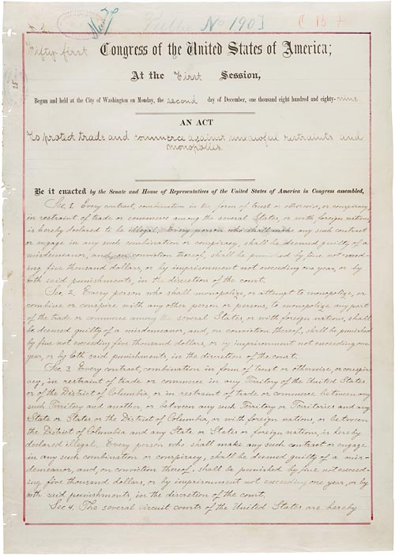
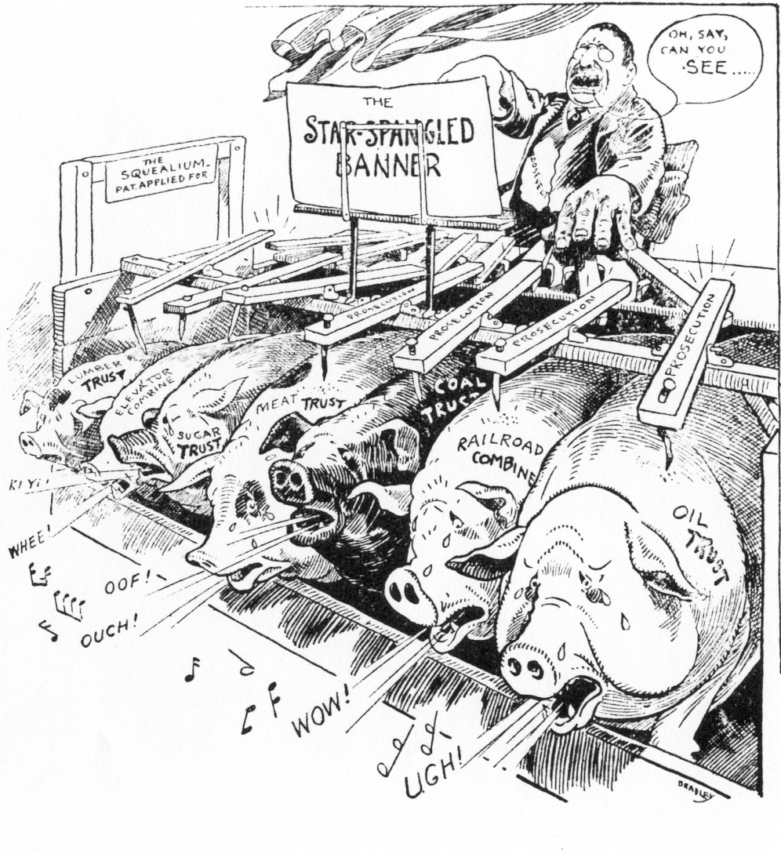
Document H:
Document H
Cartoon # 1 referencing Standard Oil (Rockefeller)
Source: From J. Ottmann Lith, Co., 1904 Sept. 7. Udo
Keppler Artist. Courtesy of the Library of Congress
Sherman Anti-Trust Act Excerpt:
An act to protect trade and commerce against unlawful restraints and monopolies.
Be it enacted by the Senate and House of Representatives of the United States of America in Congress assembled,
Sec. 2. Every person who shall monopolize, or attempt to monopolize, or combine or conspire with any other person or persons, to monopolize any part of the trade or commerce among the several States, or with foreign nations, shall be deemed guilty of a misdemeanor, and, on conviction thereof; shall be punished by fine not exceeding five thousand dollars, or by imprisonment not exceeding one year, or by both said punishments, in the discretion of the court.
Cartoon # 2 President Teddy Roosevelt’s Reaction to Trusts The Sherman Anti-Trust Act was approved on July 2, 1890.
Source: TR with Trusts, Library of Congress Source: Courtesy of the National Archives

Slide 10
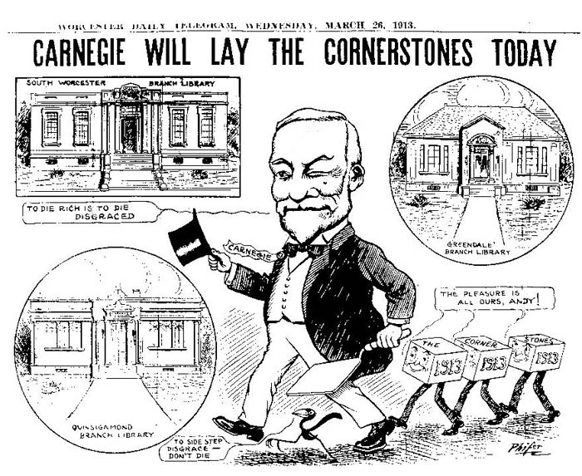
Document I
Source: http://apushindustrycomesofage.weebly.com/uploads/1/0/3/2/10328954/607321798.jpg

