Slide 2
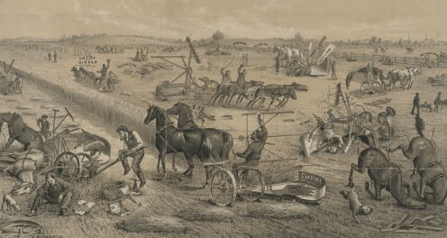
Drought
Crop/animal diseases
Expensive railroad costs
High tariffs
Framers unable to pay their mortgages
Falling prices for crops

Slide 3
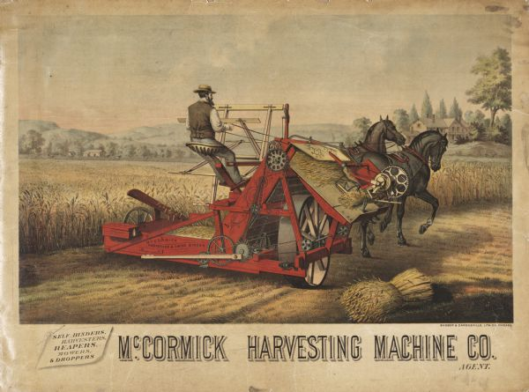
New technologies
Better farming methods
Greater crop yields
Too many farmers with a surplus
Prices fall
Farmers don’t make enough money
Notes:
McCormick Grain Binder Advertising Poster (1882)

Slide 4
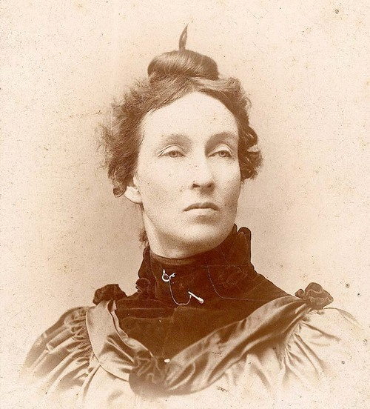
“What you farmers need to do is to raise less corn and more hell! We want the accursed foreclosure system wiped out! We will stand by our homes and stay by our firesides by force if necessary, and we will not pay our debts to the loan-shark companies until the Government pays its debts to us!”
- Mary Elizabeth Lease

Slide 5
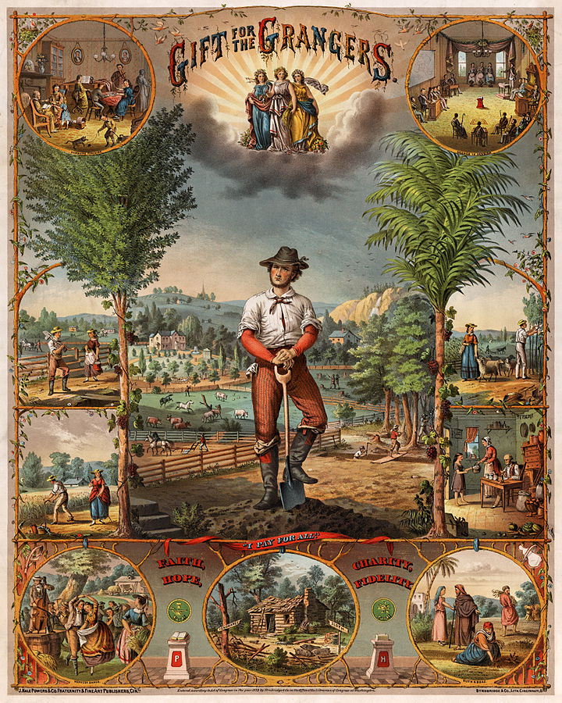
Farmers begin to organize
The Patrons of Husbandry is formed in 1867
Becomes known as the Grange
Other Farmers’ Alliances grow
Notes:
"Gift for the Grangers", 1873 print promoting U.S. farmers' organization. The upper left inset shows "Farmer's fireside" (scene of a farming family leading a rather middle-class lifestyle), upper right inset shows "Grange in session", Lower left inset shows "Harvest dance", lower center inset shows signposts of "Ignorance" and "Sloth" pointing towards broken-down cabin, and lower right inset shows Biblical scene of "Ruth and Boaz" (gleaners in the fields). The central scene shows a farmer with one foot on his shovel above the quote "I Pay for All."

Slide 6
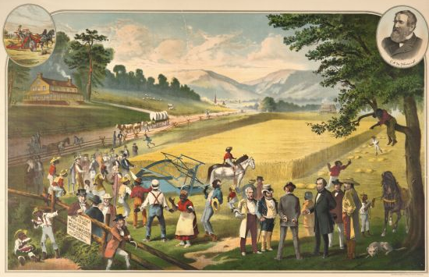
Populism took its name from a movement of the people
Begun in the Midwest in 1892
Goal was to help farmers get out of debt and give people a greater voice in government
Notes:
Image shows an advertisement of the testing the First Reaping Machine (1883)

Slide 7
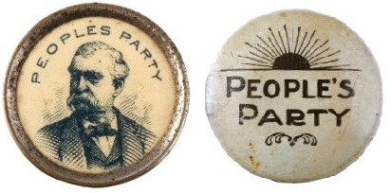
Increase the nation’s money supply
An 8-hour workday
A graduated federal income tax
Direct election of US Senators
Bimetalism

Slide 8
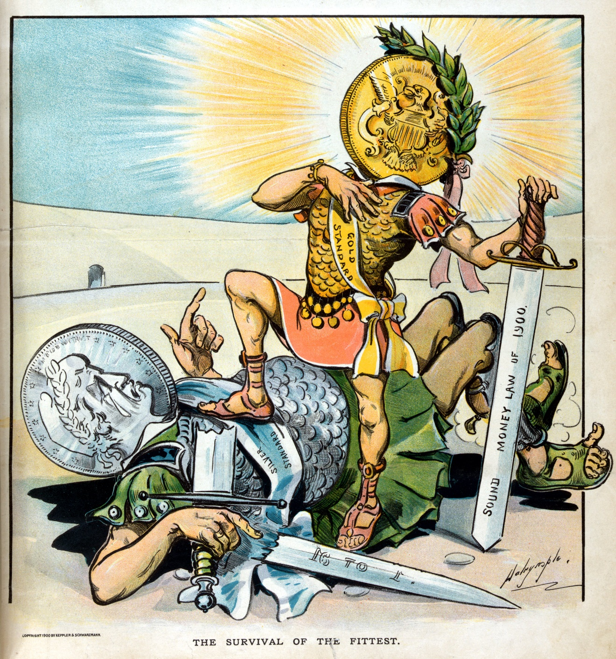
Debate was what would back US currency so that it wasn’t “worthless”
“Gold bugs” favored backing US currency only with gold
“Silverites” wished for gold and silver to be used so that more money would be available

Slide 9
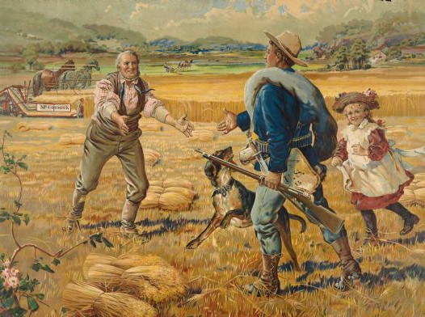
Farmers want to add more money into circulation
More money produces inflation
With inflation, prices are higher, and it will be easier for farmers to pay back loans
Farmers want the government to coin more silver – “free coinage”
Notes:
McCormick "Back from the War" Advertising Poster (1899)

Slide 10
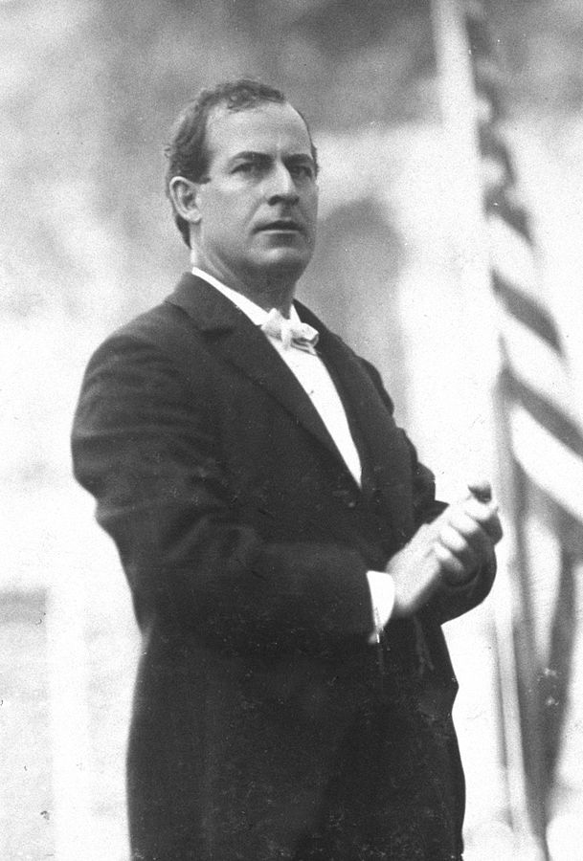
Democratic nominee for president in 1896
Backed by the Populists for his stance on bimetallism
At the 1896 Convention he gave a passionate “Cross of Gold” speech on the need for bimetallism and free silver coinage
Notes:
Photo shows the 36-year old William Jennings Bryan in 1896 as candidate after the fusion of the Democrats and the People's Party.

Slide 11
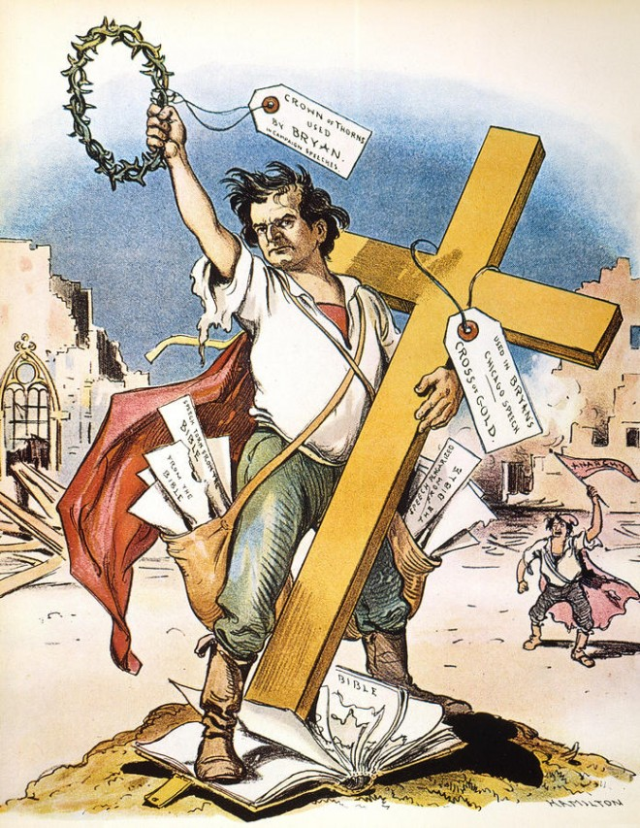
“Having behind us the producing masses of this nation and the world, supported by the commercial interests, the laboring interests, and the toilers everywhere, we will answer their demand for a gold standard by saying to them: You shall not press down upon the brow of labor this crown of thorns, you shall not crucify mankind upon a cross of gold.”
- William Jennings Bryan

Slide 12
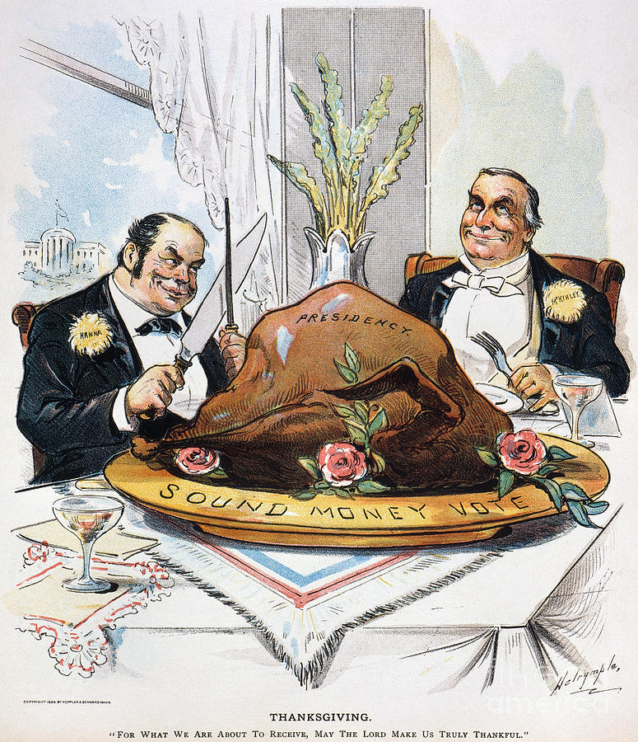
Urban voters feared bimetallism and higher prices for goods
Republican William McKinley supported the gold standard and has wide support
McKinley won the election & Populism became more a part of the Democratic Party
Notes:
Presidential election cartoon from 1896 showing William McKinley feasting on the “sound money vote”.

Slide 13
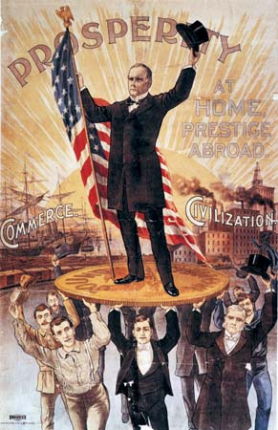
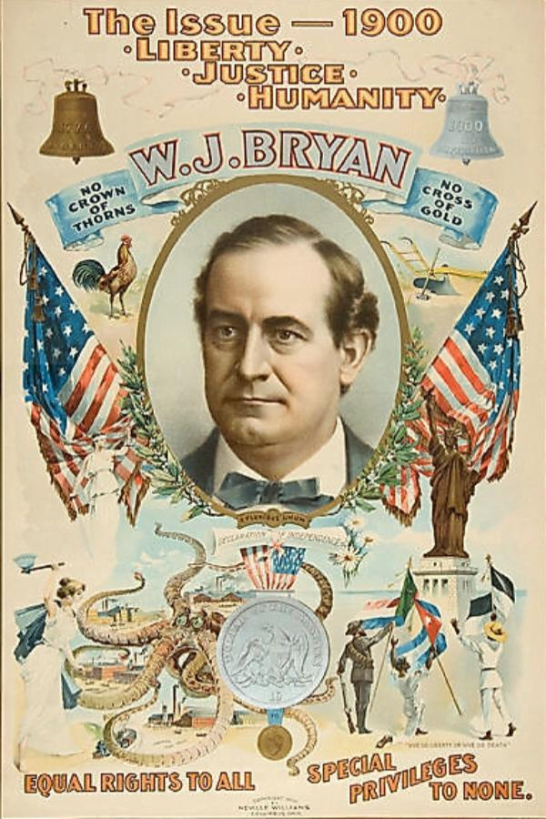
Notes:
Campaign posters from the 1896 election

Slide 14
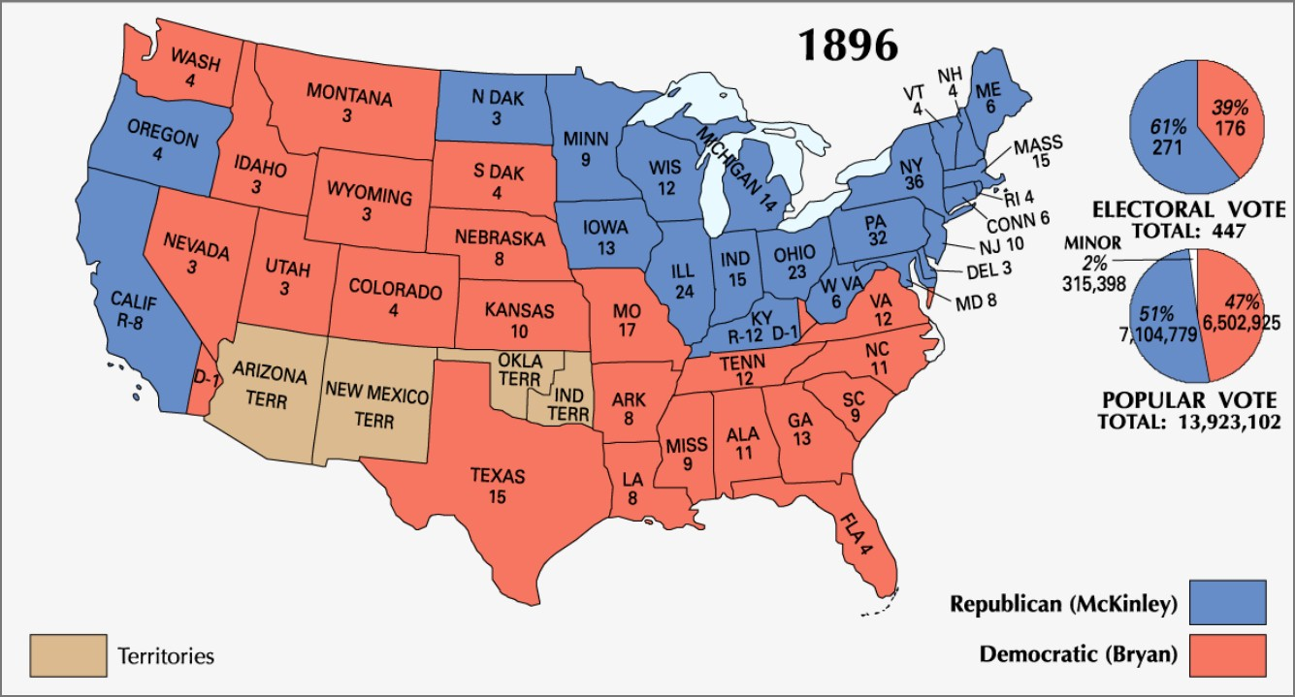

Slide 15
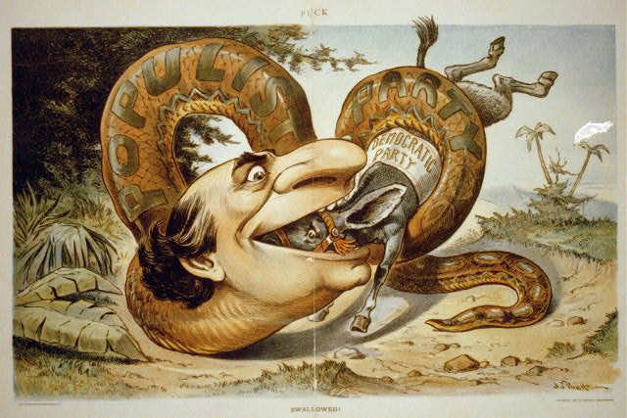
What is the message of this cartoon? What aspects of the Populist Party’s platform might appeal to non-farmers?
Notes:
Cartoon showing William Jennings Bryan and the Populist Party snake swallowing the Democratic Party. Cartoon from 1896.

