Slide 1
Ronald Reagan & George H. W. Bush

Slide 2
Increasing Conservatism
By 1980, Americans were becoming concerned with the amount of federal money being spent on entitlement programs, guaranteed benefits to particular groups.
The “New Right” reflected the growing numbers of people who opposed abortion, the Equal Rights Amendment, homosexuality, and busing for integration.
Many criticized Affirmative Action as being a policy that practices reverse racism, discriminating against white Americans.

Slide 3
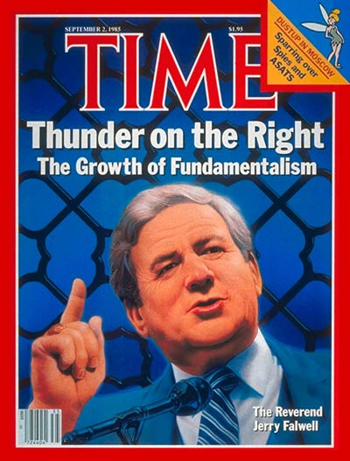
Increasing Conservatism
The Conservative Coalition was created as an alliance of business leaders, middle-class voters, isolated Democrats, and fundamentalist Christian groups.
Televangelists Jerry Falwell and Pat Robertson formed the Moral Majority, an organization of fundamentalist and evangelical Christians who believed in absolute standards of right and wrong based on the teachings of the Bible.
Jerry Falwell

Slide 4
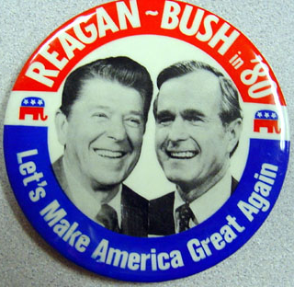
“The Great Communicator”
California Governor Ronald Reagan was the voice of conservative Americans who opposed Supreme Court decisions that legalized abortion, pornography, and teaching evolution.
Reagan and Texas Representative George H.W. Bush (VP) won the Election of 1980 against Jimmy Carter.
“Are you better off than you were four years ago?”

Slide 5
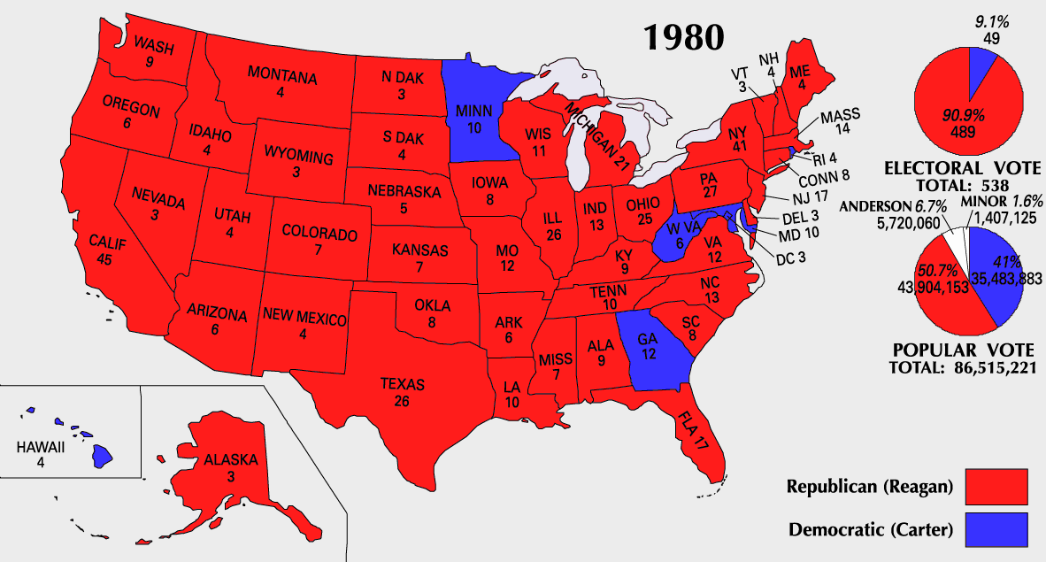
Election of 1980

Slide 6
Reaganomics
Reagan explained the poor state of the economy to the American people, and presented his 3-part plan: Reaganomics
Budget Cuts
Tax Cuts
Increased Defense Spending
These decisions were made to limit the power of the federal government, and encourage private investments.

Slide 7
Spending Cuts
The government reduced spending on social programs like school lunches, food stamps, student loans, welfare, and medicaid, but not medicare, social security, or veterans benefits.
The spending cuts did not affect all segments of the population equally.
Taxes were cut to improve the economy according to supply side economics, a theory that if people paid fewer taxes, they would save more money; banks would loan that money to businesses, which could invest in resources to improve productivity.

Slide 8
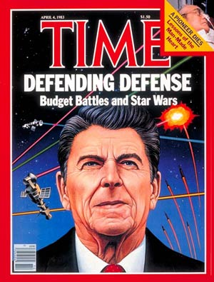
Increased Spending
Between 1981 and 1984 the Defense Department budget nearly doubled to strengthen the national defense, and it offset the cuts from social programs.
A lot of the money went towards the Strategic Defense Initiative, development of weapons that would keep Americans safe from enemy missiles.
This program was quickly nicknamed “Star Wars.”

Slide 9
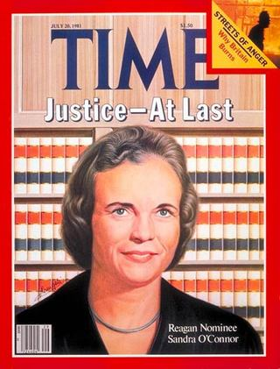
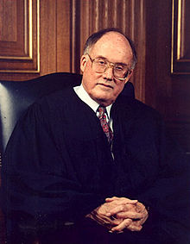
Changes in the Judiciary
Reagan nominated 4 conservatives to the Supreme Court, including the first female Supreme Court Justice Sandra Day O’Connor, to create the most conservative Supreme Court since FDR’s presidency.
In 1989 the Supreme Court ruled to limit a woman’s right to an abortion, restrict civil rights laws, and limit the rights of citizens under arrest.

Slide 10
Deregulating Industry
To further reduce the power of the federal government, Reagan practiced deregulation: cutting back federal regulation of industry.
Deregulation increased business competition, resulting in lower prices of consumer goods, but also resulted in over 1,000 bank failures due to corrupt management.
The budget of the EPA was also cut, easing pollution regulations to open land for oil drilling cutting timber in national forests.
Notes:
Examples of deregulation changes: Removed price controls on oil and eliminated federal health and safety inspections for nursing homes.

Slide 11
Reagan’s Support
Reagan earned the support of a coalition of conservatives:
Business people (Yderegulated industries), Southerners (Ylimited federal power), Westerners (Yresented land regulations), Reagan Democrats (Ydisagreed with liberal Democrats)
Reagan & Bush won the Election of 1984 against Walter Mondale and Geraldine Ferraro, the first female VP candidate.
George H.W. Bush won the Election of 1988 against Massachusetts Governor Michael Dukakis with the campaign slogan, “Read My Lips: No New Taxes.”
Notes:
Geraldine Ferraro – NY Representative

Slide 12
1980s Culture
Local governments took on the responsibility to provide healthcare, education, and safety to Americans while battling issues like abortion, drug abuse, and AIDS.
AIDS spread rapidly to destroy the immune system of anyone with the virus.
In July 1989, the Supreme Court ruled in Webster v. Reproductive Healthcare that states have the right to restrict abortion.
Reagan launched a War on Drugs and supported moves to prosecute users & dealers.

Slide 13
Education
A Nation At Risk was published, and revealed that American students lagged behind students in other industrialized nations. A commission recommended more homework, longer school days, and an extended school year.
In April 1991 President Bush recommended that parents should be given public funds, or vouchers, to send their children to private or religious schools.

Slide 14
Reagan & the Cold War
The new leader of the Communist Party in the Soviet Union was Mikhail Gorbachev, who advocated two ideas:
Glasnost: Tolerated open criticism of Soviet government.
Perestroika: Restructuring of Soviet society.
In 1988, the U.S. signed Gorbachev’s INF Treaty to eliminate two classes of weapons systems & allow nations to inspect the other’s military installations.
President Bush announced the official end to the Cold War in 1992 with Russian President Boris Yeltsin, and they signed the START II Pact to cut nuclear weapons.

Slide 15
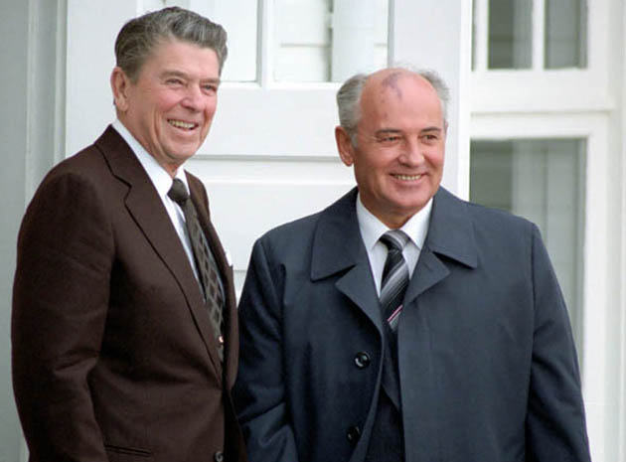
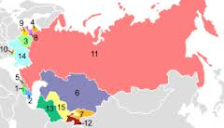
The End of Communism in Eastern Europe
In October 1989, East Germany opened the Berlin Wall, allowing Berliners to destroy parts of the wall and pass through to West Berlin for the first time in 28 years.
The Soviet Union dissolved into 15 states that were free to choose their own form of government.
1. Armenia, 2. Azerbaijan, 3. Belarus,
4. Estonia, 5. Georgia, 6. Kazakhstan,
7. Kyrgyzstan, 8. Latvia, 9. Lithuania,
10. Moldova, 11. Russia, 12. Tajikistan,
13. Turkmenistan, 14. Ukraine,
15. Uzbekistan

Slide 16
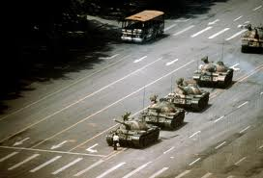
Communist China
China emphasized modernization, so they sent students to Western countries to learn new techniques.
In May of 1989, thousands of demonstrators occupied Tiananmen Square to call for democracy. After several days, troops and tanks were sent to disperse the crowds, causing thousands of casualties.

Slide 17
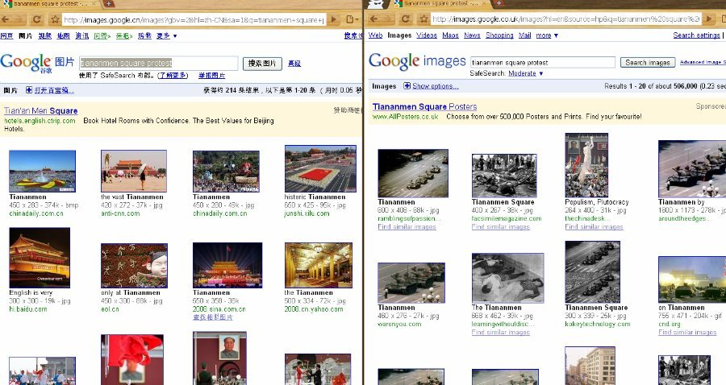
Censorship in China

Slide 18
Reagan & Nicaragua
In Nicaragua, the U.S. had helped a dictator, Somoza, gain power. President Carter recognized a Sandanista government established upon the overthrow of Somoza’s government, and provided money to the new regime.
Cuba & the Soviet Union also sent money to help, and President Reagan accused Nicaragua of supporting other Central American Revolutions.
Reagan withdrew support from Sandanistas to help the rebel Contras. Without Congressional approval, Americans directed operations to help the Contra Army.
The Boland Amendment banned military aid to the Contras.

Slide 19
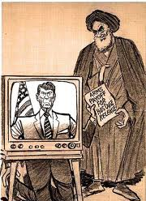
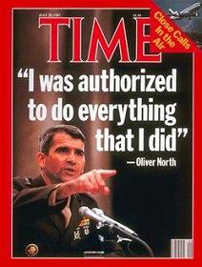
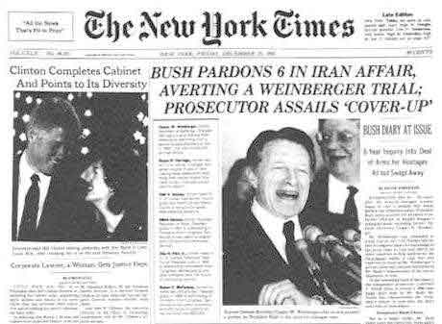
Iran-Contra Affair
In 1983 Iranian terrorists held Americans hostage in Lebanon, and Reagan declared that America would never make concessions with terrorists.
Reagan approved the sale of arms to Iran in exchange for the release of seven Americans, and sent the profits to the Contras in Nicaragua.
In 1987, Congressional Committees held trial for officials involved in helping the Contras, and those found guilty were pardoned by President GHW Bush.

Slide 20
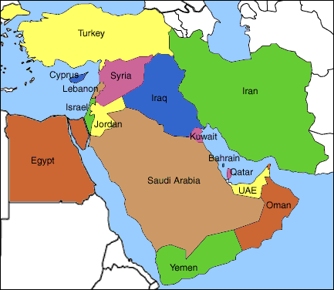
The Persian Gulf War
In 1979, Iraq was led by Saddam Hussein.
In 1980, Hussein began a brutal war against Iran, using children to clear dangerous minefields and poisonous gas to kill soldiers and civilians. Hussein had always claimed that the oil-rich nation of Kuwait was part of Iraq.
In August of 1990, when Hussein sent troops to seize Kuwait, and take over Saudi Arabia, which would give Iraq control of one-half of the world’s oil reserves.
President Bush launched Operation Desert Storm to liberate Kuwait from Iraqi control.
Iraqi Air Force Helicopter

Slide 21
President GHW Bush’s Domestic Policies
Increasing deficits and a recession that began in the 1990s hurt President GHW Bush’s domestic policy record.
He was forced to contradict his promise of “no new taxes,” by raising taxes, which lost him support.
The combination of rising taxes & a weak economy did not deliver an election victory in 1992 for George H.W. Bush.

