Slide 1
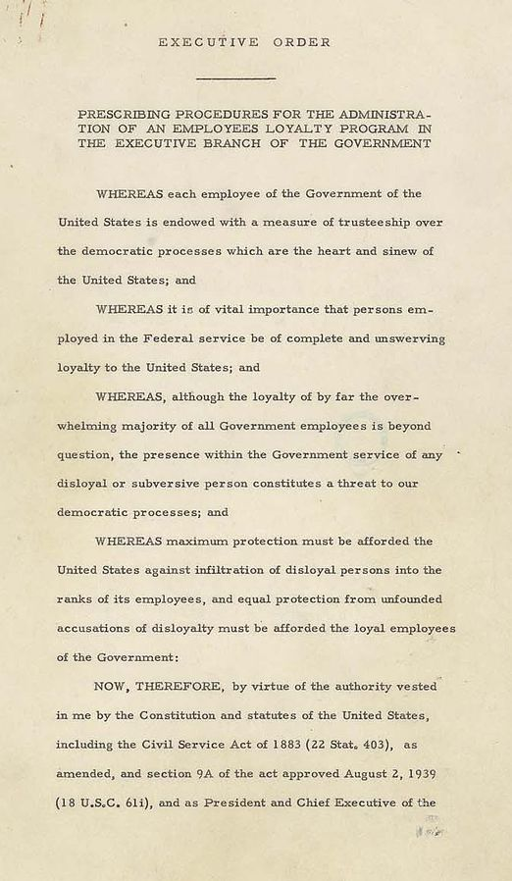
Loyalty Review Board
In response to public fears and Congressional investigations into communism in the United States, President Harry S. Truman issues an executive decree establishing a sweeping loyalty investigation of federal employees

Slide 2
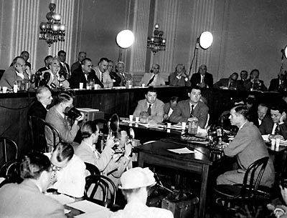
HUAC

Slide 3
HUAC
Scan the QR code or watch the video at http://www.history.com and search for HUAC video
(http://www.history.com/topics/cold-war/huac/videos/huac)
Edgar Hoover’s Speech Before HUAC
J. Edgar Hoover was the first director of the Federal Bureau of Investigation (FBI) and would serve in that position from 1924-1972. During that time, the FBI gathered information about many Americans whom the Bureau considered to have dangerous beliefs. Here Hoover talks to the House Committee on un-American Activities (HUAC), where he warned against Communist propaganda and identified specific threats.
The aims and responsibilities of the House Committee on un-American Activities and the Federal Bureau of Investigation are the same–the protection of the internal security of this nation. …
The [Communist] party has departed from depending upon the printed word as its medium of propaganda and has taken to the air. Its members and sympathizers have not only infiltrated the airways but they are now persistently seeking radio channels.
The American Communists launched a furtive attack on Hollywood in 1935 by the issuance of directive calling for a concentration in Hollywood. The orders called for action on two fronts: (1) an effort to infiltrate the labor unions; (2) infiltrate the so-called intellectual and creative fields.
In movie circles, Communists developed an effective defense a few years ago in meeting criticism. They would counter with the question, “After all, what is the matter with communism?” It was effective because many persons did not possess adequate knowledge of the subject to give an intelligent answer.
Some producers and studio heads realized the possibility that the entire industry faces serious embarrassment because it could become a springboard for Communist activities. Communist activity in Hollywood is effective and is furthered by Communists and sympathizers using the prestige of prominent persons to serve, often unwittingly, the Communist cause. The party is content and highly pleased if it is possible to have inserted in a picture a line, a scene, a sequence conveying the Communist lesson and, more particularly, if they can keep out anti-Communist lessons.
Source: Excerpt from J. Edgar Hoover, speech before HUAC, March 26, 1947.

Slide 4
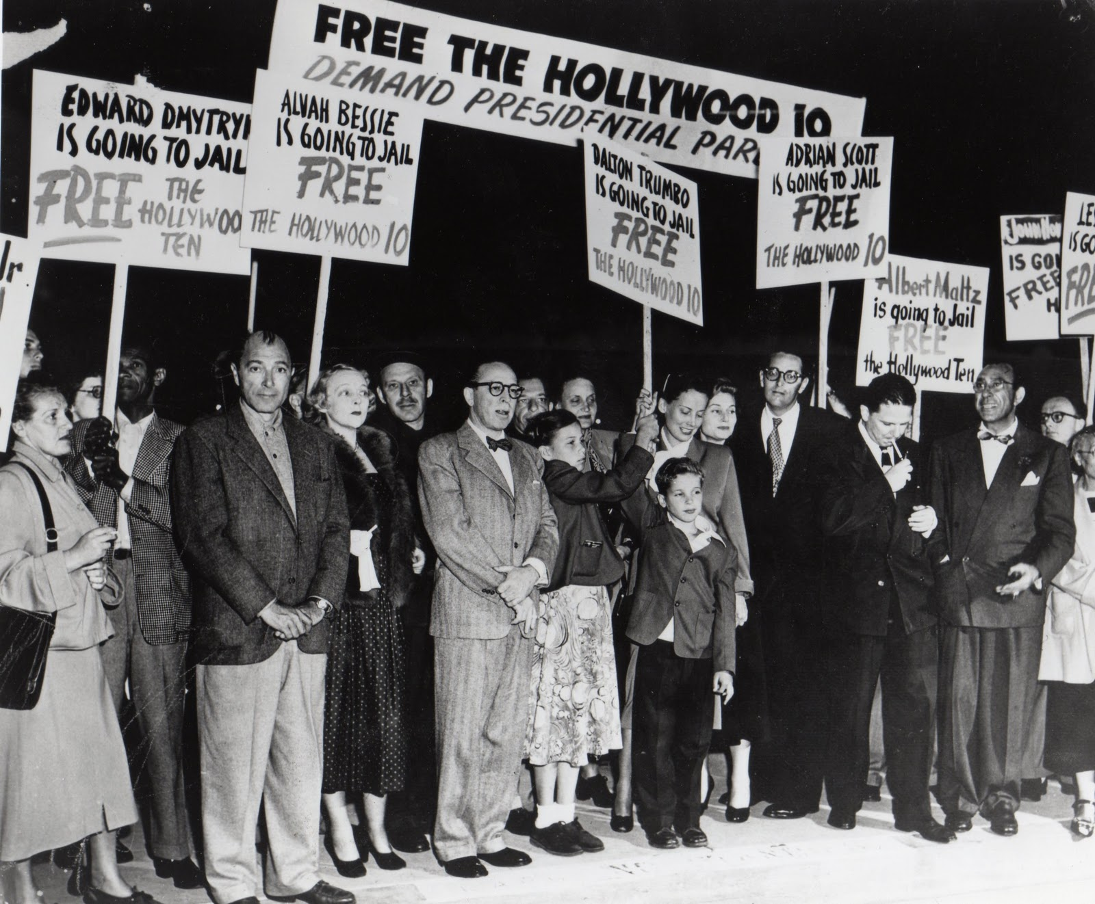
Scan the QR Code or go to http://www.history.com and search “Hollywood Ten” video. (http://www.history.com/topics/cold-war/hollywood-ten/videos/hollywood-ten)
Hollywood 10

Slide 5
McCarren Act
Otherwise known as the McCarran-Walter Act, the Immigration and Nationality Act of 1952 was meant to exclude certain immigrants from immigrating to America, post World War II and in the early Cold War. The McCarran-Walter Act moved away from excluding immigrants based simply upon country of origin. Instead it focused upon denying immigrants who were unlawful, immoral, diseased in any way, politically radical etc. and accepting those who were willing and able to assimilate into the US economic, social, and political structures, which restructured how immigration law was handled. Furthermore, the most notable exclusions were anyone even remotely associated with communism which in the early days of the Cold War was seen as a serious threat to US democracy. The main objective of this was to block any spread of communism from outside post WWII countries, as well as deny any enemies of the US during WWII such as Japan and favor “good Asian” countries such as China. The McCarran-Walter Act was a strong reinforcement in immigration selection, which was labeled the best way to preserve national security and national interests. President Truman originally vetoed the law, deeming it discriminatory; however there was enough support in Congress for the law to pass.
(Summary by Wade Johnson)
Scan the QR code or go to YOUTUBE and watch “The McCarren Act and the Efforts of Senator Joseph McCarthy”.

Slide 6
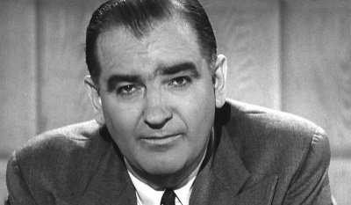
McCarthy’s Wheeling Speech
Background: Wisconsin Republican Joseph R. McCarthy first won election to the Senate in 1946 during a campaign marked by much anticommunist Red-baiting. In his famous 1950 speech, Senator McCarthy attacked the State Department (the part of the Executive branch that oversees foreign relations) and its Secretary, Dean Acheson, and accused them of harboring Communists.
“The reason why we find ourselves in a position of impotency [powerlessness] is not because our only powerful potential enemy has sent men to invade our shores, but rather because of the traitorous actions of those who have been treated so well by this Nation. It has not been the less fortunate, or members of minority groups who have been selling this Nation out, but rather those who have had all the benefits that the wealthiest Nation on earth has had to offer--the finest homes, the finest college education and the finest jobs in government we can give.
This is glaringly true in the State Department. There the bright young men who are born with silver spoons in their mouths are the ones who have been most traitorous. . . .
I have in my hand 57 cases of individuals who would appear to be either card-carrying members or certainly loyal to the Communist Party, but who nevertheless are still helping to shape our foreign policy.
One thing to remember in discussing the communists in our government is that we are not dealing with spies who get 30 pieces of silver to steal the blueprints of new weapons. We are dealing with a far more sinister type of activity because it permits the enemy to guide and shape our policy. . .
As you know, very recently the Secretary of State proclaimed his loyalty to a man guilty of what has always been considered as the most abominable of all crimes—being a traitor to the people who gave him a position of great trust—high treason. . . .
He [The Secretary of State] has lighted the spark which is resulting in a moral uprising and will end only when the whole sorry mess of twisted, warped thinkers are swept from the national scene so that we may have a new birth of honesty and decency in government.”
Source: Excerpt from Senator Joseph McCarthy’s speech made on February 9, 1950, in Wheeling, West Virginia.
McCarthyism
Scan the QR code or go to YOUTUBE to watch “The Red Scare: Communist Witch Hunt”

Slide 7
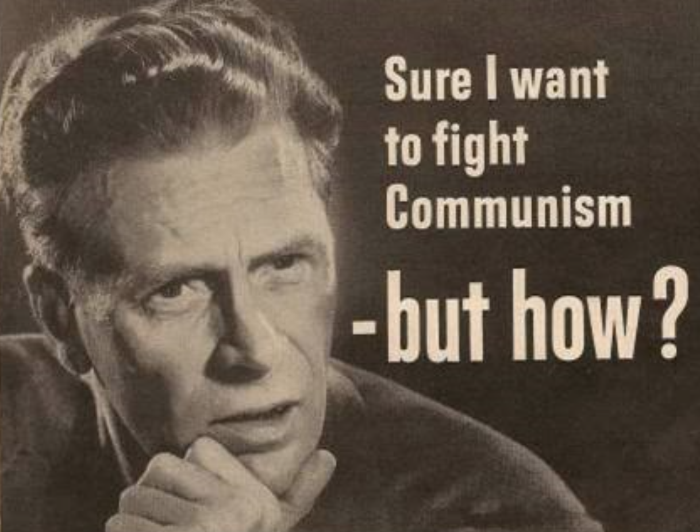
Anti- Communist Propaganda
Scan the QR Code or go to YOUTUBE to watch “How to spot a communist”

Slide 8
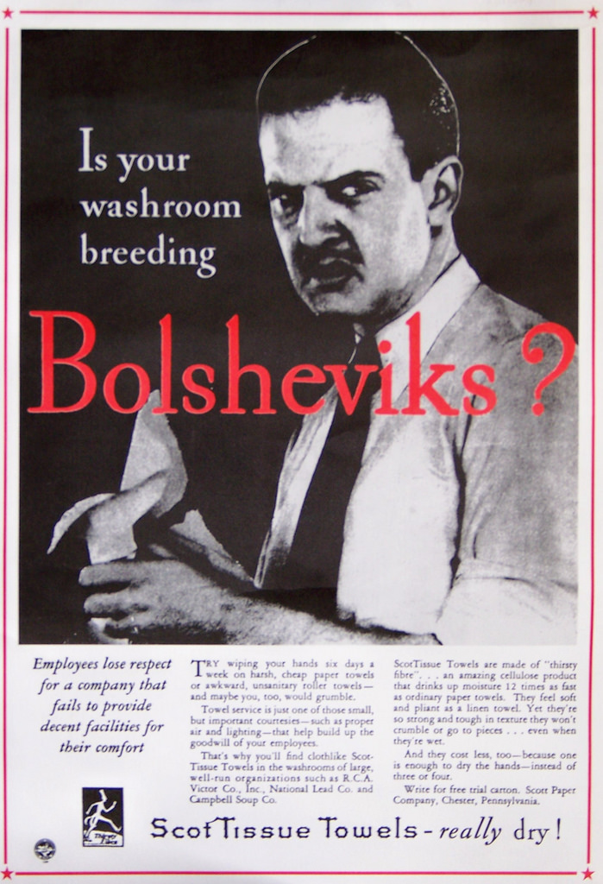
Anti- Communist Propaganda

Slide 9
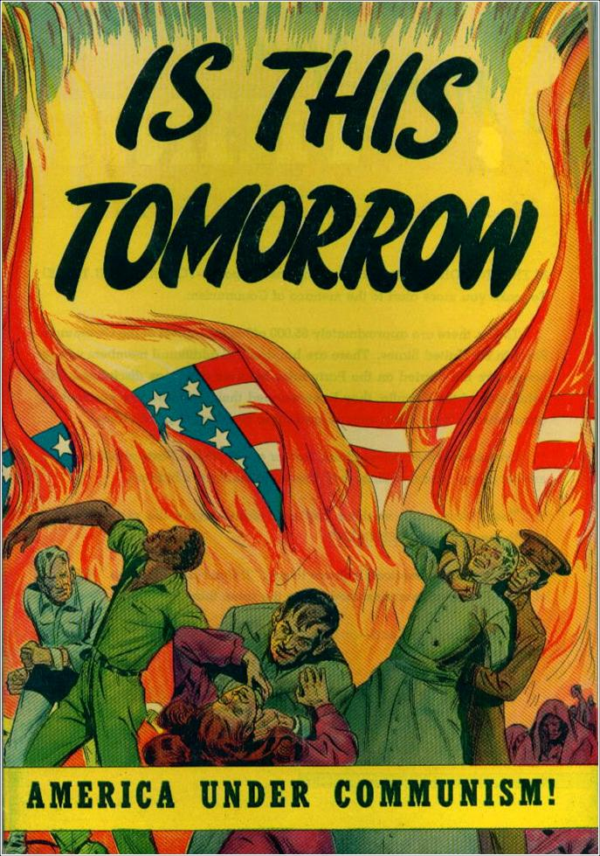
Anti- Communist Propaganda

Slide 10
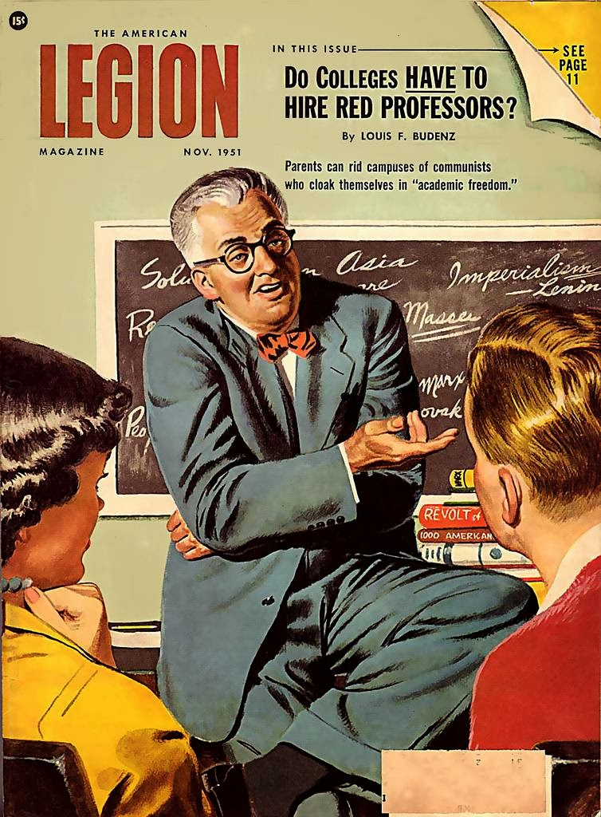
Anti- Communist Propaganda

Slide 11
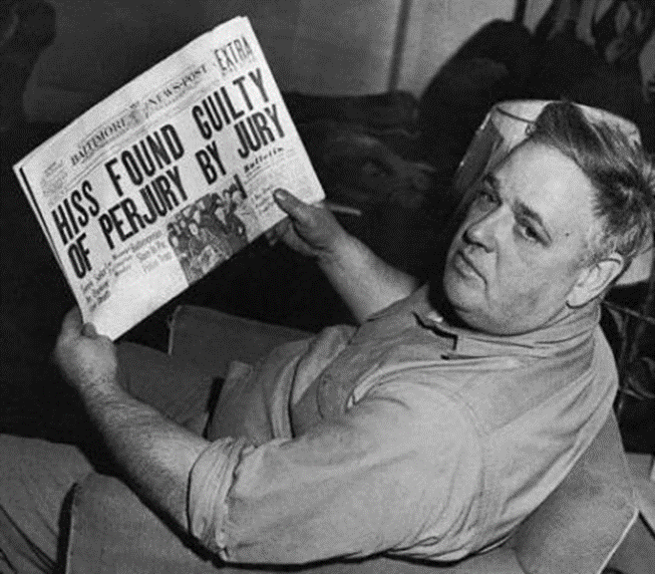
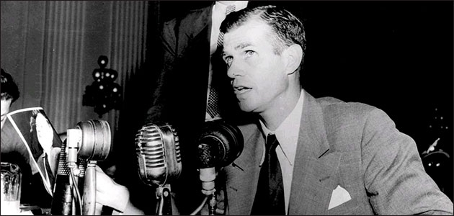
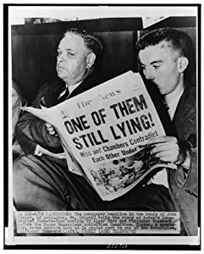
Alger Hiss
Scan the QR code or go to YOUTUBE and watch: Alger_Hiss_and_Whitaker_Chambers__Face_to_Face_in_Spy_Probe.asf
Background: Alger Hiss was born on November 11, 1904 in Baltimore, Maryland. He worked in the administration of Franklin D. Roosevelt. In 1948, Whitaker Chambers accused Hiss of having been a member of an underground communist organization. Hiss denied this but was found guilty of two counts of perjury in 1950 (the statute of limitations on a treason charge had run out) and served more than three years of a five-year prison sentence. He released in 1954, still asserting his innocence until his death in 1996.

Slide 12
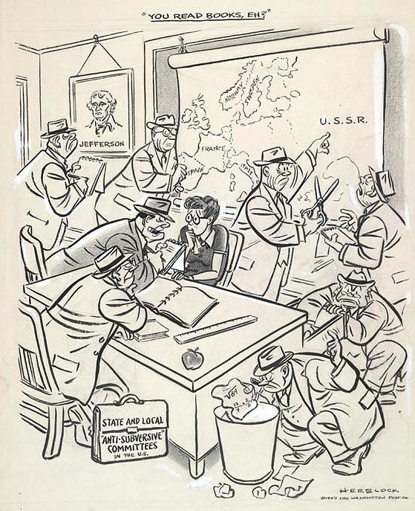
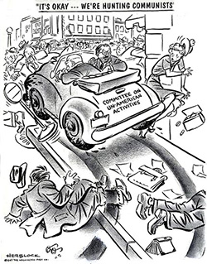
Political Cartoons
of the Red Scare
B
A

Slide 13
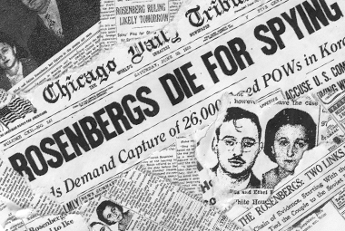
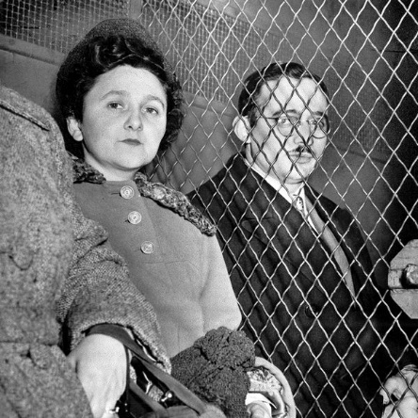
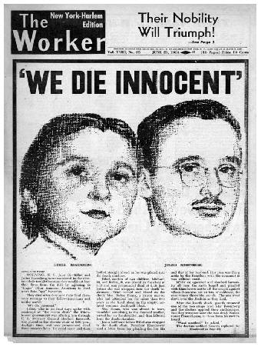
The Rosenberg’s
Scan the QR Code or go to YOUTUBE to watch “Atomic Spies Julius & Ethel Rosenberg Sentenced to Death 1951 Universal Newsreel”

