Slide 1
America by 1980
By 1980, Americans were ready for new leadership:
The disaster in Vietnam, hostage crisis in Iran, & new tensions with the USSR left many people feeling like the U.S. was losing its power in the world
Stagflation was growing worse & unemployment remained high
Johnson & Nixon made many people lose trust in gov’t, while Ford & Carter provided poor leadership in the 1970s

Slide 2
The Conservative Movement
The 1980s saw the rise of a new conservative movement known as the “New Right”
By 1980, government entitlement programs cost $300 billion yearly
Conservatives believed civil rights had goon too far & attacked affirmative action (reverse discrimination) & school busing plans

Slide 3
The Conservative Movement
The 1980s saw the rise of a new conservative movement known as the “New Right”
Devout Christians were disturbed by the decline in morality of the 1970s (hippies, sexual revolution, etc)
New Right promoted school prayer & tough punishment for crimes; Attacked abortion, the ERA, & homosexuality

Slide 4
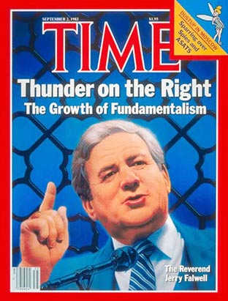
The Conservative Movement
The 1980s saw the rise of a new conservative movement known as the “New Right”
Evangelist Jerry Falwell formed the religious group, the Moral Majority, to promote family values and to raise money for conservative politicians

Slide 5
The Conservative Movement
The 1980s saw the rise of a new conservative movement known as the “New Right”
Conservatives wanted business growth, lower taxes, & free enterprise (freedom from gov’t interference in the economy) The New Right hoped to restore the superpower status of the United States

Slide 6
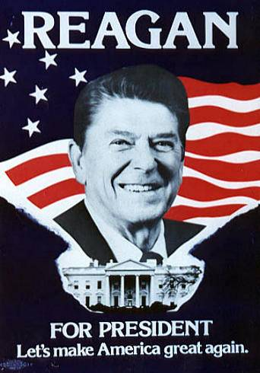
The Election of 1980
In 1980, conservative Republican Ronald Reagan ran for president
Reagan ran on a platform of lower taxes, less gov’t, & family values
Reagan took advantage of Carter’s failures with the economy & in foreign policy by asking “Are you better off than you were four years ago?”
Notes:
http://www.youtube.com/watch?v=loBe0WXtts8&feature=fvw

Slide 7
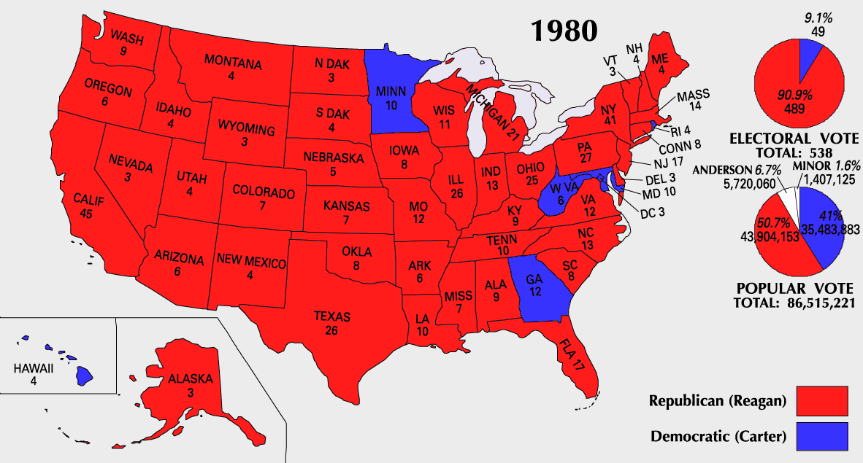
Reagan beat Carter in 1980

Slide 8
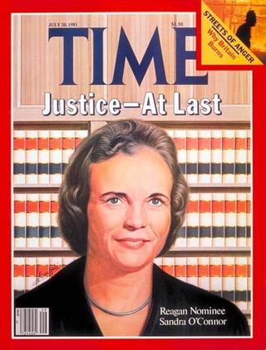
Less Government
Reagan believed that the national gov’t had grown too large & needed to be downsized
His budget cuts included reducing Medicaid as well as welfare & job training programs
Reagan believed in deregulation & helped stimulate businesses by reducing the power of gov’t agencies
He appointed four conservatives to the Supreme Court, like Sandra Day O’Conner, the 1st female justice

Slide 9
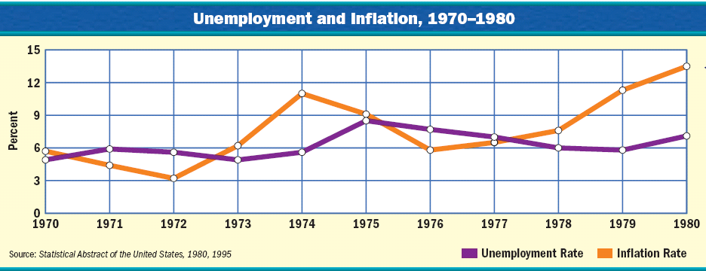
Reaganomics
When Reagan entered office, the biggest crisis facing America was stagflation in the economy

Slide 10
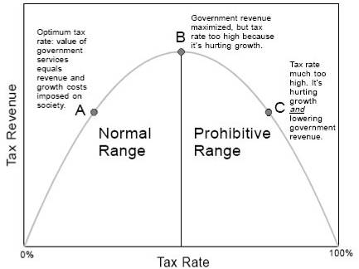
Reagan believed in a theory called “supply-side economics”
The “Laffer Curve”

Slide 11
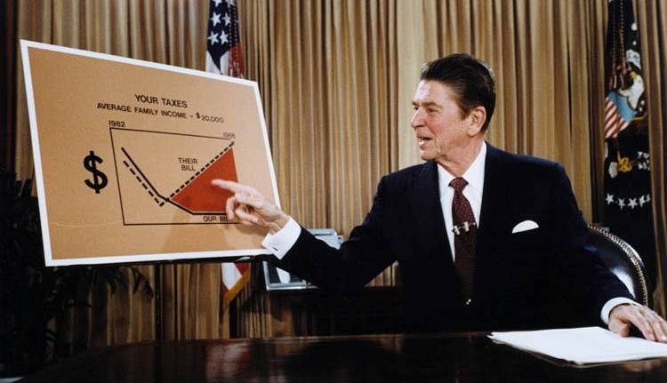
He believed that the economy was suffering in the 1970s because gov’t taxes were too high and people did not have enough money to spend
In 1981, Reagan urged Congress to pass a 25% tax cut over 3 years to stimulate spending, increase production, and lower prices

Slide 12
By 1983, “Reaganomics” worked, stagflation ended, & the economy boomed
Inflation, Unemployment, & Interest Rates
The U.S. gained 16 million new jobs, unemployment fell below 6%, & inflation declined to 4%

Slide 13
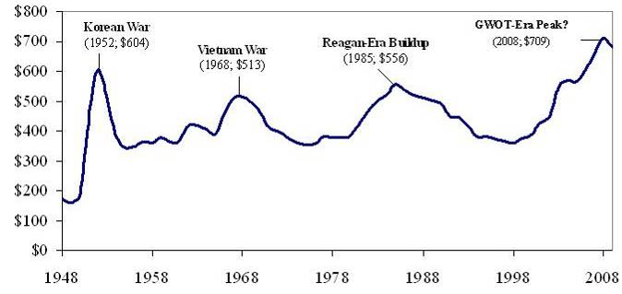
Defense Spending
In addition to downsizing the gov’t & creating tax cuts, Reagan increased defense spending in order to restore America’s place in the world

Slide 14
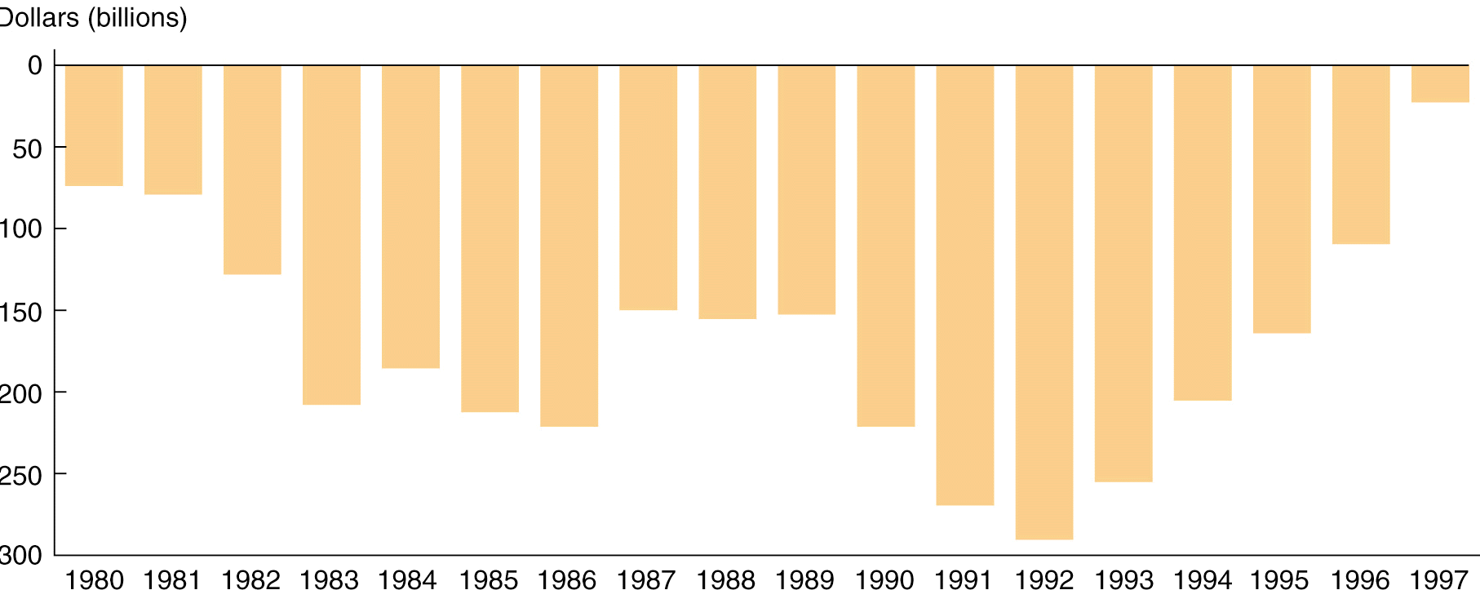
But, because military spending increased but tax revenue decreased, the gov’t experienced massive deficits due to “Reaganomics”
Government Deficits Per Year, 1980-1997
The Reagan Years (1981-1989)

Slide 15
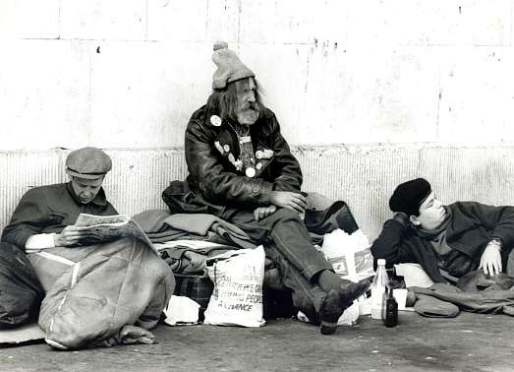
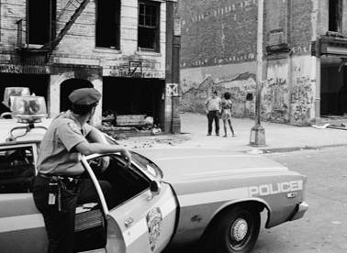
Family Values & Social Concerns
Reagan’s commitment to conservative values & cuts to social programs contributed to growing problems in the 1980s:
America saw increases in school dropout rates, homelessness, attacks on affirmative action, & urban & minority poverty

Slide 16
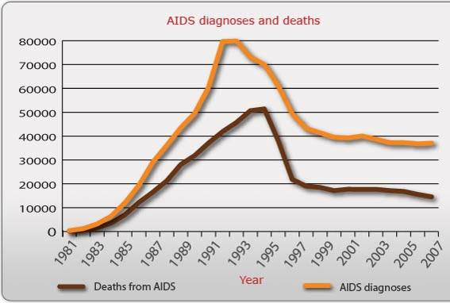
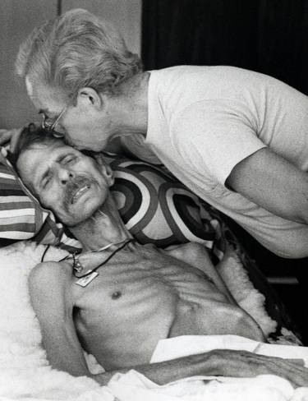
The 1st documented cases of AIDS were reported, but the Reagan administration did not move swiftly because the disease was among gay men
Notes:
The 1st documented cases of AIDS occurred in the 1980s:
1st cases were among gay men in San Francisco & NY in 1981
As cases were found in drug abusers & hemophiliacs, people worried about a contaminated national blood supply
Lack of sympathy for gays, budget cuts, & ignorance about HIV led to a limited government response

Slide 17
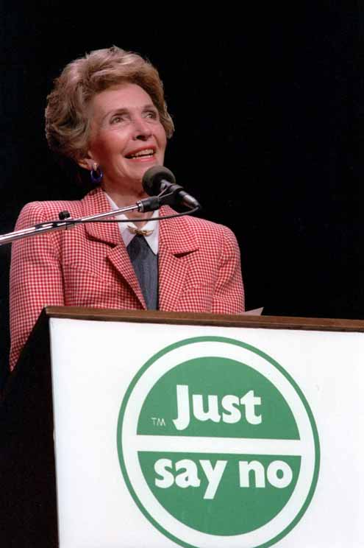
Family Values & Social Concerns
Reagan’s commitment to conservative values & cuts to social programs contributed to growing problems in the 1980s:
Crack cocaine was 1st introduced in the 1980s
The “crack epidemic” led Reagan to begin a “War on Drugs” & the “Just Say No” campaign

Slide 18
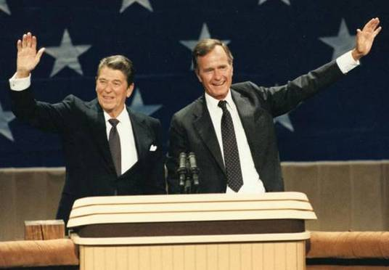
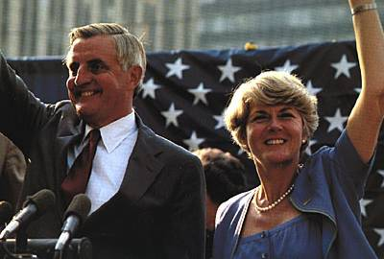
The Election of 1984
Despite the social problems, Reagan was popular among voters by the election of 1984
Walter Mondale & VP Geraldine Ferraro
Ronald Reagan & VP George Bush

Slide 19
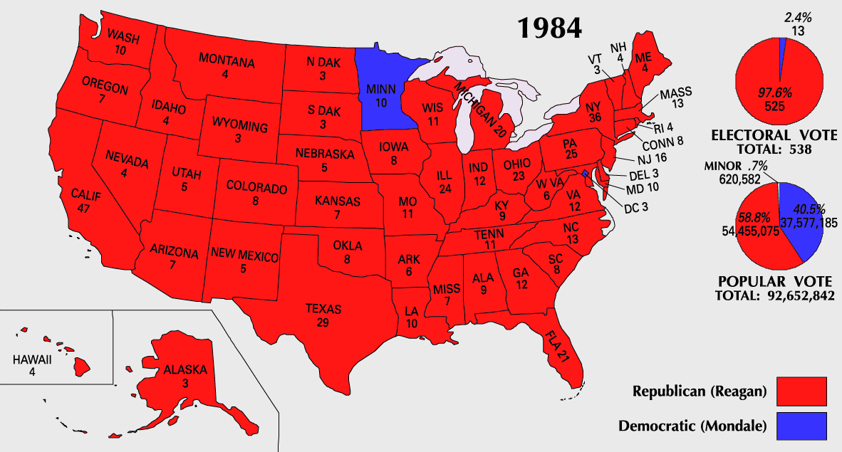
Reagan’s victory in 1984 was powered by a “conservative coalition” of voters, including many “Reagan Democrats” (voted for Reagan for president but Democrats for other offices)

Slide 20
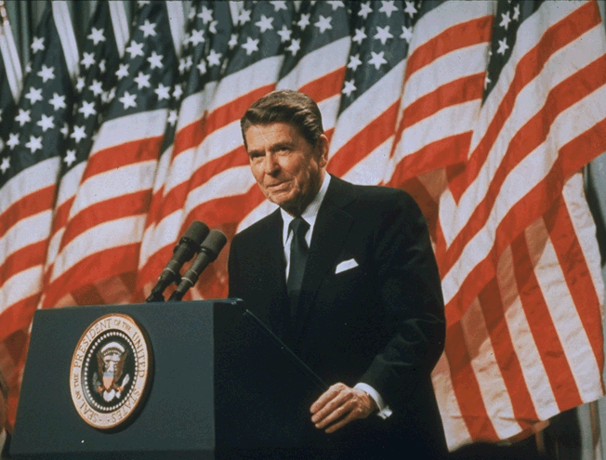
Reagan & Foreign Policy
Reagan wanted to restore U.S. foreign policy
Blamed Carter for allowing America’s international prestige & influence to fall
Increased military spending
Confronted challenges in the Middle East & in Latin America
And win the Cold War with the Soviet Union

Slide 21
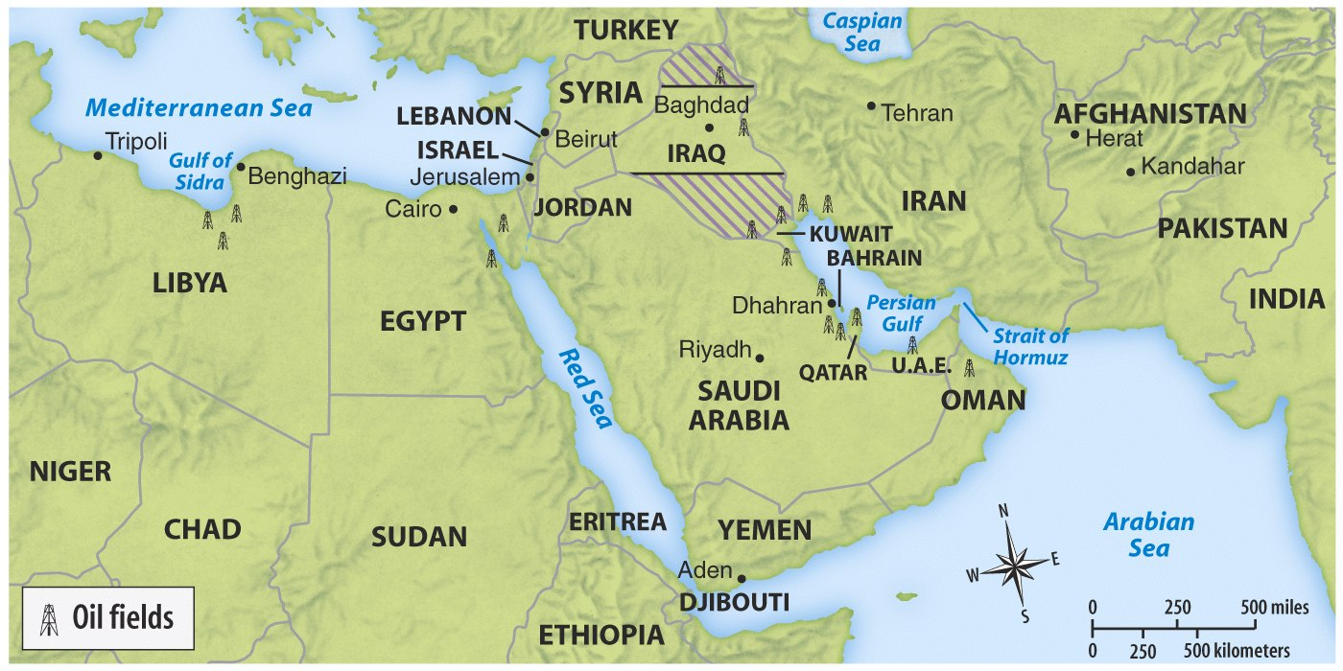
Reagan intervened in Lebanon when violence broke out between Israelis & Arabs in 1982
But, anti-American hostility led a terrorist group to seize 6 U.S hostages in Iran in 1983
Reagan’s response was to “not negotiate with terrorists”
Meanwhile…

Slide 22
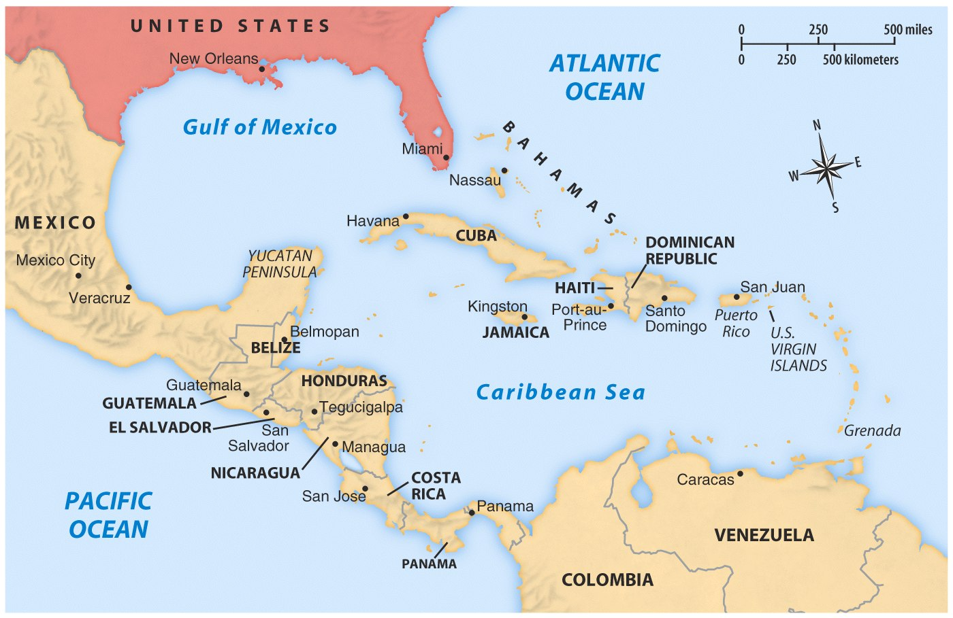
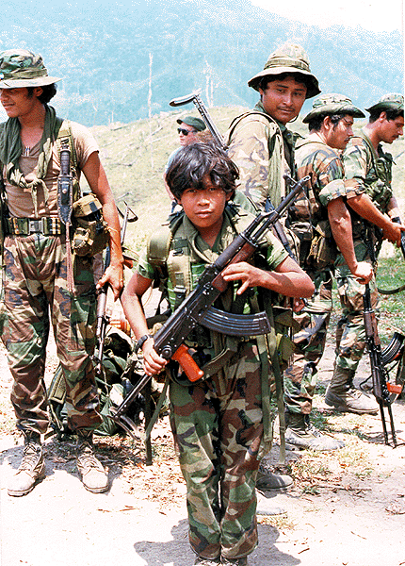
In 1979, a communist group called the Sandinistas came to power in Nicaragua
Congress denied Reagan’s plea to help Nicaraguan counter-revolutionaries (Contras) take back power
…Reagan committed to fighting communism & maintaining order in Latin America

Slide 23
The Reagan administration developed a plan to solve both the problem in Iran & in Nicaragua
The gov’t illegally sold Iran weapons in exchange for the release of the 6 hostages (arms for hostages deal)
The gov’t then gave money from the profits of the arms sales to Iran to anti-communist Contras in Nicaragua

Slide 24
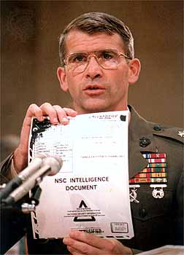
The Iran-Contra Affair
In 1987, these illegal activities were discovered & the Iran-Contra Affair rocked the Reagan administration
Reagan said he had no knowledge of the scandal & Oliver North admitted to running the operation behind the president’s back
Reagan escaped from the scandal (“Teflon president”)
Notes:
Reagan avoided implication through “plausible deniability”

Slide 25
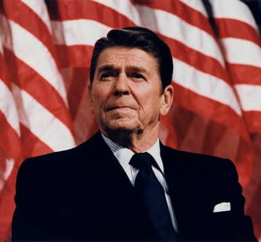
Reagan took a strong stand against communism and the Soviet Union
Reagan viewed the USSR as the "focus of evil in the modern world” and as a threat to U.S. security
He used “zero option” and sent 572 nuclear missiles within range of Moscow to match USSR ICBMs aimed at NATO nations
His most ambitious plan was a massive defensive system of satellites called the Strategic Defense Initiative (“star wars” program)
Notes:
Zero option

Slide 26
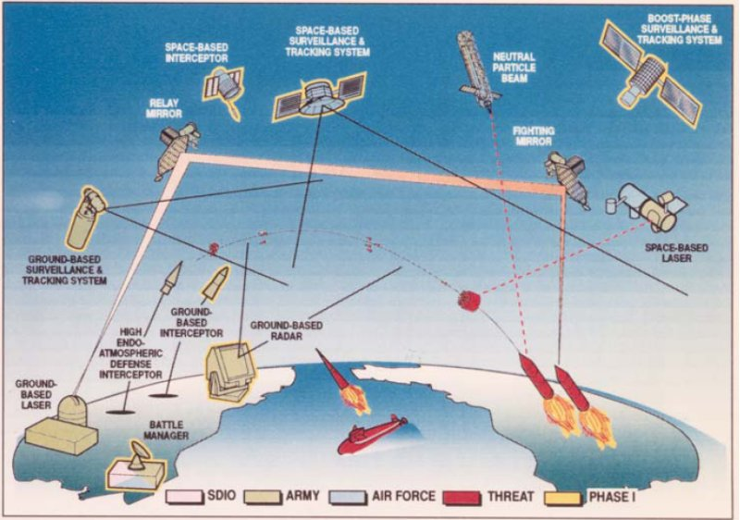
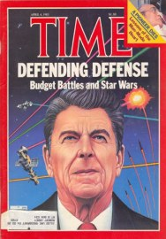
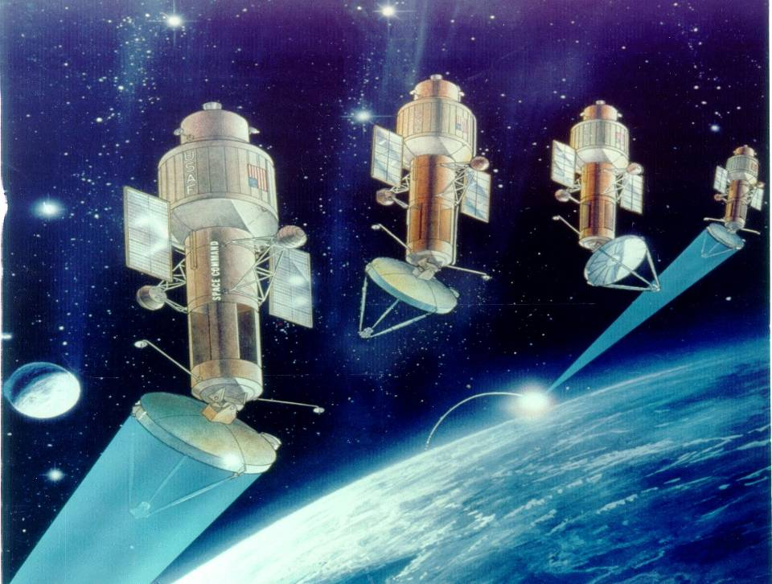
SDI would have cost the U.S. gov’t trillions of dollars at a time when “Reaganomics” involved slashing budgets for social programs

Slide 27
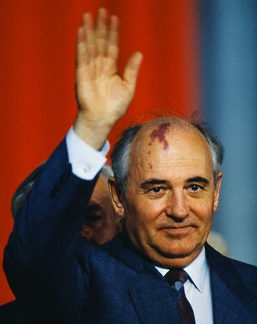
As Reagan he was coming to power, communist nations (including the USSR) were beginning to face economic failure
In 1985 Mikhail Gorbachev took charge of the USSR and began creating moderate reforms to save Russia
Perestroika: Introducing moderate capitalism & allowing some business & property ownership
Glasnost: Freedom of speech & competitive elections
Reagan was able to work with Gorbachev to reduce Cold War tensions

Slide 28
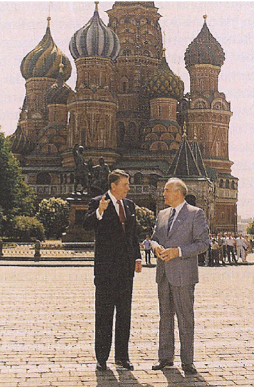
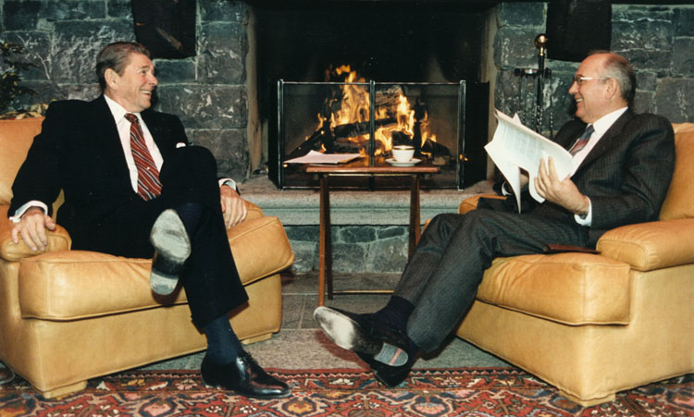
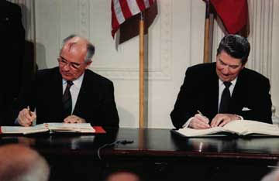
In 1987, Reagan & Gorbachev signed the INF Treaty eliminating ICBMs in Europe

Slide 29
By the late 1980s, communism was failing across Eastern Europe
Notes:
For 40 years, Communist Party leaders in Eastern Europe had ruled confidently. Each year their countries fell further behind the West; yet, they remained secure in the knowledge that the Soviet Union, backed by the Red Army, would always send in the tanks when the forces for change became too great. But they had not bargained on a liberal Soviet leader like Mikhail Gorbachev.
As Gorbachev moved toward reform within the Soviet Union and détente with the West, he pushed the conservative regimes of Eastern Europe outside his protective umbrella. By the end of 1989, the Berlin Wall had been smashed. All across Eastern Europe, citizens took to the streets, overthrowing 40 years of Communist rule. Like a series of falling dominos, Communist parties in Poland, East Germany, Hungary, Czechoslovakia, Romania, and Bulgaria fell from power.
Gorbachev, who had wanted to reform communism, may not have anticipated the swift swing toward democracy in Eastern Europe. Nor had he fully foreseen the impact that democracy in Eastern Europe would have on the Soviet Union. By 1990, leaders of several Soviet republics began to demand independence or greater autonomy within the Soviet Union.
Gorbachev had to balance the growing demand for radical political change within the Soviet Union with the demand by Communist hardliners. The hardliners demanded that he contain the new democratic currents and turn back the clock. Faced with dangerous political opposition from the right and the left and with economic failure throughout the Soviet Union, Gorbachev tried to satisfy everyone and, in the process, satisfied no one.
In 1990, following the example of Eastern Europe, the three Baltic states of Lithuania, Latvia, and Estonia announced their independence, and other Soviet republics demanded greater sovereignty. Nine of the 15 Soviet republics agreed to sign a new union treaty, granting far greater freedom and autonomy to individual republics. But in August 1991, before the treaty could be signed, conservative Communists tried to oust Gorbachev in a coup d'etat. Boris Yeltsin, the President of the Russian Republic, and his supporters defeated the coup, undermining support for the Communist Party. Gorbachev fell from power. The Soviet Union ended its existence in December 1991, when Russia and most other republics formed the Commonwealth of Independent States.

Slide 30
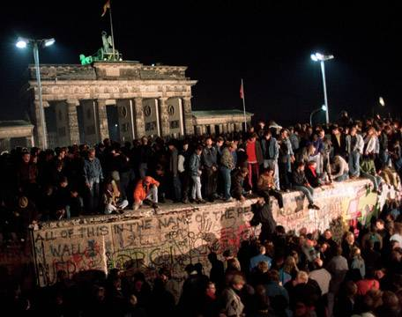
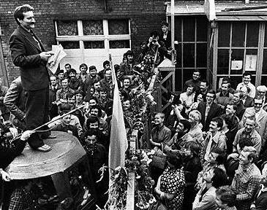
By the late 1980s, communism was failing across Eastern Europe
In 1989, East Germans denounced communism and the Berlin Wall came down
In 1989 & 1990, Eastern European nations embraced democracy
Notes:
For 40 years, Communist Party leaders in Eastern Europe had ruled confidently. Each year their countries fell further behind the West; yet, they remained secure in the knowledge that the Soviet Union, backed by the Red Army, would always send in the tanks when the forces for change became too great. But they had not bargained on a liberal Soviet leader like Mikhail Gorbachev.
As Gorbachev moved toward reform within the Soviet Union and détente with the West, he pushed the conservative regimes of Eastern Europe outside his protective umbrella. By the end of 1989, the Berlin Wall had been smashed. All across Eastern Europe, citizens took to the streets, overthrowing 40 years of Communist rule. Like a series of falling dominos, Communist parties in Poland, East Germany, Hungary, Czechoslovakia, Romania, and Bulgaria fell from power.
Gorbachev, who had wanted to reform communism, may not have anticipated the swift swing toward democracy in Eastern Europe. Nor had he fully foreseen the impact that democracy in Eastern Europe would have on the Soviet Union. By 1990, leaders of several Soviet republics began to demand independence or greater autonomy within the Soviet Union.
Gorbachev had to balance the growing demand for radical political change within the Soviet Union with the demand by Communist hardliners. The hardliners demanded that he contain the new democratic currents and turn back the clock. Faced with dangerous political opposition from the right and the left and with economic failure throughout the Soviet Union, Gorbachev tried to satisfy everyone and, in the process, satisfied no one.
In 1990, following the example of Eastern Europe, the three Baltic states of Lithuania, Latvia, and Estonia announced their independence, and other Soviet republics demanded greater sovereignty. Nine of the 15 Soviet republics agreed to sign a new union treaty, granting far greater freedom and autonomy to individual republics. But in August 1991, before the treaty could be signed, conservative Communists tried to oust Gorbachev in a coup d'etat. Boris Yeltsin, the President of the Russian Republic, and his supporters defeated the coup, undermining support for the Communist Party. Gorbachev fell from power. The Soviet Union ended its existence in December 1991, when Russia and most other republics formed the Commonwealth of Independent States.

Slide 31
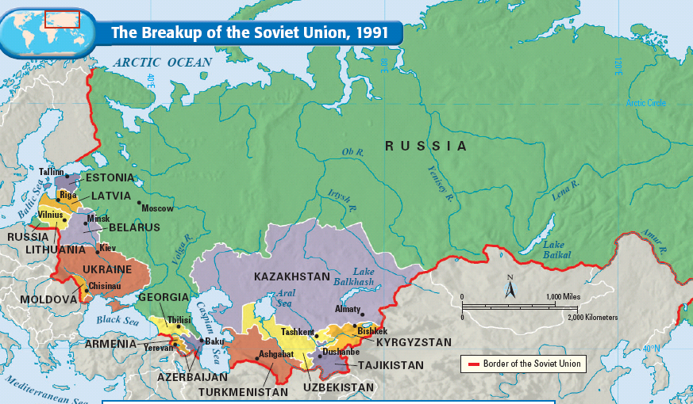
In 1990, states within the Soviet Union broke off and formed new democratic nations; In 1991, the USSR dissolved and the Cold War ended
Notes:
For 40 years, Communist Party leaders in Eastern Europe had ruled confidently. Each year their countries fell further behind the West; yet, they remained secure in the knowledge that the Soviet Union, backed by the Red Army, would always send in the tanks when the forces for change became too great. But they had not bargained on a liberal Soviet leader like Mikhail Gorbachev.
As Gorbachev moved toward reform within the Soviet Union and détente with the West, he pushed the conservative regimes of Eastern Europe outside his protective umbrella. By the end of 1989, the Berlin Wall had been smashed. All across Eastern Europe, citizens took to the streets, overthrowing 40 years of Communist rule. Like a series of falling dominos, Communist parties in Poland, East Germany, Hungary, Czechoslovakia, Romania, and Bulgaria fell from power.
Gorbachev, who had wanted to reform communism, may not have anticipated the swift swing toward democracy in Eastern Europe. Nor had he fully foreseen the impact that democracy in Eastern Europe would have on the Soviet Union. By 1990, leaders of several Soviet republics began to demand independence or greater autonomy within the Soviet Union.
Gorbachev had to balance the growing demand for radical political change within the Soviet Union with the demand by Communist hardliners. The hardliners demanded that he contain the new democratic currents and turn back the clock. Faced with dangerous political opposition from the right and the left and with economic failure throughout the Soviet Union, Gorbachev tried to satisfy everyone and, in the process, satisfied no one.
In 1990, following the example of Eastern Europe, the three Baltic states of Lithuania, Latvia, and Estonia announced their independence, and other Soviet republics demanded greater sovereignty. Nine of the 15 Soviet republics agreed to sign a new union treaty, granting far greater freedom and autonomy to individual republics. But in August 1991, before the treaty could be signed, conservative Communists tried to oust Gorbachev in a coup d'etat. Boris Yeltsin, the President of the Russian Republic, and his supporters defeated the coup, undermining support for the Communist Party. Gorbachev fell from power. The Soviet Union ended its existence in December 1991, when Russia and most other republics formed the Commonwealth of Independent States.

Slide 32
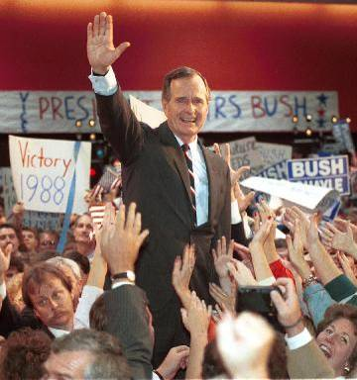
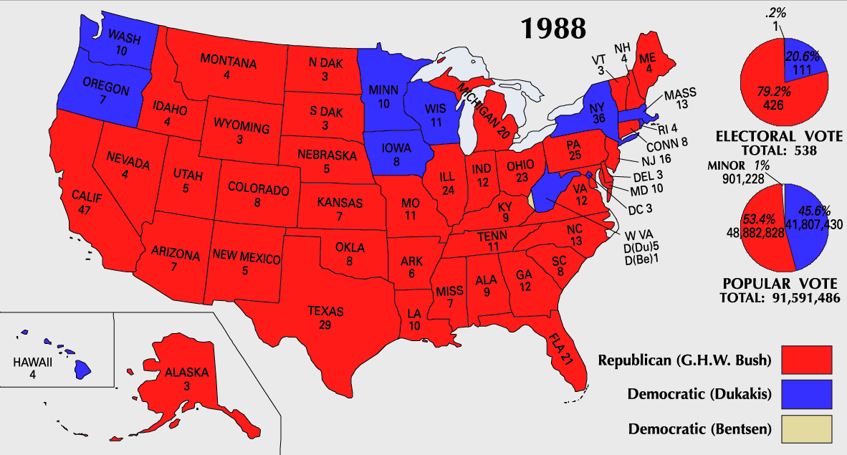
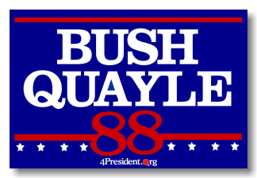
VP George Bush won the presidential election of 1988 by promising to maintain Reagan’s conservative policies

Slide 33
The defining event of the Bush years was the Persian Gulf War against Saddam Hussein & Iraq from 1990-1991
Operation Desert Shield
Operation Desert Storm

Slide 34
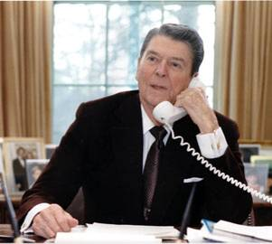
Conclusions
Reagan’s conservative policies & strong foreign policy changed America:
Reagan ended stagflation, restored the military, renewed family values, & won the Cold War
But, Reagan’s policies reduced assistance programs, ignored social problems, & tripled the national debt
Notes:
In the presidential election of 1984, Ronald Reagan and Vice President George Bush won in a landslide over Walter Mondale and Geraldine Ferraro. Ferraro was the first woman nominated for vice president on a major party ticket. Although Reagan's second term was plagued by the Iran-Contra scandal, he left office after eight years more popular than when he arrived. He could claim the distinction of being the first president to serve two full terms since Dwight Eisenhower.
Ronald Reagan could also point to an extraordinary string of accomplishments. He dampened inflation, restored public confidence in government, and presided over the beginning of the end of the Cold War. He doubled the defense budget, named the first woman to the Supreme Court, launched a strong economic boom, and created a heightened sense of national unity. In addition, his supporters said that he restored vigor to the national economy and psyche, rebuilt America's military might, regained the nation's place as the world's preeminent power, restored American patriotism, and championed traditional family values.
On the other hand, his detractors criticized him for a reckless use of military power and for circumventing Congress in foreign affairs. They accused Reagan of fostering greed and intolerance. His critics also charged that his administration, in its zeal to cut waste from government, ripped the social safety net and skimped on the government's regulatory functions. The administration, they further charged, was insensitive on racial issues. Reagan's detractors were particularly concerned about his economic legacy. During the Reagan years, the national debt tripled, from $909 billion to almost $2.9 trillion (the interest alone amounted to 14 percent of the federal budget). The deficit soaked up savings, caused interest rates to rise, and forced the federal government to shift more and more responsibilities onto the states. Corporate and individual debt also soared. During the early 1990s, the American people consumed $1 trillion more goods and services than they produced. The United States also became the world's biggest debtor nation, as a result of a weak dollar, a low level of exports, and the need to borrow abroad to finance budget deficits.

