Slide 1
Women in the 1950s

Slide 2
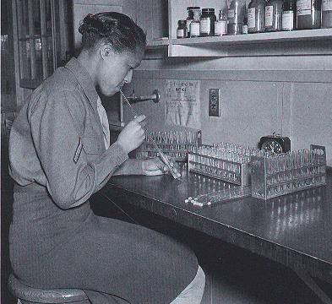
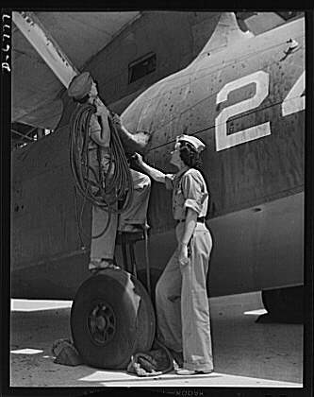
WWII employment for women
Women’s Auxiliary Corps laboratory technician conducts an experiment, Fort Jackson State Hospital, 1944
Aircraft engine technician and senior supervisor, Naval Air Base, 1942

Slide 3
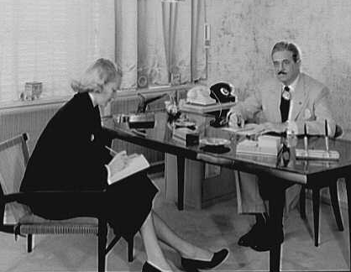
Post-WWII employment
A secretary and her boss, an industrial designer, New York City, 1950

Slide 4
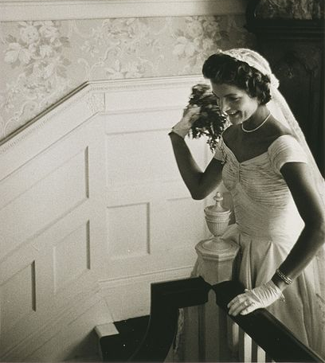
Social pressures
Early marriage
Childbearing
Stay-at-home motherhood
Nuclear family
Kennedy wedding, Jacqueline throwing the bouquet, 1953

Slide 5
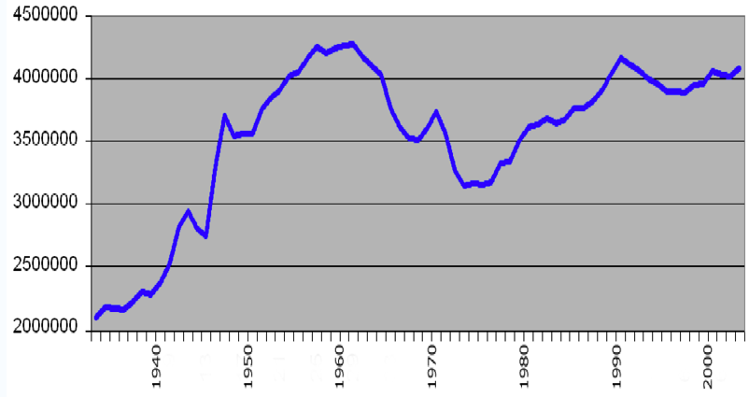
The Baby Boom
Births
Year

Slide 6
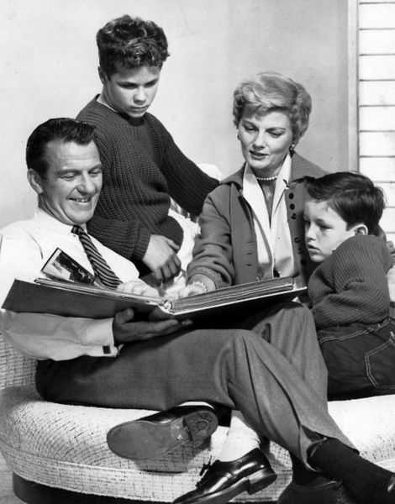
Media portrayals of gender
A photo of the Cleaver family from Leave it to Beaver, a popular TV show in the 1950s-60s

Slide 7
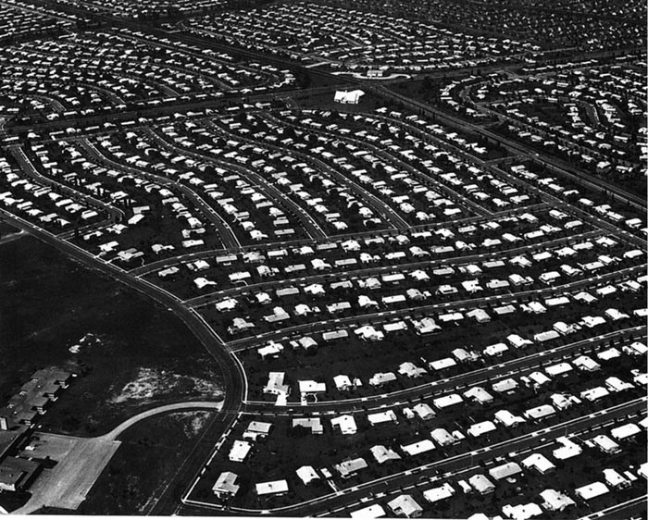
Suburbia, home of the “happy housewife”
G.I. Bill
Mass-produced, affordable homes
Great Migration and “white flight”
Levittown track homes of the 1950s

Slide 8
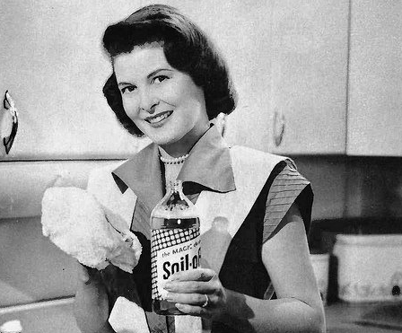
Household products marketed to women
A 1950s ad for a cleaning product
A 1950s ad for an electric iron

Slide 9
Central Historical Question
Is the image of the happy 1950s housewife accurate?

